Slide 1
Tools to develop career academies in the 21st century
7th Annual Career Clusters Institute
June 15-17, 2009

Slide 2
Presented by
Constance Scotchel-Gross
Career Education
scotche@palmbeach.k12.fl.us

Slide 3
Quiz
ABC High School starts off with a freshman class of 100 9th graders
How many will graduate from high school?
How many of the high school graduates will enter college?
How many of the high school graduates who entered college will still be enrolled in college in the sophomore year?
How many will graduate from college?

Slide 4

Out of every 100 ninth graders

Slide 5

Approximately 65 will graduate from high school

Slide 6

Approximately 39 will enter college

Slide 7

Approximately 26 are still enrolled in the sophomore year

Slide 8

Approximately 15 will graduate from College

Slide 9
We can do better
WE MUST DO BETTER!
“You have brains in your head. You have feet in your shoes. You can steer yourself in any direction you choose. You’re on your own. And you know what you know. Your are the guy who’ll decide where to go.” –Dr. Suess

Slide 10
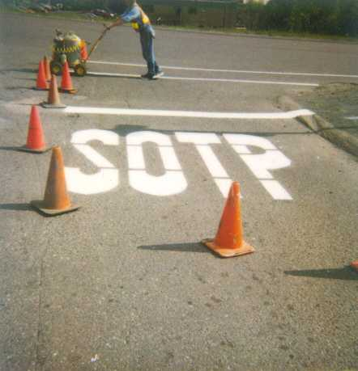

Slide 11
the School District of Palm Beach county
11th largest school district in nation; 5th in Florida
184 schools
22,144 Employees (including teachers)
12,739 Teachers
Over 100 Career Academy Programs
169,454 students
# of schools with: A=104; B=25; C=25; D=4; F=3
15,056 students participate in ESOL
61,000 students transported daily
149 languages and dialects are spoken
515 Business Partner Agreements

Slide 12
Slc research indicates
Higher attendance rates
Lower discipline issues
Higher graduation rates
Higher self-esteem and satisfaction with the school
Higher extracurricular activity participation
Lower incidence of school violence
Higher academic standards
Sense of connection with teachers, other students, and school programs
Lower sense of student apathy

Slide 13
Recent research
MDRC: Manpower Demonstration Research Corporation
www.mdrc.org/sps/swish.cgi
www.mdrc.org/sps/swish.cgi?search_index=publications&search_phrase=career+academies+&submit.x=5&submit.y=8&submit=search
www.mdrc.org/area_fact_21.html

Slide 14
Mdrc study summary
Findings suggest that a growing number of high schools may be on the right path toward keeping students engaged in school and preparing them for further education and a career.
Career Academies reduced dropout rates and improved school engagement among students least likely to do well in a regular school environment.
While the Academies produced more modest effects for other students, they created a more supportive school environment for all students and provided them with more opportunities to explore careers and engage in work-based learning opportunities.

Slide 15
What are the most important findings?
Career Academies produced sustained earnings gains that averaged 11 percent (or $2,088) more per year for program participants than for individuals in the control group — a $16,704 boost in total earnings over the eight years of follow-up.
These impacts on earnings are concentrated among young men and students at risk of academic failure. Young men saw an annual earnings gain of 17 percent (or $3,731) — or nearly $30,000 over eight years.
This study shows that career development in high schools does not have to come at the expense of academic preparation. More than 90 percent of the students graduated from high school or received a General Educational Development (GED) certificate, and half earned a postsecondary degree or credential.
Participants in Career Academies were more likely to be living independently with children and a spouse or a partner. Young men were more likely to be married.

Slide 16

Top schools in the nation
The School District of Palm Beach County is home to 9 of the top schools in the Nation, according to Newsweek. These top schools house Career Academies.
BOCA RATON COMMUNITY HIGH SCHOOL
ATLANTIC COMMUNITY HIGH SCHOOL
SPANISH RIVER COMMUNITY HIGH SCHOOL
PALM BEACH GARDENS COMMUNITY HIGH SCHOOL
FOREST HILL COMMUNITY HIGH SCHOOL
JUPITER HIGH SCHOOL
WILLIAM T. DWYER
SUNCOAST HIGH
ALEXANDER DREYFOOS SCHOOL OF THE ARTS

Slide 17
GRADUATION RATES for career academy and non-academy sy 2008
ACADEMY
NON-ACADEMY
ACADEMY
NON-ACADEMY
ACADEMY
NON-ACADEMY

Slide 18
GRADUATION RATES for career academy and non-academy sy 2008
ACADEMY
NON-ACADEMY
ACADEMY
NON-ACADEMY
ACADEMY
NON-ACADEMY

Slide 19
GRADUATION RATES for career academy and non-academy sy 2008
ACADEMY
NON-ACADEMY
ACADEMY
NON-ACADEMY
ACADEMY
NON-ACADEMY

Slide 20
GRADUATION RATES for career academy and non-academy sy 2008
ACADEMY
NON-ACADEMY

Slide 21
Florida Comprehensive Achievement Test (FCAT)
Reading and Math Scores for 2008 Seniors
326

Slide 22
Grade point average comparison for career academy and non-academy Sy 2008
326

Slide 23
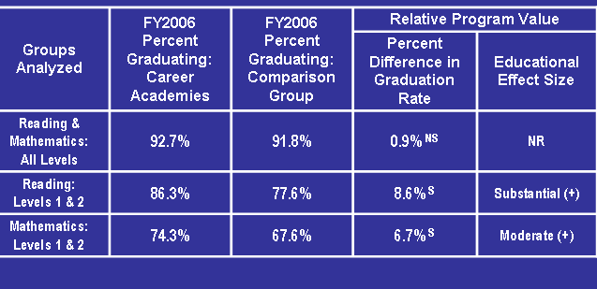
Comparison of percent of students graduating in 2006
Palm Beach County, FL

Slide 24
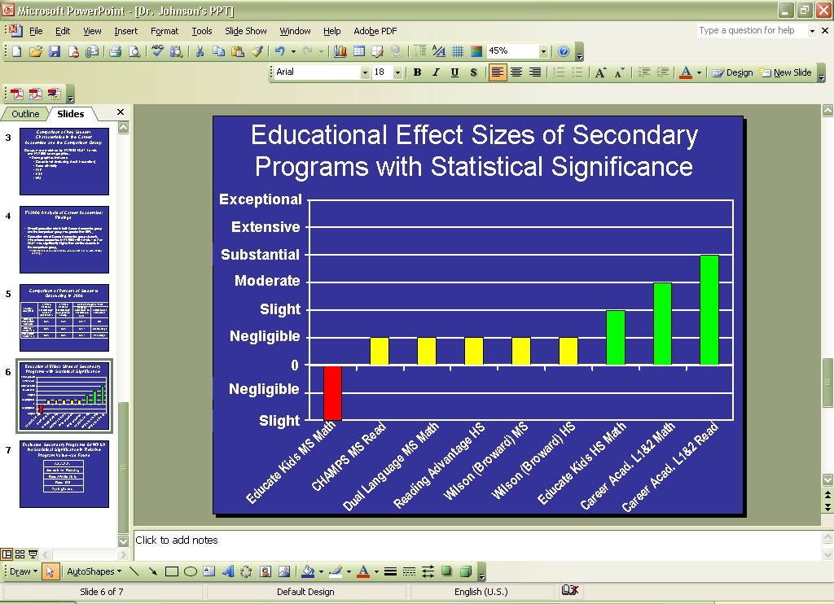

Slide 25
Career & technical education programs
Career academies
I’m thinking about it…
I have a good idea of what I want to do . .
The Student:
attends an assigned school within a boundary area
not necessarily part of a career plan
may take unrelated career courses
attends traditional academic courses that may be unrelated to the career focus
The Student:
is able to fulfill a career plan
has a commitment to a career path by taking specific program of study courses in a sequence
has academic courses that relate to the career focus and stress preparation for post-secondary education, integration of curriculum
and employment
Common Areas
Curriculum Frameworks
Occupational Completion
Points
Sequence of Courses
Career Assessment
Bright Future Scholarships
Work-Based Experiences

Slide 26
Getting started
Theme
Vision
Program Name
Admin/District/School Board Support
Parental Involvement
Program Structure
Staffing
Staff Development
Student Recruitment

Slide 27
Establish your theme
What are the key industries in the area?
What are the projected local employment needs?
What interests the students in the school?
Who is readily available and would be a good match to teach in that area?

Slide 28
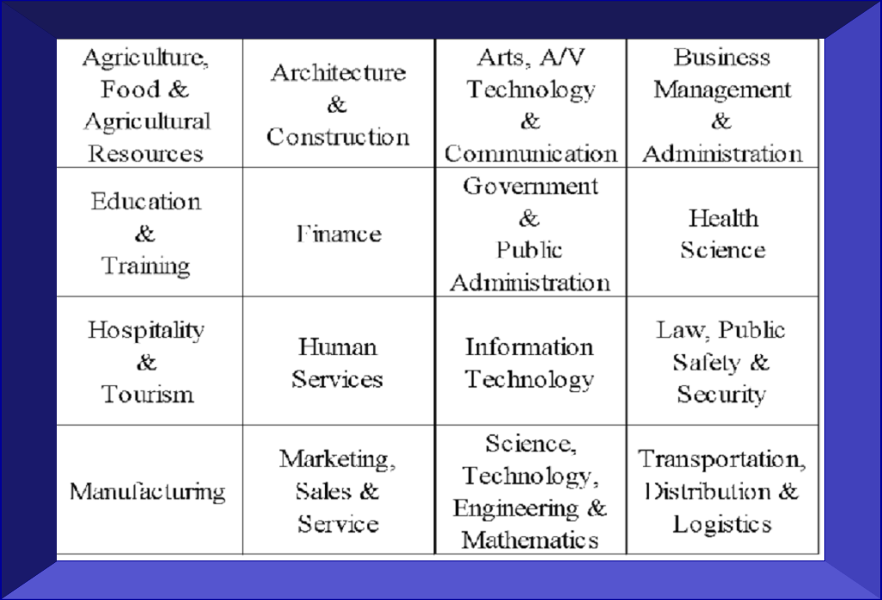
16 national career clusters
Themes tend to revolve around career clusters
Early Childhood
Teacher Education
Criminl Justice/
Pre Law
Global Business & Entrepreneurship
Culinary Arts
Hospitality, Tourism, & Resort Management

Slide 29
What theme is the best fit?
What theme makes sense for your smaller learning community?
What academy theme would support the local economy?
Example: A community with a strong healthcare presence might consider starting a Medical Science career academy because the resources and opportunities are readily available.

Slide 30
Ways to identify appropriate theme
Conduct a Needs-Assessment
  Student
  Educator/Administrator
  Parent
  Employer
  Community & Government Leader
Meet with local workforce organizations

Slide 31
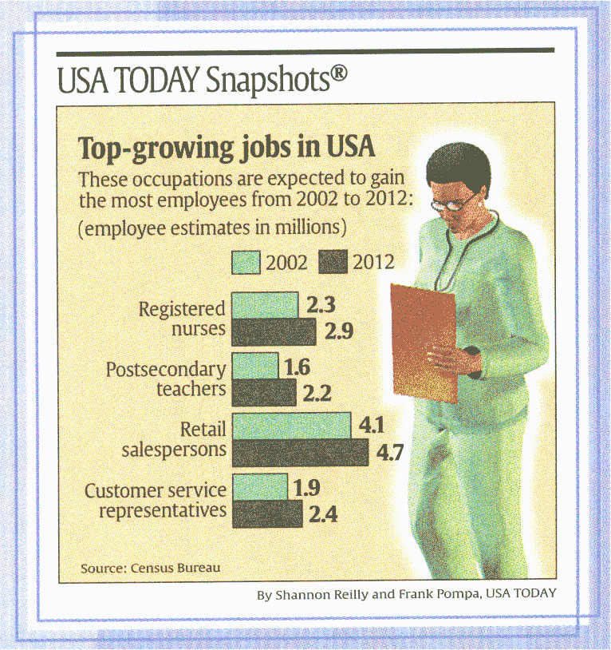

Slide 32
Industry employment projections to 2015
Industry sectors growing the fastest and gaining the most new jobs: professional and business services; and education and health services.
Industry sectors growing the slowest: manufacturing and construction.
Short-term construction declines will result in fewer new jobs and slower growth for this industry in the long-term (42,000 jobs; 7% growth).
Manufacturing will have the fewest number of new jobs: growth in pharmaceuticals, medical instruments, and some construction-related manufacturing are keeping this industry from declining (1,550 jobs; 0.4% growth).
Retail trade will see strong gains in general merchandise stores, motor vehicle dealers and building material stores as each continue to expand and steal market share from other sectors in trade.

Slide 33
Industry employment projections to 2015
The information sector will be driven by gains in software publishing, wireless telecommunications and Internet-related service providers.
Financial services growth will be slowed by current weakness in mortgage lending, causing the industry to grow slower than the average for all industries.
Growth in employment services, legal, engineering, computer design and consulting services will make professional and business services the fastest growing industry sector.
Educational services, both private and public, will have 63 percent of its job growth occur in the elementary and secondary schools.

Slide 34
Industry employment projections to 2015
Doctors’ offices and other outpatient care services will account for more than 50 percent new jobs in health care.
Food services and drinking places will account for two-thirds of the job growth in leisure and hospitality. Art, entertainment and recreation services will grow the fastest within leisure and hospitality.
All sectors of government are projected to grow, but at slower rates. Almost 90 percent of the new jobs in government will be in local government.
Growth in jobs as self-employed and unpaid family workers will be slower, comprising only 4 percent of the new jobs.

Slide 35
Industry employment projections to 2015
9 of the 10 fastest-growing occupations are in the computer or healthcare career fields.
Nearly all of the 10 fast-growing occupations are growing at a faster rate and adding greater numbers of new jobs than previously forecasted.
7 of the 10 fastest-growing occupations earn more than $26 per hour.
Of the top 10 occupations expected to gain the most new jobs, most are the largest occupations in the state, have widespread demand among numerous industries, include a lot of part-time work, and have minimal requirements for entry into the occupation.
Overall, more job openings will be due to replacement needs than due to economic growth.

Slide 36
Fastest-growing industries

Slide 37
Industries gaining the most new jobs

Slide 38
Career Academy Industry Certification
Agriscience Education Programs
Horticulture Science and Service
Horticulture Science & Service 4 - 8121610
Veterinary Assisting
Veterinary Assisting 5 - 8111530
Certified Veterinary Assistant (CVA) ANICT001
Certified Horticulture Professional (FCHP) FNGLA001

Slide 39
Career Academy Industry Certification
Industrial Education Programs
Air-Conditioning, Refrigeration and Heating Technology
Air-Conditioning, Refrigeration and Heating Technology 7 - 8713070
HEAT certification HVACE007
Automotive Collision Repair and Refinishing
Automotive Collision Repair and Refinishing 3 - 8709030
Automotive Collision Repair and Refinishing 4 - 8709040
ASE Collision Repair and Refinishing Technician: Non-structural Analysis and Damage Repair (B3) - NIASE018
ASE Collision Repair and Refinishing Technician: Painting and Refinishing (B2) - NIASE029

Slide 40
Career Academy Industry Certification
Industrial Education Programs
Automotive Service Technology
Automotive Service Technology 6 -8709460
Automotive Service Technology 7 -8709470
Automotive Service Technology 9 -8709490
Automotive Service Technology 12 -8709493
ASE Automobile Technician: Suspension and Steering NIASE014
ASE Automobile Technician: Brakes NIASE007
ASE Automobile Technician: Electrical/Electronic Systems NIASE008
ASE Automobile Technician: Engine Performance NIASE009

Slide 41
Career Academy Industry Certification
Industrial Education Programs
Building Construction Technology
Building Construction Technology 2 – 8720320
Building Construction Technology 4 – 8720340
Carpentry
Carpentry and Cabinetmaking 1 - 8722110
Carpentry 4 – 8722140
NCCER Carpentry - Level 1 - NCCER005
NCCER Carpentry - Level 2- NCCER032
NCCER Carpentry - Level 1 - NCCER005
NCCER Carpentry - Level 2- NCCER032

Slide 42
Career Academy Industry Certification
Technology Education Programs
Commercial Art Technology
Commercial Art 2 - 8718020
Commercial Photography
Commercial Photography 2 - 8772020
Television Production Technology
Television Production Technology 4 - 8772140
Apple Certified Pro (ACP) Final Cut Pro APPLE009
Adobe Certified Expert (Illustrator CS 2) ADOBE003
Adobe Certified Associate (Photoshop) ADOBE012

Slide 43
Career Academy Industry Certification
Technology Education Programs
Communications Technology
Communications Technology II - 8601020
Adobe Certified Associate (Photoshop) ADOBE012
Construction Technology
Construction Technology II - 8600720
NCCER Carpentry - Level 1 - NCCER005
Materials and Processes Technology
Materials and Processes Technology III - 8601130
Autodesk Certified Associate - AutoCAD 2009 ADESK016

Slide 44
Career Academy Industry Certification
Technology Education Programs
Pathways To Engineering (PLTW)
Introduction To Engineering Design - 8600550
Autodesk Certified Associate - Inventor 2009 ADESK019
Geospatial/Geographic Information Systems Technology
Engineering Design and Development - 8600650
GIS Technician (Entry) DIGIT001

Slide 45
Career Academy Industry Certification
Family Consumer Science Education Programs
Culinary Operations
Culinary Operations 4 - 8515110
National ProStart Certificate of Achievement NRAEF002
Early Childhood Education
Early Childhood Education 4 - 8503214
National Child Development Associate (CDA) CPREC001

Slide 46
Career Academy Industry Certification
Business Technology Education Programs
Academy of International Business
International Finance and Law - 8216120
Microsoft MCAS Bundle Certification* MICRO061 or Microsoft Office Master MICRO017
Accounting Operations
Accounting Applications 3 - 8203330
Business Supervision and Management
Business Supervision 1 - 8215140
Microsoft MCAS Bundle Certification* MICRO061 or Microsoft Office Master MICRO017
Microsoft MCAS Bundle Certification* MICRO061 or Microsoft Office Master MICRO017

Slide 47
Career Academy Industry Certification
Business Technology Education Programs
Digital Design
Digital Design 2 - 8209520
Adobe Certified Associate (Photoshop) - ADOBE012
Network Support Services
Networking 2 – 8207030
Networking 3 – 8207040
Digital Design 3 - 8209530
Adobe Certified Expert (InDesign) - ADOBE004
CompTIA A+ certification COMPT001
CompTIA Network+ Certification COMPT006

Slide 48
Career Academy Industry Certification
Business Technology Education Programs
PC Support Services
PC Support 2 - 8207220
PC Support 3 - 8207230
New Media Technology
Web Design 1 – 8207110
CompTIA A+ certification COMPT001
CompTIA Network+ Certification COMPT006
Adobe Certified Associate (Dreamweaver) ADOBE010
Apple Certified Pro (ACP) Final Cut Pro APPLE009
Digital Video and Sound Fundamentals - 8207420

Slide 49
Career Academy Industry Certification
Business Technology Education Programs
Web Design Services
Web Design 2 - 8207120
Adobe Certified Associate (Dreamweaver) ADOBE010
Academy of Finance
Personal Financial Planning - 8815120
Microsoft MCAS Bundle Certification* MICRO061 or Microsoft Office Master MICRO017
Web Design 4 - 8207140
Certified Internet Web (CIW) Associate Design Specialist PROSO001
Web Design 3 - 82707130
Adobe Certified Associate (Flash) ADOBE011

Slide 50
Career Academy Industry Certification
Medical Sciences Education Programs
Allied Health Assisting
Allied Health Assisting 3 - 8417131
Certified Medical Administrative Assistant NATHA003
Dental Aide
Dental Aide 3 - 8417141
Certified Dental Assistant (CDA) DANBD001
EKG Aide
Electrocardiograph Aide 3 - 8417161
Certified EKG Technician (CET) NATHA002

Slide 51
Career Academy Industry Certification
Medical Sciences Education Programs
First Responder
First Responder 3 - 8417171
First Responder Certification NREMT003
Health Unit Coordinator
Certified Health Unit Coordinator (CHUC) NAHUC001
Health Unit Coordinator 3 - 8417181

Slide 52
Career Academy Industry Certification
Medical Sciences Education Programs
Nursing Assistant
Nursing Assistant 3 - 8417211
Certified Nursing Assistant FDMQA002
Practical Nursing
Practical Nursing 1 - 8418310
Licensed Practical Nurse FDMQA017
Practical Nursing 9 - 8418390
Certified Nursing Assistant FDMQA002

Slide 53
Career Academy Industry Certification
Medical Sciences Education Programs
Medical Laboratory Assisting
Medical Lab Assisting 4 - 8417202
National Certified Phlebotomy Technician
Home Health Aide
Home Health Aide 3 - 8417191
Certified Home Care Aide NAHCH001

Slide 54

vision
What do you want students to know?
What do you want students to be able to do?

Slide 55
Program name
Make sure the name is practical.. Easy to identify, spell and pronounce!
Make it appealing and catchy!
The name should reflect in your mission/vision statement.

Slide 56
support
Administrative/District/School Board Support
  How can you get their support?
  How can we get them involved?
  How can we keep them involved?

Slide 57
Parent involvement
In what ways can a parent be involved in the program?
How will you encourage parents to be involved?
How will parents be kept informed about their students progress?

Slide 58
Program structure
Will all students in the same grade level be scheduled for the same classes together?
What modifications will be in place for ESE?
What programs are already in place that support the vision of this program? (JA)
What opportunities does our school already offer for job shadowing, internships, etc?

Slide 59
staffing
How many staff members will be needed for year 1? 2? 3?
How will they be selected… volunteer? appointed?
Staff should be creative, open to change, and have an appreciation for hands-on and performance based learning opportunities.
List all possible courses along with a potential teacher for each course

Slide 60
staffing
Director/Coordinator
Team Teachers
Schedule Team Meetings
Common Prep Time
Staff Development
Professional Conferences

Slide 61
Student recruitment
How are you going to attract and recruit students into the program?
What grade will they be recruited?
What methods of recruitment will be used?
Application process? Interview? Criteria?
Marketing materials?

Slide 62
Financial matters
Facilities-Where will the program be located? Rooms close proximity? Office space needed?
Funding-How much money will it take to fund the program? Perkins funding? SLC? Other funding? Sponsorship? Grant writing?
Budget- Create a budget to include ALL categories. (sub pay, textbooks, stipends, travel/conf, student activities, etc..)
Equipment/Supplies-What is needed to set up the program? Can you get donations?
Technology-What is needed? Enough computers available? Do they need upgrading? Donations available? WISH LIST!

Slide 63
Classroom design
Academic courses- What academic classes need to be in the program? Integration? Will a career focus be infused? How?
CTE classes-What CTE courses need to be offered?
Sequencing-OCPs, scholarships, program of study
Scheduling- block schedule? How do they need to be scheduled so they don’t interfere with job shadowing, etc? What other master schedule considerations are there? (Visit casn.berkeley.edu for a scheduling guide from CASN)

Slide 64
Graduation Requirements- What are the school requirements? Is a senior project required?
Bright Future scholarships—Gold Seal, Medallion, Scholar levels
Articulations- What classes are being articulated? What needs to be articulated? Can this be a marketing tool used when recruiting?

Slide 65
Post-secondary articulation agreements
District curriculum is aligned with post-secondary curriculum, qualifying students for college credits
  Art Institute of Fort Lauderdale
  Johnson and Wales University
  Keiser College
  Lincoln College of Technology
  Florida Culinary Institute
  Palm Beach Community College
  Academy of Practical Nursing
  Health Career Institute

Slide 66
Integrated Curriculum- How will you assure rigor and relevance? How will academic & technical be integrated? How can curriculum be aligned with employer’s expectations?
Development of Curriculum- Who can help develop the curriculum? What resources are needed to develop curriculum? (supplements for curriculum writing?)

Slide 67
Real world connections
Business/Community Partnerships-Who is close to school? Who is interested? Deliver materials & meet with them!
Advisory Board-School based and District (CEBLC)
Guest Speakers
Field Trips
Mentoring/Internships/Externships
Industry certifications

Slide 68
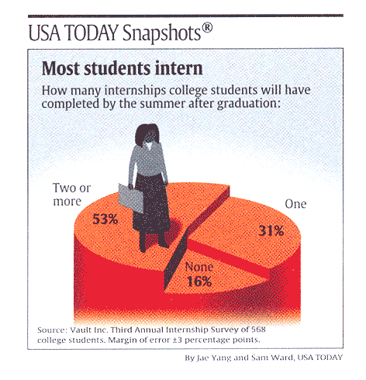

Slide 69
Why do we need business and community partners?
“Teachers face major challenges, a fact that impacts teacher training, recruitment and retention. Without support from the community at large, including businesses, all our students will suffer.”--Ms. Becton, Verizon

Slide 70
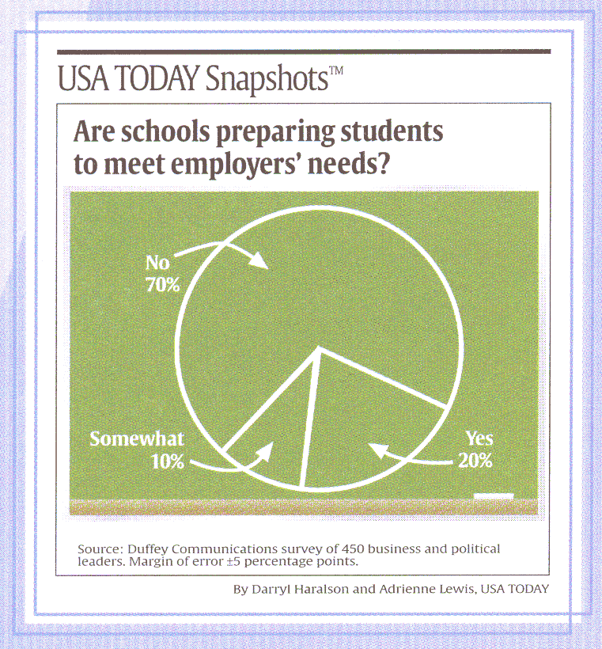

Slide 71
Strong partnerships
Career Education Business Leadership Committee (CEBLC) is a collaborative committee: PBCSD partners with:
    Palm Beach County Education Commission
    Junior Achievement
    Palm Health Care Foundation
    Leadership Palm Beach County
    Human Resource Association of Palm Beach County
    Workforce Alliance
    Business Development Board
    Local Postsecondary institutions
    Chamber of Commerce
    QE3
    Quantum Foundation
    Ed. Foundation
  A response to the business community’s request for higher performing graduates
  Business expertise to develop industry standard curriculum and facilities

Slide 72
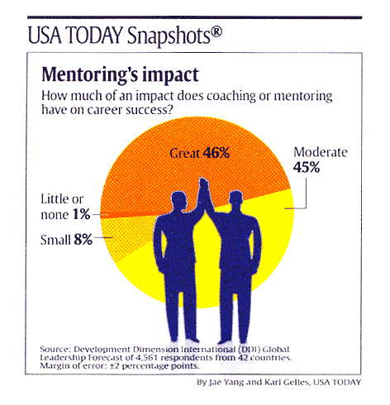

Slide 73
A business partnership is not about money
“First you friend raise, then you fund raise.” –Rev Bill Byron, Catholic University, Washington, D.C.

Slide 74
Administrative issues
Legal Issues
Program policies-for students, parents, community
Contracts-Are they needed? With whom? What situations?
Insurance-Students visiting work sites? Travel time?

Slide 75
Spread the news
Public Awareness-Most important!
Department of Public Affairs
Brochures-to reach ALL stakeholders
Scholarship Committee-Do you want one?
Alumni Involvement-advisory board?
‘Branding’- use on all letterhead, business cards, etc

Slide 76
Tracking program progress
Data-assures goals are being met
  Coding
Program Evaluation- review and reflect: where do we need improvement?

Slide 77
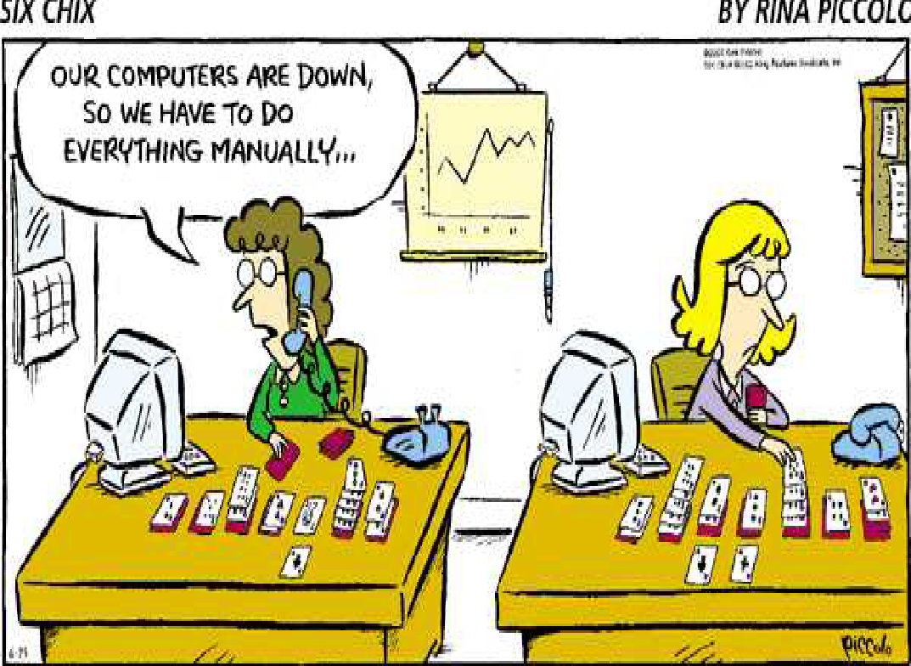

Slide 78
National standards of practice Self Assessment rubric
Defined Mission & Goals
Academy Structure
Host District and High School
Faculty & Staff
Professional Development
Governance & Leadership
Curriculum & Instruction
Employer, Higher Education & Community Involvement
Student Assessment
Cycle of Improvement

Slide 79
STAFF DEVELOPMENT FOR TEACHERS AND SCHOOL-CENTER PERSONNEL
CAREER EDUCATION BUSINESS LEADERSHIP COMMITTEE
(CEBLC)
EDUCATION COMMISSION
DEPARTMENT OF PLANNING/FACILITIES MANAGEMENT
DEPARTMENT OF SECONDARY CURRICULUM
Research & Evaluation
The School District of Palm Beach County
Career Academy Programs
CAREER EDUCATION CURRICULUM
POST-SECONDARY ARTICULATIONS
STUDENT INPUT
COMPREHENSIVE GUIDANCE APPROACH
PARENT INPUT
COMMUNITY PARTNERSHIPS

Slide 80
Key to academy success
Strong District Administrative Support
Principals
Qualified dedicated teachers and support staff
Strong Business/Community Partnerships
Presenters/Attendance at National Conferences
Specific, well-planned staff development that is continual, relevant, timely

Slide 81
challenges
Academies are a lot of work
Academies require collaboration from a number of parties
Academies can cause new problems
Academies require a lot of planning

Slide 82


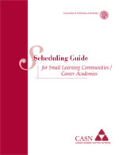




Slide 83
Congratulations to our nine nationally recognized academies
MODEL ACADEMIES
Atlantic HS – Criminal Justice
Forest Hill HS – Environmental Science
John I. Leonard HS – Computer Education
Lake Worth HS – Medical Sciences
Palm Beach Gardens HS – Hospitality Management
West Boca Raton HS – Culinary Arts
William T. Dwyer HS – Academy of Finance
CERTIFIED ACADEMIES
Palm Beach Central HS – Culinary Arts
Palm Beach Lakes HS – Medical Sciences
Seminole Ridge HS – Biotechnology
Seminole Ridge HS – Construction

Slide 84

For more information on Career Education in
Palm Beach County, contact:
Constance Scotchel-Gross, Manager
Career Education
(561) 357-7537 or
visit www.palmbeach.k12.fl.us/careered

