Slide 1
Engaging the Media
October 10, 2018

Slide 2
Speakers
Paula Bowles, Chief Communications and Marketing Officer of the Oklahoma Department of Career and Technology Education
Catherine Gewertz, Education Week

Slide 3
Agenda
Oklahoma's approach to media engagement
How to get press interested in CTE in your community

Slide 4
Engaging the Media Advance CTE Webinar Oct. 10, 2018 Paula Bowles Chief Communications & Marketing Officer Oklahoma CareerTech

Slide 5
Oklahoma CareerTech Overview
Delivers through
393 K-12 School Districts
29 Technology Center Districts
16 Skills Center Sites (Offender Training)
31 Adult Basic Ed Providers

Slide 6
Oklahoma CareerTech Overview
550,000 Plus Annual Enrollments
2,591 Teachers in Full-Time Offerings
94 Percent Placement
Nearly 7,000 Businesses Served

Slide 7
Why Engage Media?
Research indicates:
56 percent of registered voters have heard of CareerTech
People are not fully aware of CT services
Need to deliver messages through multiple platforms.

Slide 8
Media Strategy
Communications/Marketing Plan Supports System Strategic Plan Goals:
Enhance Business/Education Partnerships
Increase Career Awareness
Increase Educational Attainment

Slide 9
Communications/ Marketing Plan
Key Message:
The Marketing Media Services Division provides leadership, support and assistance to communicate the benefits of Oklahoma CareerTech education.

Slide 10
Examples
Online newsletter subscriptions:
Director’s Weekly Memo
CareerTech Update
Topic bulletins
Highlight success stories through all media outlets
Social media campaigns
News releases, alerts & opinion editorials

Slide 11
Media Approaches
Monthly local column in newspaper
Connect with students through CTSO members
Themed social media campaigns, ie CT Month
Editorial board meetings
Support statewide marketing messages

Slide 12
Outcomes of Media Engagement
Monthly column repurposed and shared throughout state
More exposure in state’s largest newspaper
Social media shares increased

Slide 13
Contact
Paula B. Bowles
Chief Communications & Marketing Officer
405.743.5108
Paula.bowles@Careertech.ok.gov

Slide 14
Questions
Please type your question into the chat box.

Slide 15
Getting Reporters Interested in CTE
Catherine Gewertz,
Education Week
Advance CTE webinar, 10/10/18

Slide 16
What’s Makes a Good Pitch?
State/regional connections
Signifying something larger; trend, controversy
--Builds pipeline in high-demand sector
--From old voc-ed to rigorous, higher-tech models
--Outstanding quality/track record
--Equity/tracking
For some: lighthearted/good photos/video

Slide 17
The Care & Feeding of Reporters
Build relationships when there’s no story
--Trust & education
Give us a lot of notice
-- We are so friggin’ busy and stressed-out
Reach out in advance/heads-up
Provide embargoed information (trust)

Slide 18
What EdWeek Looks For
National significance
-- Local works too: “tell the big story with the small story”
Policy connection
-- affecting debate/shaping decisions
-- outgrowth of debate/decisions

Slide 19
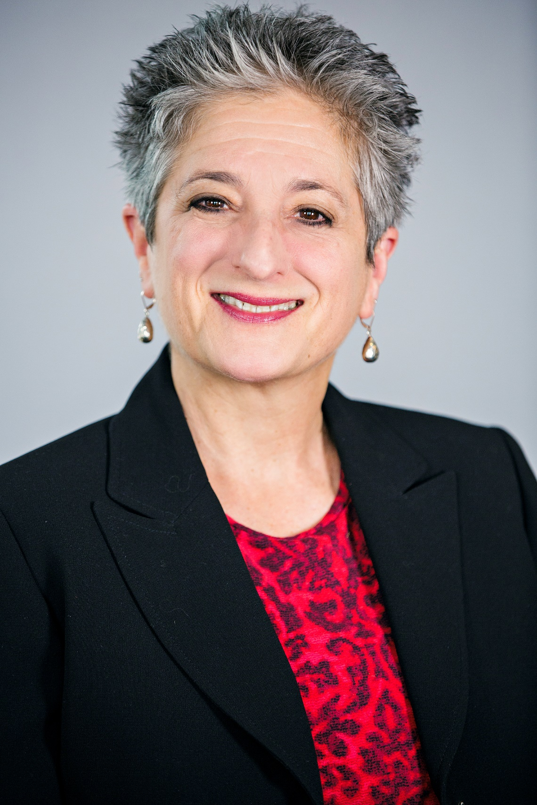
Where You Can Find Me
Catherine Gewertz
Senior contributing writer, EdWeek
High school/transitions to college & work
cgewertz@epe.org
(301) 280-3139

Slide 20
Questions
Please type your question into the chat box.

