Slide 1
The Common Career Technical Core:
The Basics

Slide 2
Why the Common Career Technical Core?
Vision calls for the development of world-class CTE
program standards.
Notes:
CTE’s ever-present commitment to being responsive to the needs of the workplace and economy, we set forth a joint vision in 2010 to chart our future. Reading the tea leaves of economic trends, greater expectations for postsecondary education, understanding of the essential connection between CTE/WD/ED, political leaders calling for a shift from islands of excellence to high quality CTE for all
State CTE Directors from all 50 states united around a new vision for CTE, called “Reflect, Transform, Lead.”
Reflect on and learn from and honor our history.
Continue to drive our current transformation.
Lead the future through a bold, progressive agenda.
The vision sets expectations for CTE and promotes specific policy and programmatic action steps to achieve the vision.
One key action step from the new vision was the development of a set of world-class CTE program standards--the Common Career Technical Core.
Not only was this important from a content reason – but we also believe that common standards make good sense from an economic and efficiency standpoint. If we can band together to build common standards, state resources currently dedicated to these efforts can be redirected to support many of the other myriad needs we have – whether it be professional development, curriculum, equipment, integration, program articulation, etc.
To learn more about the vision for CTE or to read the full report, visit www.careertech.org.

Slide 3
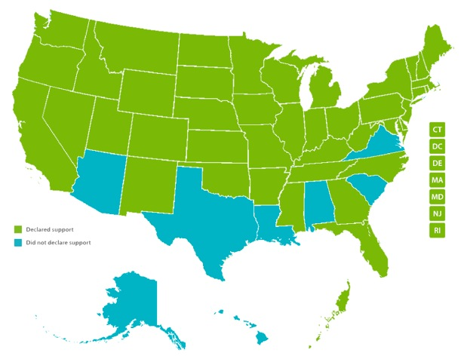
Developed by states for states
Notes:
The Common Career Technical Core is a state-led effort. Forty-two states, the District of Columbia, and one territory--Palau--participated in the development and validation of the CCTC.
IF PROMPTED BY AUDIENCE: Alabama, Alaska, Arizona, Hawaii, Louisiana, South Carolina, Texas and Virginia DID NOT.]

Slide 4
The Common Career Technical Core
The Common Career Technical Core
Are benchmark standards
Define what a student should know and be able to do at the end of a program of study.
Notes:
Unpack this term to help you understand what makes the CCTC different from other CTE standards

Slide 5
Key Term: End of Program of Study
The CCTC standards are written to address the educational expectations across an entire program of study.
High-quality programs of study encompass learning at both the secondary and postsecondary level.

Slide 6
Key Term: Benchmark Standard
A benchmark standard serves as a common reference point against which other standards, curriculum and programs of study can be compared.
As benchmark standards, in practice, the CCTC can serve as an anchor for the patchwork of state, industry and local standards currently in use across the country.
Notes:
States, districts and educators can use the CCTC to ensure their standards and instruction are putting students on a path to meet and master those end-of-program of study expectations.

Slide 7
Scope and Use of Standards
These program-level standards are intended to provide the core expectations across the different delivery systems and approaches.
Focus is on foundational and higher-order concepts/skills for each cluster and pathway.
Link to state CTE standards and curriculum framework, certification, and/or program efforts.

Slide 8
Common Career Technical Core Design & Components

Slide 9
Components of CCTC
Standards for
Career Ready Practice
Cluster- and Pathway-Level Content Standards
12 practices with suggested indicators
Positioned to be applied across the entire continuum of instruction
Modeled after Common Core’s Standards for Mathematical Practice
Expectations within Career Cluster and Career Pathways that frame a Program of Study
Based on Validated Knowledge and Skills Statements
Used to align expectations across states

Slide 10
Career Ready Practices
Act as a responsible and contributing citizen and employee
Apply appropriate academic and technical skills
Attend to personal health and financial well-being
Communicate clearly and effectively and with reason
Consider the environmental, social and economic impacts of decisions
Demonstrate creativity and innovation

Slide 11
Career Ready Practices
Employ valid and reliable research strategies
Utilize critical thinking to make sense of problems and persevere in solving them
Model integrity, ethical leadership and effective management
Plan education and career paths aligned to personal goals
Use technology to enhance productivity
Work productively in teams, using cultural global competence

Slide 12
16 Career Clusters®
Agriculture, Food & Natural Resources
Architecture & Construction
Arts, A/V Technology & Communications
Business Management & Administration
Education & Training
Finance
Government & Public Administration
Health Science
Hospitality & Tourism
Human Services
Information Technology
Law, Public Safety, Corrections & Security
Manufacturing
Marketing
Science, Technology, Engineering & Mathematics
Transportation, Distribution & Logistics

Slide 13
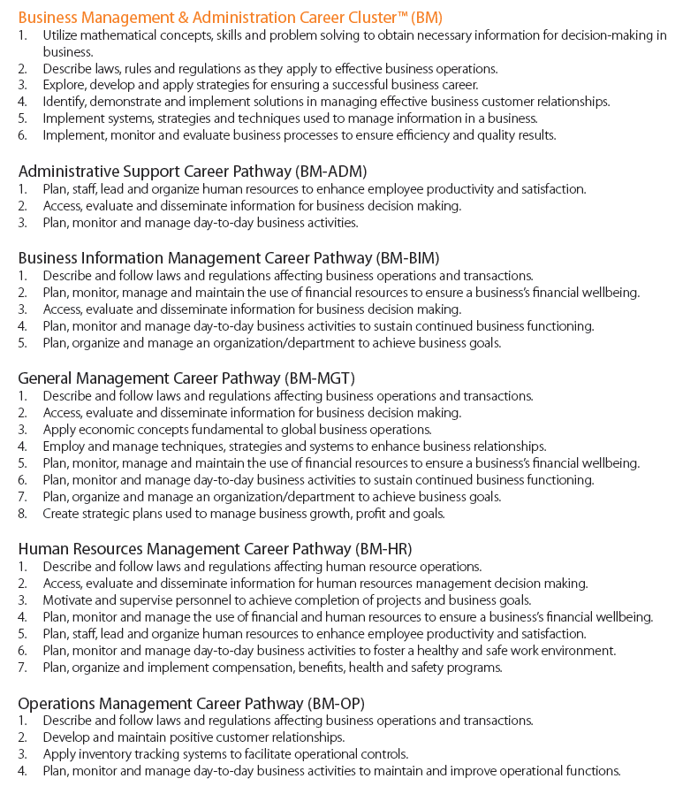

Slide 14
CCTC Resources
Download the CCTC
More info on development
More info on the Career Ready Practices
Communications materials
www.careertech.org/CCTC

