Slide 1
Expanding and Elevating High-Quality Career Technical Education
Empowering Students through Career Technical Education & Career Advising
Module 3
[ Somewhere - insert state name/location ]
[ Sometime- insert date]
[Someone - insert Facilitator Name]

Slide 2
Welcome
Notes:
Use this slide as a space saver for the CTE State Lead (or State Lead who is the main contact for this training )to kick off the training with introductions, a welcome and/or a kick off statement encouraging folks to stay engaged in the content and know that it is valued.
While attendees are logging in, prompt them to begin introducing themselves in the chat with: Name, Title, School/District Name
If in-person, wait until slide #5 for introductions of attendees.

Slide 3
Pre-Workshop Survey
(add link or QR code)
Notes:
Instructions in Worksheet for attendees to follow.
See Facilitator Guide for recommendations.

Slide 4
Community Agreements
(see module worksheet)
Notes:
These are a list of norms for attendees to interact with one another, set as the norm for either in-person or virtual trainings - in fact, it was originally designed as a list for virtual training environments.
Optional slide for Facilitators: Knowing that you likely know your audience best, utilize this sample list of training norms, edit and add/delete accordingly. Also apply what norms/agreements are best for in-person or virtual training environments.
The list is hyperlinked in the training worksheet listed in the module folder.

Slide 5
Introductions
In the spirit of high quality career and technical education programming, finish this sentence in chat:
When I was in high school, the best part of my day was ________________.
Notes:
While we gather and attendees trickle in...remind them to introduce themselves in the chat with their Name, Title (mention grade level if relevant), School/District Name
If in-person, facilitate the introduction format of your choice (i.e. popcorn, meet your neighbor, etc…)
This guiding questions has attendees reflect back on their own High School learning experience and whether or not a contextual class like a CTE class was the ‘best’ part of a typical high school day. If not, what was so great about a class or a high school experience? Is it the same for students now? Could CTE be the best part of a students day today? If not, why not? What needs to be different?
Modeling aspiration, reflection and maybe humor. See if anyone wants to go off mute and share more about their response. Anyone find anything surprising?
This is a great guiding question for when you take this training experience back to more of your colleagues. Since many of you will be the ‘messenger’ for CTE, this question helps folks/x feel more at ease with the topic.

Slide 6
Learning Objectives
Gain a clear understanding of what comprises high-quality CTE programming and how it serves each learner
Become knowledgeable of the variations of state and local CTE delivery systems and how delivery design can be leveraged to deliver equitable program access and enrollment.
Identify and discuss the various components and benefits of a high-quality CTE program of study, including: work-based learning, industry-valued credentials, early postsecondary opportunities, Career & Technical Student Organizations and top considerations to ensure equitable access to these experiences for each learner.
Connect understanding components of high-quality CTE to the role of counseling and career advising professional to guide each learners towards equitable learning experiences and outcomes.
Notes:
Advance CTE paired down each module to reflect 5 or less learning objectives. As a facilitator, you may add more if you know you want to with your training group. Double check that these objectives match or align to those listed in the facilitator guide for this module.
**Pro-Tip: animate each bullet point so to emphasize each objective with attendees - less text on the screen at first.
*If you feel so inclined, feel free to take a long pause once done with the last objective and ask attendees: What learning objective would you add to this list because it is a learning moment you hope to gain today?

Slide 7
Notes:
NOW NEW NEXT is a main theme for the module and will guide how we reflect about the information shared and make plans to act on it after this training.
Call out the worksheet. We will reference NOW NEW NEXT at least twice in this module.
NOW indicates a reflective moment around what is in place. NOW is an indicator of what you can quickly recite and would share in the metaphorical ‘elevator’ or ‘sidewalk chat’ or ‘dinner party’ or ‘family reunion’ or ‘water cooler’ etc…..[insert whatever is most culturally relevant for you and/or the group here]
NEW will be the space where something is pulled from today's information. An idea, an initiative, new program implementation. A-Ha’s! New nuggets of knowledge. Big or small, the details that are NEW can live here for reference at the end of the module.
NEXT is use for looking to the future. What will you try? What will you implement? What will you take action on? What will you want to learn more about? Who else do you need with you to make it happen? ETC…. Structure and strategy around these ideas will accompany you a the end of the module
Again, we’ll be revisiting during NOW NEW NEXT conversation at the conclusion of this module.

Slide 8
Notes:
Put the link in the chat:
A Shared Vision | Advance CTE (careertech.org)
Include the link for attendees to access or navigate away from this slide to the webpage to explain this section and the next slide too:
A Shared Vision | Advance CTE (careertech.org)
Use this text as script or go off-script as you feel comfortable:
Without Limits: A Shared Vision for the Future of Career Technical Education (CTE Without Limits) puts forth a bold vision for a cohesive, flexible, and responsive career preparation ecosystem that will close equity gaps in educational outcomes and workforce readiness, and leverage CTE as a catalyst for ensuring each learner can reach success in the career of their choice.
Developed with input from nearly 200 national, state and local education and workforce development leaders and supported by 42 national organizations, CTE Without Limits lays out five inter-connected and equally critical principles:
Each learner engages in a cohesive, flexible, and responsive career preparation ecosystem
Each learner feels welcome in, is supported by, and has the means to succeed in the career preparation ecosystem
Each learner skillfully navigates their own career journey
Each learner’s skills are counted, valued, and portable
Each learner can access CTE without borders
CTE Without Limits is ambitious and forward looking. It puts equity at the center and recognizes that our country needs a CTE system that works for each learner, wherever they are in their career journey and whatever their background.
This vision is not just calling for updates to our CTE, education and workforce systems. Rather, it is calling for a more cohesive, flexible and responsive career preparation ecosystem, with CTE at its nexus, that draws on the capacity of each existing system; leverages these systems’ greatest assets; and pushes for new models of collaboration, learner-centric design and delivery, funding and accountability that create the right incentives and supports.
Only through shared commitment and shared ownership among leaders and practitioners at all levels can we realize the possibility and aspiration of a new career preparation ecosystem that provides each learner with limitless opportunity.
Each learner must have access to and the means to be successful in the career of their choice and will require:
All systems working in concert
A commitment to tearing down the barriers that limit opportunity
CTE to serve as the catalyst to make this vision a reality

Slide 9
Speakers
Explore more by visiting: https://careertech.org/without-limits
Notes:
Take a moment to reiterate the 5 principles of the CTE Without Limits vision.
If applicable to your audience, ask which principle stands out to them the most, which one seems the easiest/hardest, which one(s) are they already doing in school, district, campus, community or region, etc….

Slide 10
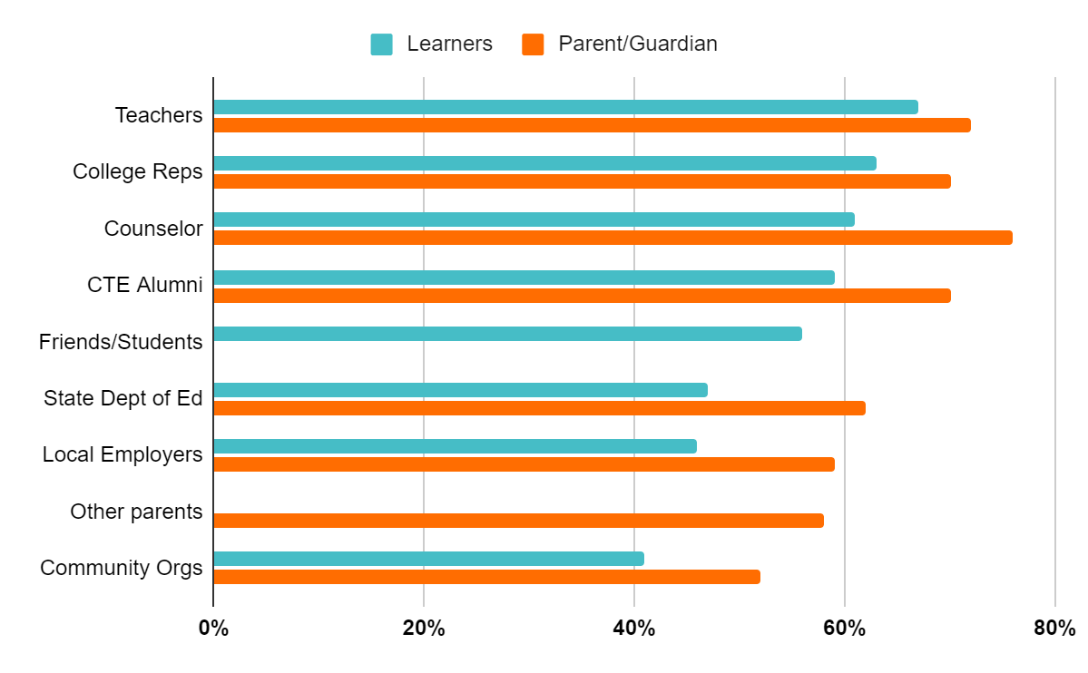
School Counselors Top Source for Information
67% - #1 Learners
76% - #1 Parent/Guardian
Notes:
AS A FRIENDLY REMINDER…..School Counselors are the top trusted messengers for students and families when it comes to conveying information about CTE.
We will review more about the survey in this workshop, but the reason for the development of this specific training is because of this finding: We learned that school counselors and teachers are the most trusted source of information about CTE for students and parents.
Let’s say that outloud again!
YES! What a useful and helpful finding!
Yet it seemed, through this national survey, that school counselors needed support in how to speak about CTE and career advising strategies.
Advance CTE and Siemens discussed strategies for activating school counselors to have an impact on as many counselors throughout the country as possible. The goal was to create an off-the-shelf training in partnership with ASCA and ACTE and guided by the input of an advisory committee. The advisory committee consisted of members of ASCA and ACTE as well as a few State CTE Directors, State Directors of School Counseling, and national experts in school counseling and career development. The members had the opportunity to weigh in and make recommendations throughout the development of the training. The training was first completed in 2019 and updated in 2021. Now here we are in 2022 at it again! Kudos to you each for being a part of this.
NOTE: The percentage is lower among students because historically marginalized learners (learners of color and low income) ranked them lower. It is unknown if this is a result of the pandemic or larger trust issues.
‹#›

Slide 11
Our Role
Personal interests/aspirations/aptitudes + Competencies/Skills +
Being informed on where/what
= CTE Champion!
Notes:
The formula for becoming a CTE champion involves the following:
When we help our students/learners get to know their own personal interests, future aspirations and understand their aptitude for future work paired with the competencies and skills they may already have or gain as they continue along their education and employment journeys paired again by knowing what their opportunities for career success in their state, community or anywhere.
When these three areas are focused on with EACH student/learner then that makes us a CTE Champion who remains in touch with economic needs, labor market resources, CTE happenings and changes.
CTE Champions also maintain good connections and collaboration with CTE educators and leaders.
CTE Champions also do not have to be the experts on specific career areas although they DO need to know who does
CTE Champions check their bias at the door. CTE Champions know just enough of CTE logistics, compliance and requirements to be official AND keep apprised of programming, economic, industry (hot jobs) changes. CTE Champions see EACH student as an individual pathway participant, supporting EACH learner obtain what learning and experience fits them best.
How would you describe a CTE Champion?
Are you looking forward to this title?

Slide 12
MYTH FACT
Myth
CTE serves only “disadvantaged” students.
Fact
CTE is for EVERY learner.
92% of high school students take some form of CTE
77% of high school students earn at least one CTE course credit including 80% White, 75% Black and 74% Latinx learners.
http://www.nrccte.org/sites/default/files/publication-files/nrccte_cte_typology.pdf
https://cte.careertech.org/sites/default/files/documents/fact-sheets/CTE_Myths_Facts_2020.pdf
Notes:
Myth is animated and shows first, click to show FACT.
Then click again to get bullet data points. Ask attendees, does any of this seem surprising?
Let them know that when they get access to the slides they can explore the weblink resources.
‹#›

Slide 13
Notes:
As we mentioned earlier, NOW NEW NEXT is a main theme for the module and will guide how we reflect about the information shared and make plans to act on it after the workshop.
Remember to call out where to find the reflection prompts in the Worksheet. We will reference this theme throughout our time together AND will dive into our Now and New next…..
NOW indicates a reflective moment around what is in place. NOW is an indicator of what you can quickly recite and would share in the metaphorical ‘elevator’ or ‘sidewalk chat’ or ‘dinner party’ or ‘family reunion’ or ‘water cooler’ etc…..[insert whatever is most culturally relevant for you and/or the group here]
NEW will be the space where something is pulled from today's information. An idea, an initiative, new program implementation. A-Ha’s! New nuggets of knowledge. Big or small, the details that are NEW can live here for reference at the end and into session 2.
NEXT is use for looking to the future. What will you try? What will you implement? What will you take action on? What will you want to learn more about? Who else do you need with you to make it happen? ETC…. Structure and strategy around these ideas will accompany you a the end of the session
Again, we’ll be pausing during NOW NEW NEXT slides that come up during our time together in this module.

Slide 14
Activity 1
High-Quality CTE
KNOW
WONDER OPPORTUNITIES
Notes:
Let’s dive into what we already KNOW, what we question or are curious about or WONDER about and what OPPORTUNITIES exist to do more, less, different or other…
‹#›

Slide 15
 | KNOW | WONDER | OPPORTUNITIES
Programs of Study (POS)
Career Clusters
CTSO: Career & Technical Student Organization
Dual Enrollment/ Concurrent Enrollment (early postsecondary opportunities)
Work Based Learning (WBL)
Teacher Recruitment & Retention
Partnerships
Credentials
Diversity, Equity & Inclusion
Notes:
Suggestion - have attendees rank themselves by level of awareness/understanding in these components using a 1-4 likert scale PRIOR to starting this activity
If in-person, have attendees ‘look around’ the room to note who has the high level of knowledge in particular topic. Let attendees know that those would be the individuals to collaborate with, partner with and ‘pick the brains of’. Same thing would be true for the opportunity or idea topics…..who has a cool idea that the attendees hadn’t thought of yet and how can a connection be made to build a ‘team’ to embark on doing the idea?
Take whatever time is allotted to have attendees make notes or chart thoughts on chart paper or break out into small virtual groups to list what they already KNOW about each topic on the far left column, what they WONDER (or have questions about) and what they might see an OPPORTUNITY for in the future within each topic.
Not all topics will have every column filled, no problem.
The intention is to help the audience get a general idea about where everyone stands in their knowledge level (because then collaboration is imminent) as well as what ideas, questions and future action the group can partake in based on how this chart looks at the end.

Slide 16
High-Quality CTE Programs of Study
National Career Clusters® Framework
Notes:
Given the complexity of CTE, we want to ensure that you have a clear understanding of what high-quality CTE is and looks like as well as what variations there are in CTE delivery systems. This will assist you in accurately explaining CTE to students, parents, families and others. There are many commonalities between and among states but also some variations. It is important that school counselors understand their state and local delivery systems to be effective advocates of CTE programming options for their students.
CTE is delivered across the country within the context of the National Career Clusters Framework.
Ask attendees:
Which Career Clusters can you name?
How many of you are familiar with the Career Cluster Framework?
‹#›

Slide 17
Career Clusters Framework
Provides a vital structure for organizing high-quality CTE programs
Is an organizing tool for curriculum design and instruction
Serves as a guide in developing programs that bridge secondary and postsecondary
Helps students discover their interests and passions and choose an educational pathway
Notes:
Career Clusters are used in a variety of ways and mainly serve as the organizational structure for CTE programs. This helps in the design of curriculum as well as provides a mechanism to build consistency across secondary and postsecondary programs. The Career Clusters also help students begin to explore their interests and possibly a pathway based on their passion. Though a slightly funny term, think about them as just a way of organizing or grouping similar fields of work together due to similarities in skills needed.
**NOTE: this is the national definition and description. Each state may vary on how they describe or define the Career Clusters Framework.
‹#›

Slide 18
Notes:
There are currently 16 Career Clusters that are part of the national framework that represent the full world of work. This framework has been in place for nearly 20 years, and there are efforts in the works to update the framework over the next few years. In fact, the most recent update retitles the framework to be more like a Career-iodic-table!
Link here: https://careertech.org/the-framework for the Advance CTE update on the national Cluster Model revision work. Add this link to chat if deemed appropriate.
‹#›

Slide 19
Variability Among States
Examples:
Montana is implementing 11 Career Clusters
Colorado, Florida, Georgia and Michigan added Energy as a 17th Career Cluster
Nebraska, Kansas and Colorado rearranged the 16 Career Clusters into six career/industry sector fields
Notes:
Every state has its unique way of implementing Career Clusters. So there are no “hard and fast” rules about what states can do with the framework. This slide shows some variation from state to state.
‹#›

Slide 20
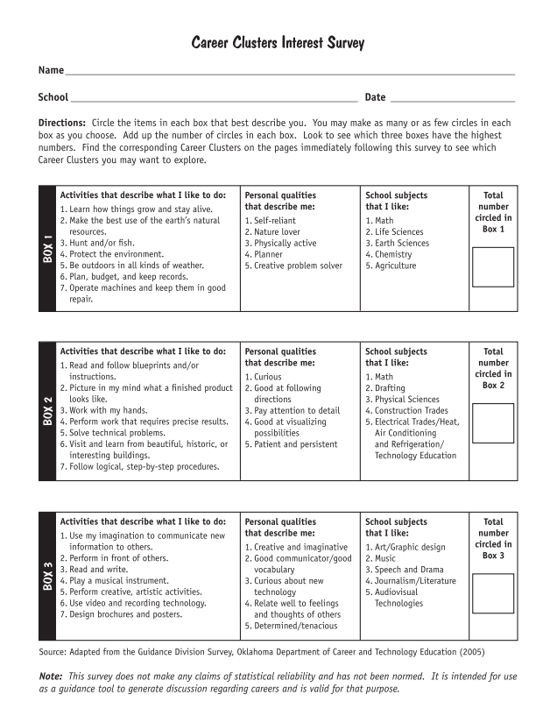
Career Cluster Interest Survey
Found on careertech.org in both English and Spanish; https://careertech.org/resource/career-clusters-student-interest-survey
Notes:
There are Career Cluster interest inventories available on the Advance CTE website as a preliminary career exploration tool.
Ask the room: Has anyone here every used these surveys? Raise of hand (emoji if virtual)
This one is aligned to Hollands Codes. It is also akin to tools found in Xello and Naviance like: ‘Do as you are’
‹#›

Slide 21
Activity 2:
Worksheet Page 4
Review questions in your worksheet to understand what information you need about Career Clusters in your state and community.
Notes:
Take a minute or so and look at the worksheet questions on Page 4. These questions may guide you in determining what you need to find out about your state and local school district’s use of Career Clusters. You may not know the answers now, but it would be valuable for you to find this out to better communicate with students and families.
Here is where Career Clusters can be explored on Advance CTE’s website: https://careertech.org/career-clusters
(feel free to put in chat)
Career Clusters are an important career development tool.
Do you know where the information is for your state? For your school district?
Are you able to communicate the information to others with confidence?
Could be a 5 minute breakout, or a 3-4 minute personal reflection. With no share out... could be whole group and someone comes off mute to share... you choose how you’d like to engage the attendees on this one.
This is a perfect moment to elevate positive enrollment trends in CTE programs across the state, or enrollment disparities by gender, race/ethnicity, language, ability and other special populations.
Consider asking the attendees to consider the following:
Who are missing audiences in these programs (e.g. learners with a disability, English language learners, other special populations)?
Do your CTE classrooms match your hallways, and do your hallways match your streets?
‹#›

Slide 22
CTE Delivery Systems
Career Academies
Stand-alone schools or “schools within schools”
Prominent career academy models
Offered in a quarter of all public high schools
Community and Technical Colleges
Two-year educational institutions
Programs that lead to associate degrees, diplomas and/or certifications
Technical colleges more likely to focus on career-focused programs
Notes:
CTE is delivered differently and varies across states and communities; across state boundaries, across school district boundaries and even within buildings.
Here’s a few models that you may already be familiar with:
Career academies are either stand-alone schools or “schools-within-a-school” that provide college-preparatory curriculum in the context of a career-oriented theme. Early college high schools are a model that links secondary and postsecondary studies, often on a no- or low-cost fast track to an associate degree. Regardless of delivery system, quality is critical.
**NOTE: When presenting in a specific state, include information about the specific state’s CTE delivery system and models. There is space for this two slides from now.
‹#›

Slide 23
CTE Delivery Systems
Middle grades programming
Comprehensive high schools
Technical/vocational high schools
Primarily or solely offer CTE programs
Area technical centers
Shared time or full time
May serve high school students and adult learners
Delivered to students from one or more local districts
Notes:
Programs may be offered in comprehensive high schools; technical/vocational high schools; area technical centers; and community and technical colleges. Even within 5th through 8th grade classrooms too! Check out the Middle Grade CTE efforts here: https://careertech.org/resource/expanding-middle-school-cte (feel free to put in chat box) - what a great way to capture students engagement and interest in CTE when earlier than high school! It’s all about career exploration at that stage.
**Facilitators, be sure to add any state relevant delivery system here
‹#›

Slide 24
State/Local CTE Delivery
[Placeholder slide(s) to share state/local CTE delivery system
Guest Speaker/Subject Matter Expert]
Notes:
Add slides/content for state specific information here.
OPTIONAL IDEA: invite a local or state guest(s) to join to detail more about the delivery systems.

Slide 25
Discussion 1
What questions or curiosities do you have regarding your state’s delivery of CTE?
In what ways can you learn more (any upcoming state or local PD or resources)?
https://careertech.org/cte-your-state
Notes:
What questions or curiosities do attendees have regarding their State’s Delivery of CTE?
In what ways can attendees learn more (any upcoming state or local PD or resources?
https://careertech.org/cte-your-state with this weblink, explore your state’s stats and comparison with others.
‹#›

Slide 26
Components of High-Quality CTE Programs
Notes:
Let’s dive into the components that make up high quality CTE Programming. Being knowledgeable of these will support being a great CTE Champion as you’ll learn what is high quality versus just mediocre when it comes to great CTE options, programming and success for each of our learners.

Slide 27
Key Components of a High-Quality CTE Program of Study
Programs of Study (POS)
Work-based learning (WBL)
Credentials
Early postsecondary opportunities
Career technical student organizations (CTSOs)
Equity is the plate that holds these experiences together
High Quality CTE Tools: https://www.acteonline.org/professional-development/high-quality-cte-tools/
Notes:
While there are many elements of programs of study, some which may be too technical to discuss today, we are going to highlight several key components that are essential for a high-quality CTE program of study.
This is important so that you will know what to look for when you are advising students and speaking with families.
Regrettably, there are many CTE programs that are currently operating that may not necessarily meet the criteria of “high quality.” So we want to be sure that we are guiding students to programs that will lead them to success. We will be talking about work-based learning, credentials, early post secondary opportunities and career technical student organizations, or CTSOs.
We will go through each of these four components separately.
It will be helpful to remind ourselves that these experiences cannot be high-quality if they are not equitable and inclusive for every learner. Each of us still has work to do to achieve equity for each learner.
Metaphorically, imagine these 5 components as food items that are served on a plate. That plate is Equity and Inclusion. Without the plate, the five components wouldn’t be ‘eaten’ so the message here is that equity is foundational to high quality CTE (as well as inclusion, diversity and access).
‹#›

Slide 28
Program of Study (POS)
Defined by Perkins V: Strengthening Career and Technical Education for the 21st Century Act
Coordinated, non-duplicative sequence of academic and technical content at the secondary and postsecondary levels that:
Incorporates challenging state academic standards
Addresses both academic and technical knowledge and skills, including employability skills
Is aligned with the needs of industries in the economy
Progresses in specificity
Has multiple entry and exit points that incorporate credentialing
Culminates in the attainment of a recognized postsecondary credential
Notes:
We are going to continue to explore a term commonly used in CTE — “program of study.”
The term “program of study” (a very lovely acronym that might make you laugh: POS) was introduced in the Perkins legislation in 2006 and was further clarified in the Strengthening Career and Technical Education for the 21st Century Act, commonly called Perkins V. This new definition highlights many components of a quality program of study that we will discuss. There is much to digest here, and these highlighted words capture the essence of the concept of a program of study. It is academically and technically challenging, progresses in specificity, and ultimately culminates in attainment of a postsecondary credential. We are going to explore a few of the essential components for all quality programs.
For many of us, we can think of a Program of Study as a glorified and extensive course guide which helps map out intentional scheduling of courses and thoughtful option making for in and out of school experience.
‹#›

Slide 29
Programs of Study
‹#›
Notes:
Here’s one example of what a Program of Study would look like on paper. Note that it serves as a guidance tool for both academics and career. It also speaks to in and out of school experience, some life experiences and references intentional course scheduling and thoughtful registering of classes for students. One could utilize a POS for family members to get a better understanding of a students middle school/high school learning trajectory. It also helps students feel empowered for their future and supports an increase of advocacy for their learning. They become very informed!
Also, it is important to note that despite the boxes on this document, there is still a fluidity and optionality that occurs with CTE. Nothing is stagnant. The more students get to know themselves, what they like and dislike, what they aspire to do and what not to do,t his ‘map’ can be edited accordingly AND edited individually. Another great attribute of CTE that we may not have known prior.
‹#›

Slide 30
Optional Local SME/Guest
Placeholder
Notes:
As noted earlier in the module, we do encourage welcoming in local Subject Matter Experts (SMEs) or guests like CTE Directors, CTE teachers, current CTE Champion School Counselors or even CTE students to join the training to share perspectives, process and more.
The timing for this one would be great for someone to share about local/state level POS processes, scheduling, registrering, advising using POS or something of that ilk.

Slide 31
Work-Based Learning (WBL)
A continuum of experiences beginning in early grades through middle and high school — and extending into postsecondary — that builds students’ awareness of careers
Types include:
Job shadowing
Mentoring
School-based enterprises
Internships
Youth apprenticeships
Registered apprenticeship
Notes:
The next component we’ll be diving into is: Work-Based Learning. WBL experiences offer students opportunities to reinforce and deepen their classroom learning, explore future career fields, and demonstrate their skills in an authentic setting. It can take on many forms, depending on the design of the experience and the population being served. Many people are familiar with the formerly popular “co-op” model in which students went to class for half-day and then worked for part of their day. Work-based learning is much more than that one specific model. There are many strategies for providing students opportunities to gain real-world skills.
In just a little bit, we will break out into small groups and dive deeper into what you already do, know or want to do or know in these four components.
‹#›

Slide 32
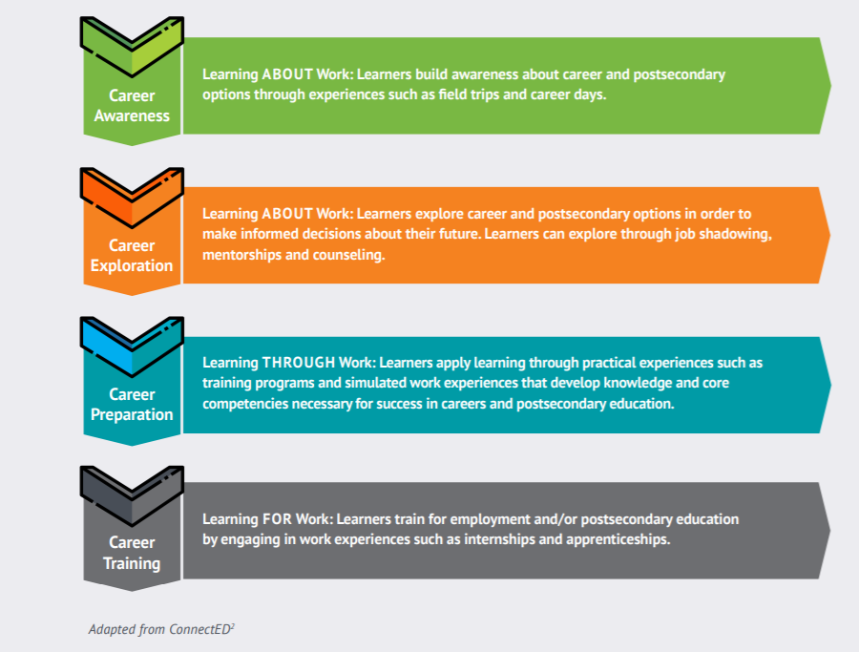
Work-Based Learning (WBL) Continuum
‹#›
Notes:
High-quality work-based learning should begin in the early grades with activities that help build students’ awareness of possible careers. Think Middle School CTE!
This exploration continues through middle and high school with job shadowing and/or mentoring to better inform students’ decision-making and culminates with more intensive career preparation activities such as school-based enterprises, internships and pre-apprenticeships as students move along in their career pathway from high school to postsecondary education.
For many of us from the realm of School Counseling, Work Based Learning is simply the career development theory of Frank Parsons (in the 1940s) coming back to life!
For others in the room, if we think to post world war’s we might remember how the focus was about getting people back to work and re-setting the economy. This is Work Based Learning today too! Really, it is all associated with the economic story of our local and state level communities. How can we grow, thrive and contribute back? That’s WBL and it’s not about being in or only learning in a classroom anymore.
‹#›

Slide 33
[Option Local WBL models and/or SME Guest
Placeholder]
Notes:
As noted earlier in the module, we do encourage welcoming in local Subject Matter Experts (SMEs) or guests like CTE Directors, CTE teachers, current CTE Champion School Counselors or even CTE students to join the training to share perspectives, process and more.
The timing for this one would be great for someone to share about local/state level WBL processes, happenings, options and success stories. Many positions are being formed nationwide for individuals to be WBL Coordinators or community liaisons. A guest like this would be terrific here.

Slide 34
Credentials
A signal for what individuals know and can do
Can be earned in secondary or postsecondary
Precise definitions may vary across states
Types include:
Badges
Degree
Certificates
Industry-recognized credentials
Certifications
Licenses
Notes:
Next up is Credentials
Credentials are the second component of a high-quality program. Credentials serve as a signal for what individuals know and can do, making it easier for employers to find the right candidates for the job. Credentials come in all shapes and sizes, each differing by field of study, the amount of training and education required, and value to employers. Some of these credentials may be earned in high school.
‹#›

Slide 35
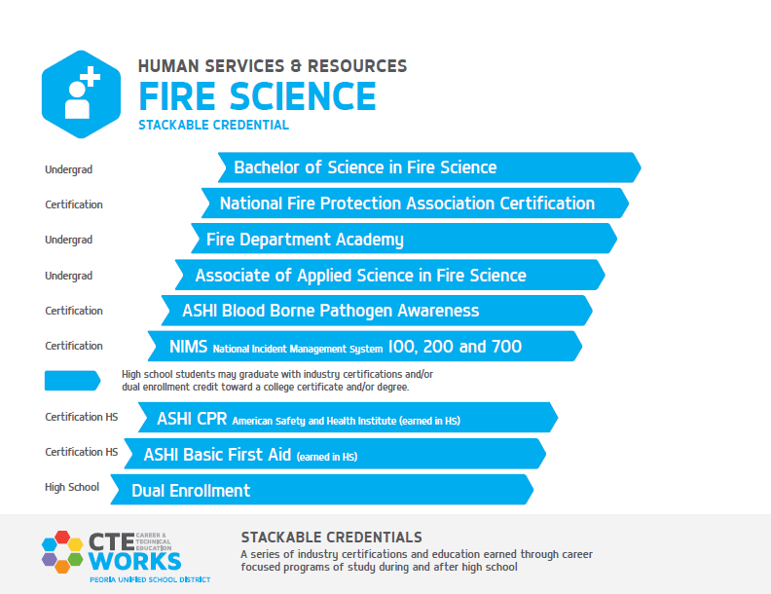
Notes:
This is an example of stackable credentials in Fire Science in Peoria Unified School District in Arizona. Students can begin to earn credentials in high school that offer them opportunities — CPR and first aid — while also taking dual enrollment courses. They continue to earn certifications along the way to an associate degree and ultimately can earn a BA.
You might be thinking of your own model right now. Hold it for the break out time to share!
‹#›

Slide 36
Early Postsecondary Opportunities
Courses and/or exams that give students the chance to obtain postsecondary credit while still in high school.
Types may include:
Dual enrollment/dual credit Articulated credit
Transcripted credit Concurrent enrollment
Dual enrollment fairly prominent in CTE
1.5 million high school students participate
More than 600,00 dual enrollment credits were earned in CTE courses (1/3 of all dual enrollment credits earned)
*NCES Data
Notes:
Early Postsecondary Opportunities or EPSOs are the third component of a high-quality program.
We also commonly (more so) know these possibilities as Concurrent Enrollment or Dual-Enrollment too.
The world of postsecondary opportunities is also growing as students have more opportunities to earn college credits while in high school. This extends beyond the traditional academic areas and includes a significant number of CTE courses. Dual enrollment (or, for some, Concurrent Enrollment) in CTE courses represents a third of all dual enrollment credits earned by students.
There is much variability in policy and practices between states that may incentivize dual enrollment through various funding policies.
You’ll get to share more about your Dual Enrollment or Concurrent Enrollment practices in the break out session coming up.
‹#›

Slide 37
Value of Early Postsecondary Options
Help students realize that they can handle college-level work
Have positive effects on postsecondary degree attainment, college access and enrollment, credit accumulation, high school completion and academic achievement
Are especially relevant for underserved populations, including first-generation college seekers
Save students time and money
https://ies.ed.gov/ncee/wwc/Docs/InterventionReports/wwc_dual_enrollment_022817.pdf
Notes:
The studies on dual enrollment have highlighted the positive effect that it can have in so many areas. Completing a college-level course and receiving college credits can be a life-altering experience for students, bolstering their confidence and empowering them to continue on the journey.
For first-generation college seekers, this is incredibly valuable in launching them on a pathway. Many of our underserved students have never been to a college campus, nonetheless completed a college-level course. Dual enrollment can also cut the length of time to a degree and the costs for learners, too.
‹#›

Slide 38
‹#›
Notes:
This is a visual from Tennessee that demonstrates what a pathway looks like that includes both postsecondary opportunities and industry credentials in a mechatronics program. As you can see there are multiple entry and exit points that provide learners with opportunities to advance in a career.
This image also offers permission to reframe a students academic plan to include the concept of ‘exit’ and ‘entrances’ as well as ‘on-ramps’ or ‘off ramps’ to help families and students understand that their career path is fluid and their skills as transferable.
The message here is also in support of CTE as a way of creating a flowing map of options while in high school and post-high school.
‹#›

Slide 39
[Placeholder: Local SME/ Guest]
Notes:
As noted earlier in the module, we do encourage welcoming in local Subject Matter Experts (SMEs) or guests like CTE Directors, CTE teachers, current CTE Champion School Counselors or even CTE students to join the training to share perspectives, process and more.
The timing for this one would be great for someone to share about local/state level Early Postsecondary Options processes, happenings, options and success stories. Many states have terrific partnerships between community colleges, technical schools and high schools. Many School Counselors identify with the Concurrent Enrollment Role or Dual Enrollment Role AND there also might be inidviuals who are very knowledgeable and passionate about this experience. A guest like this would be terrific here.

Slide 40
Career Technical Student Organizations (CTSOs)
Enhance student learning through contextual instruction, leadership development and personal development
Are an integral component of classroom curriculum
Build on employability and career skills
Provide career development competitive events
Notes:
Last but not least, we have Career Technical Student Organizations or CTSOs which you may be familiar with acronyms like: DECA, FCCLA, FBLA, HOSA, FFA etc.
These co-curricular organizations provide experiential learning and opportunities to network with the business community through competitions, leadership opportunities and business partnerships. There are local, state and national competitive events that provide students “real-world” learning.
CTSO’s are an integrated component of CTE programing not intended to be delivered as an out-of-school club or activity. More like an inter-curricular experience happening in CTE classrooms daily.
The competitive events that happen in CTSOs make for great moments for folks like us to get to know how CTE feels and sounds. We can each serve as evaluators or judges for the competitive events. Our community members can volunteer to do so too and in turn might find the perfect match for one of their job openings or scholarship awardee or internship too. Great connections!
‹#›

Slide 41
National Coordinating Council for Career and Technical Student Organizations
Business Professionals of America (BPA)
DECA
Future Business Leaders of America (FBLA)
National FFA Organization (FFA)
Family, Career and Community Leaders of America (FCCLA)
Future Health Professionals (HOSA)
SkillsUSA
Technology Student Association (TSA)
‹#›
Notes:
Nationally, these are the CTSOs that our CTE programs affiliate with. As noted earlier, each state and even each local school might have alterations of these national organizations.
Raise your hand emoji:
Who here was in one of these CTSOs when they were in high school?
Put in the chat, which one(s)?
Anyone run a different one then listed here? Put in the chat, if so.
Raise your hand emoji again if you have ever served as ‘judge’ or volunteered for any of these COSTO Competitve Events?
‹#›

Slide 42
OPTIONAL Discussion 2: Knowledge Building
OPTION 1:
What questions do you have about the components of a high-quality CTE program?
Is anything confusing or requiring additional local context?
OPTION 2:
What is your greatest gap or challenge in greatest in CTE program delivery or promotion?
What steps can be taken to close that gap?
Notes:
*****Facilitators!
Please feel free to ‘unhide’ this slide to incorporate any of the discussion/reflection/knowledge building questions with your groups. We may suggest utilizing these questions as ‘homework’ items or even collaboration/teamwork items post module completion too.
See Facilitator Guide for more instructions on an activity found in this slide area….

Slide 43
Notes:
Remember, NOW NEW NEXT is a main theme for the session and will guide how we reflect about the information shared and make plans to act on it after the workshop.
NOW indicates a reflective moment around what is in place. NOW is an indicator of what you can quickly recite and would share in the metaphorical ‘elevator’ or ‘sidewalk chat’ or ‘dinner party’ or ‘family reunion’ or ‘water cooler’ etc…..[insert whatever is most culturally relevant for you and/or the group here]
NEW will be the space where something is pulled from today's information. An idea, an initiative, new program implementation. A-Ha’s! New nuggets of knowledge. Big or small, the details that are NEW can live here for reference at the end and into session 2.
NEXT is use for looking to the future. What will you try? What will you implement? What will you take action on? What will you want to learn more about? Who else do you need with you to make it happen? ETC…. Structure and strategy around these ideas will accompany you a the end of the session
Again, let’s pause just as we begin to conclude our training: circle back on your NOW NEW NEXT that we did in the beginning. What changed? What can be added? What is different?
Anyone want to share either any of their now, new or next?! Please do. Come off mute, raise hand, put in chat, circle up in small group, popcorn style share out (try to hear from at least 3 people minimum)
Reference Page 2 of the Worksheet

Slide 44
Activity 1 Revisit
High-Quality CTE
KNOW
WONDER
OPPORTUNITIES
Notes:
‹#›

Slide 45
 | KNOW | WONDER | OPPORTUNITIES
Programs of Study (POS)
Career Clusters
CTSO: Career & Technical Student Organization
Dual Enrollment/ Concurrent Enrollment (early postsecondary opportunities)
Work Based Learning (WBL)
Teacher Recruitment & Retention
Partnerships
Credentials
Diversity, Equity & Inclusion
Notes:
Remember back to your ranking you gave yourself earlier….have attendees rank themselves by level of awareness/understanding in these components NOW using a 1-4 likert scale
If time, have 3-5 attendees share out their growth of knowledge in a component, have them ask a question or relay what they are still curious about and have a few solicit future ideas and opportunities to take into consideration as actions after this module concludes.

Slide 46
More to Consider
Consider exploring the High Quality Framework and think about you would leverage the framework elements in your CTE advocacy:
https://www.acteonline.org/wp-content/uploads/2019/01/HighQualityCTEFramework2018.pdf
From what you now know, what would help you further your advocacy for CTE?
How equitable are access and admission processes for CTE programs in your state?
Are there policy changes/initiative in progress to advance equity?
In what ways would your scheduling or registration processes change or be impacted by the knowledge you have now?
‹#›
Notes:
SLIDE IS HIDDEN. Feel free to unhide and use as deemed best fit.
Please add the High Quality Framework link to the chat: https://www.acteonline.org/wp-content/uploads/2019/01/HighQualityCTEFramework2018.pdf
We won’t be taking too much more time to diver into the framework although we find it beneficial to stay as connected as we can with CTE programming and make our experience here meaningful and productive. After scrolling through the framework and after learning what we’ve gone over in this section, try reflecting on these three questions on the slide and if you want, check out the Guiding Questions in the Handout Hub too. These questions will help with our break out activity forthcoming.
‹#›

Slide 47
OPTIONAL Activity 3: Workbook Page 6
What’s Next?
Choose two (2) of the 4 high-quality indicators: WBL, Credentials, Early Postsecondary Opportunities, CTSOs
Gather insight from colleagues (use prompts on Page 7 of worksheet)
Use a Jamboard or other tracking tool to document
Share out with large group
Notes:
If time permits, we encourage this activity to help culminate new knowledge and sharing of ideas for future action AND helping the group become CTE champions!
Set up the conversations to begin with these prompts:
Share out what you know about these four components. How do they look, sound and feel in your role? (this will feel like conducting a current inventory or status of these 4 components)
What did you learn from others who shared?
In what ways are these components aligned with other processes/initiatives already happening?
What ways do they reflect the best quality programming possible?
*think about this as: what is currently going on and how can you do it better
‹#›

Slide 48
Learning That Works Resource Center
https://www.careertech.org/resource-center
Handout Hub
‹#›
Notes:
Before we conclude for today, please find more information and lots of great borrow-able resources at the Learning the Works Resource Center on Advance CTE’s website
Put the Link in the chat: https://careertech.org/resource-center
Also, you’ll find the Handout Hub in your materials too. If you haven’t already, explore what is in there. We aim to make sure you have what you need to be the best CTE Champion you can and to have this training be as productive and meaningful as possible too.
Put Handout Hub link in chat. It is found in the module folder.
Note the additional page of additional resources and tools on Advance CTE’s homepage. Stay connected to the latest and most up to date reports, initiatives, efforts and more: www.careertech.org
‹#›

Slide 49
Post-Workshop Survey
&
Collective Commitment
(add link or QR code)
Notes:
Survey descriptions is in Facilitator Guide - option to add it to the attendees worksheet.
Collective Commitment is also detailed out in the worksheet. It is not an actual form, more like an option for attendees to keep accountable with their action steps and action planning and take-aways from this training.

Slide 50
Thank You!
Congratulations on beginning to become a CTE Champion!
Insert contact info here:
Insert local resource links here:
Insert next steps or other last thoughts here:
Insert CEU option here:

