Slide 1
Connecting Career Technical Education & Effective Career Advising Practices
Empowering Students through Career Technical Education & Career Advising
Module 4
[ Somewhere - insert state name/location ]
[ Sometime- insert date]
[Someone - insert Facilitator Name]

Slide 2
Welcome
Notes:
Use this slide as a space saver for the CTE State Lead (or State Lead who is the main contact for this training )to kick off the training with introductions, a welcome and/or a kick off statement encouraging folks to stay engaged in the content and know that it is valued.
While attendees are logging in, prompt them to begin introducing themselves in the chat with: Name, Title, School/District Name
If in-person, wait until slide #5 for introductions of attendees.

Slide 3
Pre-Workshop Survey
[Insert link or QR code here]
Notes:
Instructions in Worksheet for attendees to follow.
See Facilitator Guide for recommendations.

Slide 4
Community Agreements
(see module worksheet)
Notes:
These are a list of norms for attendees to interact with one another, set as the norm for either in-person or virtual trainings - in fact, it was originally designed as a list for virtual training environments.
Optional slide for Facilitators: Knowing that you likely know your audience best, utilize this sample list of training norms, edit and add/delete accordingly. Also apply what norms/agreements are best for in-person or virtual training environments.
The list is hyperlinked in the training worksheet listed in the module folder.

Slide 5
Introductions
In the spirit of career development and future planning, finish this sentence in chat:
“When I was a young person, I aspired to become…”
Notes:
While we gather and attendees trickle in...remind them to introduce themselves in the chat with their Name, Title (mention grade level if relevant), School/District Name
Since we will be talking about Career Development today, share with the group what you wanted to be when you were a younger person (10 or 12 years old or so).
We try to no longer use the old adage with students: What did you want to be when you grow up? We want to honor that career development is lifelong and we aren’t ever fully grown up :)
Modeling aspiration, reflection and maybe humor (potentially even validation of folks becoming what they aspired to be, or how it can change to new opportunities) do a quick synopsis of what people put in the chat. See if anyone wants to go off mute and share more about their aspiration. Anyone find anything surprising?
This is a great guiding question for when you take this training experience back to more of your colleagues. Since many of you will be the ‘messenger’ for career development, this question helps folks/x feel more at ease with the topic.

Slide 6
Learning Objectives
Gain knowledge on effective career advising strategies, resources and processes to empower students to explore future career options, and evaluate against current work;
Increase familiarity with Individual Learning Plans (ILPs), their value to career advising and navigation for students and various implementation models at scale at the local and state level
Develop a mindset that reflects the thinking that a successful career advising and development system must respond to students’ interests and provide career awareness and exploration for each student — not just those enrolled in CTE.
Help foster a seamless career advising and development continuum from elementary through postsecondary; including wraparound services, accelerated learning strategies, guided pathways and connections with local employers to ensure smooth transitions into the labor market.
Notes:
Advance CTE paired down each module to reflect 5 or less learning objectives. As a facilitator, you may add more if you know you want to with your training group. Double check that these objectives match or align to those listed in the facilitator guide for this module.
**Pro-Tip: animate each bullet point so to emphasize each objective with attendees - less text on the screen at first.
*If you feel so inclined, feel free to take a long pause once done with the last objective and ask attendees: What learning objective would you add to this list because it is a learning moment you hope to gain today?

Slide 7
Notes:
NOW NEW NEXT is a main theme for the session and will guide how we reflect about the information shared and make plans to act on it after the workshop.
Call out the worksheet. We will reference NOW NEW NEXT at least twice in this module.
NOW indicates a reflective moment around what is in place. NOW is an indicator of what you can quickly recite and would share in the metaphorical ‘elevator’ or ‘sidewalk chat’ or ‘dinner party’ or ‘family reunion’ or ‘water cooler’ etc…..[insert whatever is most culturally relevant for you and/or the group here]
NEW will be the space where something is pulled from today's information. An idea, an initiative, new program implementation. A-Ha’s! New nuggets of knowledge. Big or small, the details that are NEW can live here for reference at the end of the module.
NEXT is use for looking to the future. What will you try? What will you implement? What will you take action on? What will you want to learn more about? Who else do you need with you to make it happen? ETC…. Structure and strategy around these ideas will accompany you a the end of the module
Again, we’ll be revisiting during NOW NEW NEXT conversation at the conclusion of this module.

Slide 8
Notes:
Put the link in the chat:
A Shared Vision | Advance CTE (careertech.org)
Include the link for attendees to access or navigate away from this slide to the webpage to explain this section and the next slide too:
A Shared Vision | Advance CTE (careertech.org)
Without Limits: A Shared Vision for the Future of Career Technical Education (CTE Without Limits) puts forth a bold vision for a cohesive, flexible, and responsive career preparation ecosystem that will close equity gaps in educational outcomes and workforce readiness, and leverage CTE as a catalyst for ensuring each learner can reach success in the career of their choice.
Developed with input from nearly 200 national, state and local education and workforce development leaders and supported by 42 national organizations, CTE Without Limits lays out five inter-connected and equally critical principles:
Each learner engages in a cohesive, flexible, and responsive career preparation ecosystem
Each learner feels welcome in, is supported by, and has the means to succeed in the career preparation ecosystem
Each learner skillfully navigates their own career journey
Each learner’s skills are counted, valued, and portable
Each learner can access CTE without borders
CTE Without Limits is ambitious and forward looking. It puts equity at the center and recognizes that our country needs a CTE system that works for each learner, wherever they are in their career journey and whatever their background.
This vision is not just calling for updates to our CTE, education and workforce systems. Rather, it is calling for a more cohesive, flexible and responsive career preparation ecosystem, with CTE at its nexus, that draws on the capacity of each existing system; leverages these systems’ greatest assets; and pushes for new models of collaboration, learner-centric design and delivery, funding and accountability that create the right incentives and supports.
Only through shared commitment and shared ownership among leaders and practitioners at all levels can we realize the possibility and aspiration of a new career preparation ecosystem that provides each learner with limitless opportunity.
Each learner must have access to and the means to be successful in the career of their choice and will require:
All systems working in concert
A commitment to tearing down the barriers that limit opportunity
CTE to serve as the catalyst to make this vision a reality

Slide 9
Speakers
Explore more by visiting: https://careertech.org/without-limits
Notes:
Take a moment to reiterate the 5 principles of the CTE Without Limits vision.
If applicable to your audience, ask which principle stands out to them the most, which one seems the easiest/hardest, which one(s) are they already doing, etc….

Slide 10
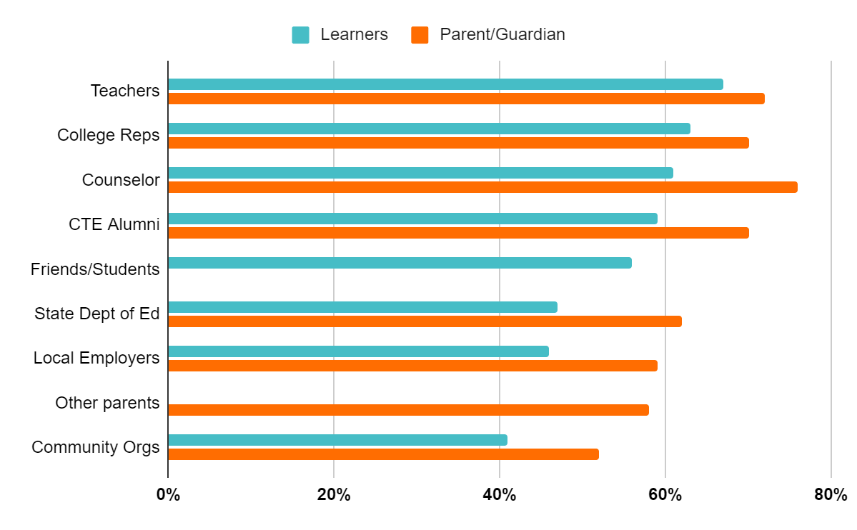
School Counselors Top Source for Information
67% - #1 Learners
76% - #1 Parent/Guardian
Notes:
AS A FRIENDLY REMINDER…..School Counselors are the top trusted messengers for students and families when it comes to conveying information about CTE.
We will review more about the survey in this workshop, but the reason for the development of this specific training is because of this finding: We learned that school counselors and teachers are the most trusted source of information about CTE for students and parents.
Let’s say that outloud again!
YES! What a useful and helpful finding!
Yet it seemed, through this national survey, that school counselors needed support in how to speak about CTE and career advising strategies.
Advance CTE and Siemens discussed strategies for activating school counselors to have an impact on as many counselors throughout the country as possible. The goal was to create an off-the-shelf training in partnership with ASCA and ACTE and guided by the input of an advisory committee. The advisory committee consisted of members of ASCA and ACTE as well as a few State CTE Directors, State Directors of School Counseling, and national experts in school counseling and career development. The members had the opportunity to weigh in and make recommendations throughout the development of the training. The training was first completed in 2019 and updated in 2021. Now here we are in 2022 at it again! Kudos to you each for being a part of this.
‹#›

Slide 11
Our Role
Personal interests/aspirations/aptitudes + Competencies/Skills +
Being informed on where/what
= CTE Champion!
Notes:
The formula for becoming a CTE champion involves the following:
When we help our students/learners get to know their own personal interests, future aspirations and understand their aptitude for future work paired with the competencies and skills they may already have or gain as they continue along their education and employment journeys paired again by knowing what their opportunities for career success in their state, community or anywhere.
When these three areas are focused on with EACH student/learner then that makes us a CTE Champion who remains in touch with economic needs, labor market resources, CTE happenings and changes.
CTE Champions also maintain good connections and collaboration with CTE educators and leaders.
CTE Champions also do not have to be the experts on specific career areas although they DO need to know who does
CTE Champions check their bias at the door. CTE Champions know just enough of CTE logistics, compliance and requirements to be official AND keep apprised of programming, economic, industry (hot jobs) changes. CTE Champions see EACH student as an individual pathway participant, supporting EACH learner obtain what learning and experience fits them best.
How would you describe a CTE Champion?
Are you looking forward to this title?

Slide 12
MYTH FACT
Fact
CTE provides a seamless pathway to postsecondary education.
Myth
Only non-college-bound students take CTE classes.
Nearly every state reports higher graduation rates for CTE concentrators compared to all students
72% of CTE concentrators enroll in postsecondary education full time immediately after graduating
CTE students have many opportunities to earn college credit in high school through dual and concurrent enrollment
http://s3.amazonaws.com/PCRN/docs/NACTE_FinalReport2014.pdf
Notes:
‹#›

Slide 13
MYTH FACT
Myth
CTE is jobs training
Fact
CTE empowers learners to explore multiple career options
CTE programs of study start broad before providing career pathway-specific knowledge and skills
CTE provides hands-on training, mentoring and internships to expand professional networks
85% of CTE families are satisfied with their ability/their students ability to explore careers compared to 54% of families not in CTE.
https://cte.careertech.org/sites/default/files/AdvanceCTE_CommResearchReport_042721.pdf
Notes:
‹#›

Slide 14
Why is providing career information to students and families important?
How should it be used to inform student exploration and planning?
What strategies are you currently using to provide career information and planning support?
Discussion #1
Notes:
Chat, come off mute, quick small group breakout
Turn to a neighbor, think/pair/share in mini group of 3-4
Use sticky notes to respond, put on chart paper
Use Jamboard for virtual sticky notes - two separate boards.
Other annotation ideas

Slide 15
The State of Career Technical Education: Career Advising and Development
Need for information on effective state-and school-level strategies for career advising and development
Advance CTE partnered with ASCA to conduct survey research
Responses from 45 State CTE Directors, 10 state school counseling directors and 647 school counselors
School counselors from all 50 states and District of Columbia, as well as all grade levels
Notes:
We’ve generated a long list of strategies used.
And one of the questions we may have is: do we know how effective these strategies are?
Maybe you have a method of collecting data to assess the effectiveness of your career advisement activities, but for the most part there is a lack of research on the efficacy of many of the strategies currently used by counselors and advisors.
To get more information about career advising strategies and their effectiveness, Advance CTE partnered with the American School Counselor Association (ASCA) to conduct three surveys to ascertain more information about effective career advising strategies at the state and local levels. Advance CTE surveyed State CTE Directors, and ASCA sent separate surveys to a selection of school counselors and to State School Counseling Directors in states where that role has been specifically identified. The surveys provided invaluable insight into what is happening related to career advising and development at the state and local levels and revealed some interesting barriers and promising strategies. You have a copy of this report in your materials found in the Handout Hub today.
Check out some of the findings! - go to next slide -
‹#›

Slide 16
Report Findings
There was a major disconnect in state and local responses
Few states believe their systems are fully aligned throughout K-12
Career advising and development efforts are much more common at the high school level
Effectiveness of strategies is a ‘mixed bag’
‹#›
Notes:
Here are some of the major findings from the report. Respondents were asked to identify strategies used along with their perceived effectiveness. There were major disconnects between state and local perceptions of effectiveness.
Bulleted points are animated on ‘click’
‘a mixed bag’ is a reference for describing a situation or a group of things containing some good items, features, or people and some bad ones.
‹#›

Slide 17
Report Findings (cont’d)
58 percent of states rate their state systems as only somewhat effective in their career advising and development efforts.
Most frequently used strategy is conducting inventories with students to identify their interests, skills and abilities
The most effective strategies are not the most used.
‹#›
Notes:
Not surprising, the most frequently used strategy by counselors in conducting interest inventories. Curiously, though, the most used strategies were not identified as being the most effective.
‹#›

Slide 18
Most Effective/Least Used
Connecting students with CTE coursework and career pathways as a career advising and development strategy
Providing or facilitating work-based learning experiences for students
Engaging and partnering with industry and community
‹#›
Notes:
While these strategies that are core to CTE are considered the most effective, regrettably they are the least used.
For example, the report indicated that providing facilitated opportunities for students to participate in work-based learning; providing experiential learning opportunities; and engaging or partnering with industry and community partners are all things that are already happening as part of CTE programs. These are seen as more effective strategies than things that can potentially be a bigger lift on you, such as creating career days/fairs or working with teachers to integrate career readiness in the curriculum.
It’s important to get some more information regarding why they are underused as these can potentially have a much wider impact on students if implemented.
‹#›

Slide 19
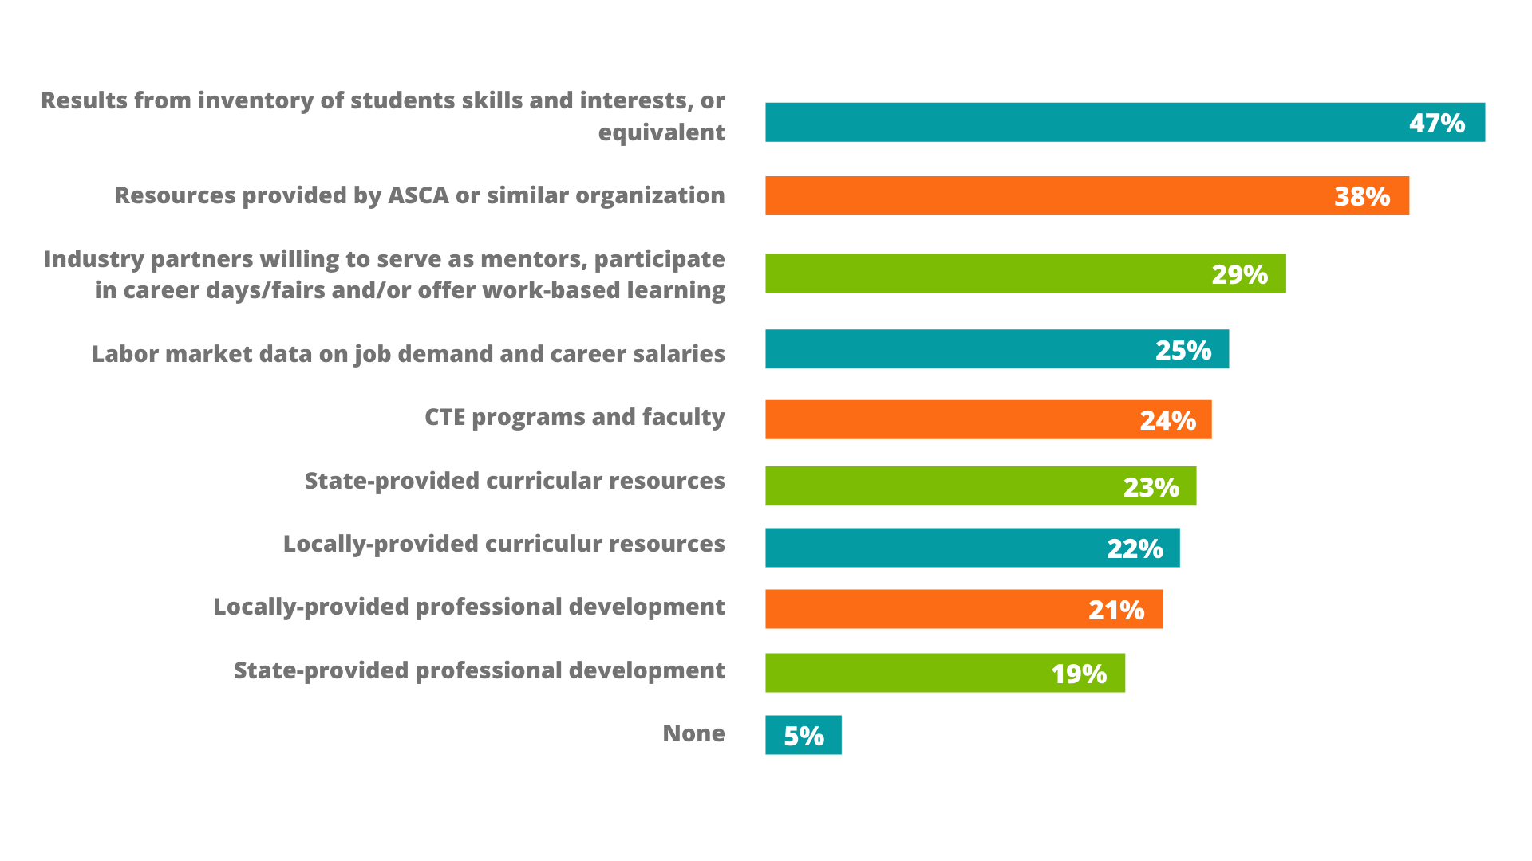
What Resources Do You Use to Support Career Development Efforts?
Notes:
Additionally, school counselors need more resources they’re not always getting from the state level to implement career counseling strategies. As clearly seen here, interest and skill inventories are the most used resource with a need for more comprehensive professional development for everyone.
‹#›

Slide 20
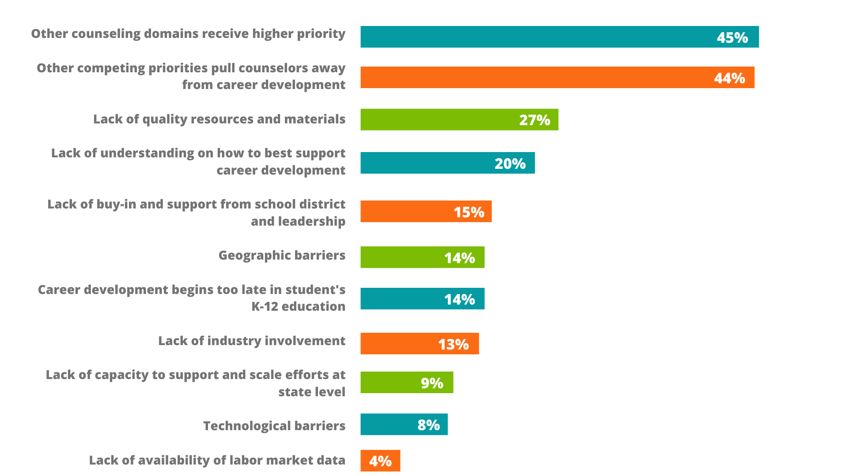
What Barriers Do You Face in Providing Effective Career Development Services?
Notes:
This is a very telling finding as well.
School counselors identified significant challenges to implementing career counseling strategies. Do you find it surprising that counselors indicate that there is much less focus on the “career” domain in school counseling? *pause for the answer - either in chat, thumbs up or down emoji.*
It often, at least pre-pandemic, viewed as the least important of the other School Counselor domains of social-emotional” and “academic” development. Post-pandemic, we may find our School Counselors (as well as additional staff) are focused heavily on social/emotional and meaningfully integrating career and academic. Are you seeing this shift and focus too? *pausse for the answer - either in chat, thumbs up or down emoji, raise hand for ‘off mute’ to share.
‹#›

Slide 21
Recommendations
Provide more effective professional development and resources to school counselors
Ensure that career advising and development is a school- and community-wide effort
Explore partnerships between secondary and postsecondary systems and institutions to both gather more data on existing strategies and implement new strategies as appropriate
Examine and improve current career advising and development strategies so that they are all part of one broad, cohesive strategy
‹#›
Notes:
This is what the report recommends and we share it now so to perhaps provide some strategies and ideas that resonate with you and your school cultures too.
*bulleted points are animated on a ‘click’
Provide more effective professional development and resources to school counselors and establish feedback loops to ensure that the professional advising and development is having its intended impact
Ensure that career advising and development is a school- and community-wide effort, with effective coordination between school counselors and school administration and active participation from classroom instructors and community organizations
Exploring partnerships between secondary and postsecondary systems to gather data and implement new strategies as well as working toward a broader more cohesive system is also essential.
Examine and improve current career advising and development strategies so that they are all part of one broad, cohesive strategy designed to guide all learners effectively to the careers of their choice
‹#›

Slide 22
Notes:
NOW NEW NEXT is a main theme for the session and will guide how we reflect about the information shared and make plans to act on it after the workshop.
Call out Workbook page 1. We will reference this page throughout our time together.
NOW indicates a reflective moment around what is in place. NOW is an indicator of what you can quickly recite and would share in the metaphorical ‘elevator’ or ‘sidewalk chat’ or ‘dinner party’ or ‘family reunion’ or ‘water cooler’ etc…..[insert whatever is most culturally relevant for you and/or the group here]
NEW will be the space where something is pulled from today's information. An idea, an initiative, new program implementation. A-Ha’s! New nuggets of knowledge. Big or small, the details that are NEW can live here for reference at the end of the module.
NEXT is use for looking to the future. What will you try? What will you implement? What will you take action on? What will you want to learn more about? Who else do you need with you to make it happen? ETC…. Structure and strategy around these ideas will accompany you a the end of the module
Again, we’ll be revisiting during NOW NEW NEXT conversation at the conclusion of this module.

Slide 23
Discussion 2
Which of these recommendations would be of value to your school/community and would help address potential gaps in your local career development system?

Slide 24
Key Recommendation
Improve the effectiveness of Individual Learning Plans (or equivalent) by:
Scaling up innovative practices, including having students begin them in middle school, and
Working with school counselors to ensure that Individual Learning Plans are integrated into a broader career development process
Notes:
Some of us may find this recommendation very exciting!
Individual Learning Plans (or ILPs) have been identified as a tool that can be leveraged to support MEANINGFUL AND developmental PERSONAL, academic and career advisement for each student. There is much opportunity to have systemic change when states implement such a system. These may have different names in different states — Individual Career and Academic Plans, Individual Graduation Plans, Student Success Plans, etc. — but fundamentally these are intended to guide a student in making informed personal, educational and career plans.
‹#›

Slide 25
Individual Learning Plans (ILP) as a Career Advising Tool
Academic and career planning tool
Known by Individual Career and Academic Plan (ICAP) and other terms
Used in 38 states, but mandated for all students in only 21 states (U.S. Department of Labor)
Varied effectiveness
Disconnect between state and local levels
Value in beginning plans in middle school
Need to engage parents, guardians and teachers
Notes:
We are going to spend a little time discussing Individual Learning Plans since this has really been identified as a potential area that could impact career development systemically. These plans can be used as an academic and career planning tool and their use varies in states.
With an emoji of your choosing, please share how you FEEL about your state’s ILP (or whatever you call it)? *this will be an entertaining way of gaining a temperature of the groups attitude towards ILPs :)
‹#›

Slide 26
Individual Learning Plans (ILP) as an Effective Career Advising Tool
ILP’s can be used more effectively by:
Beginning them in middle school
Including them as part of a wider conversation and process
Being clear and strategic about connections to career pathways and CTE opportunities
Notes:
Here’s a little bit of ILP research. Individual Learning Plans ibase a change theory on the establishment of career and life goals being the change mechanism that leads to improved academic outcomes and postsecondary completion rates. Research on goal-setting has suggested that developing self-defined career and life goals is an important mechanism that enables youth to have choices and results in their proactively seeking out their own learning pathways as they pursue those choices.
Quality Individual Learning Plan implementation from a caring and encouraging adult helps learners establish career and life goals. Often times these caring and encouraging adults are NOT JUST School Counselors, rather any staff member in the building or community even.
Some cool positive data stories form effective ILPs:
Education becomes perceived as more meaningful and relevant to helping them achieve those goals.
Learners pursue more rigorous education and work-based learning opportunities.
Increased academic performance, postsecondary completion rates, higher wage earnings and overall life satisfaction.
‹#›

Slide 27
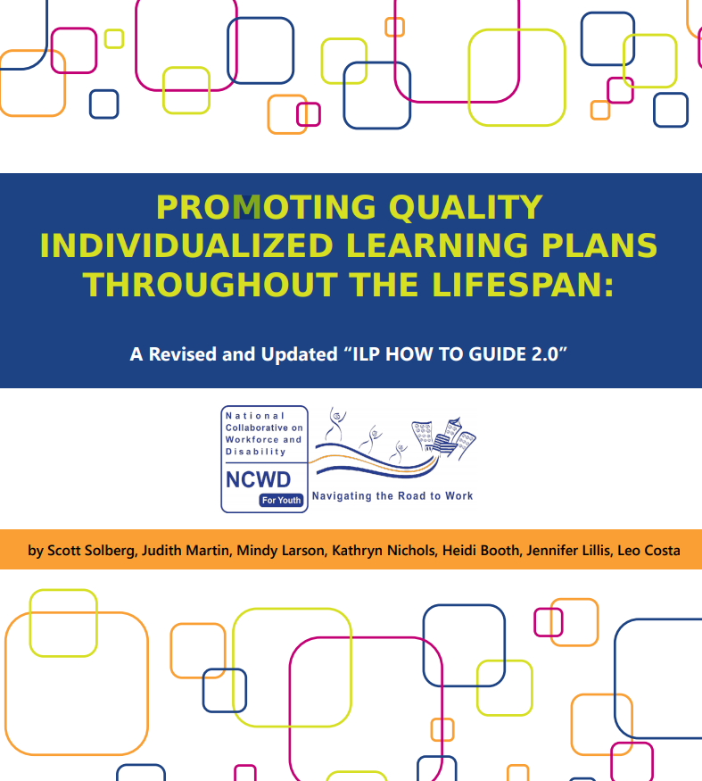
Resource: Implementing Individual Learning Plans
http://www.ncwd-youth.info/wp-content/uploads/2018/03/Promoting-Quality-ILPs-Throughout-the-Lifespan-WEB.pdf
Notes:
If you haven’t scanned through this yet, This document is an incredible resource with much information on Individual Learning Plans as well as links to many other career advisement tools.
Put the link in chat: http://www.ncwd-youth.info/wp-content/uploads/2018/03/Promoting-Quality-ILPs-Throughout-the-Lifespan-WEB.pdf
It can also be found in the Handout Hub.
‹#›

Slide 28
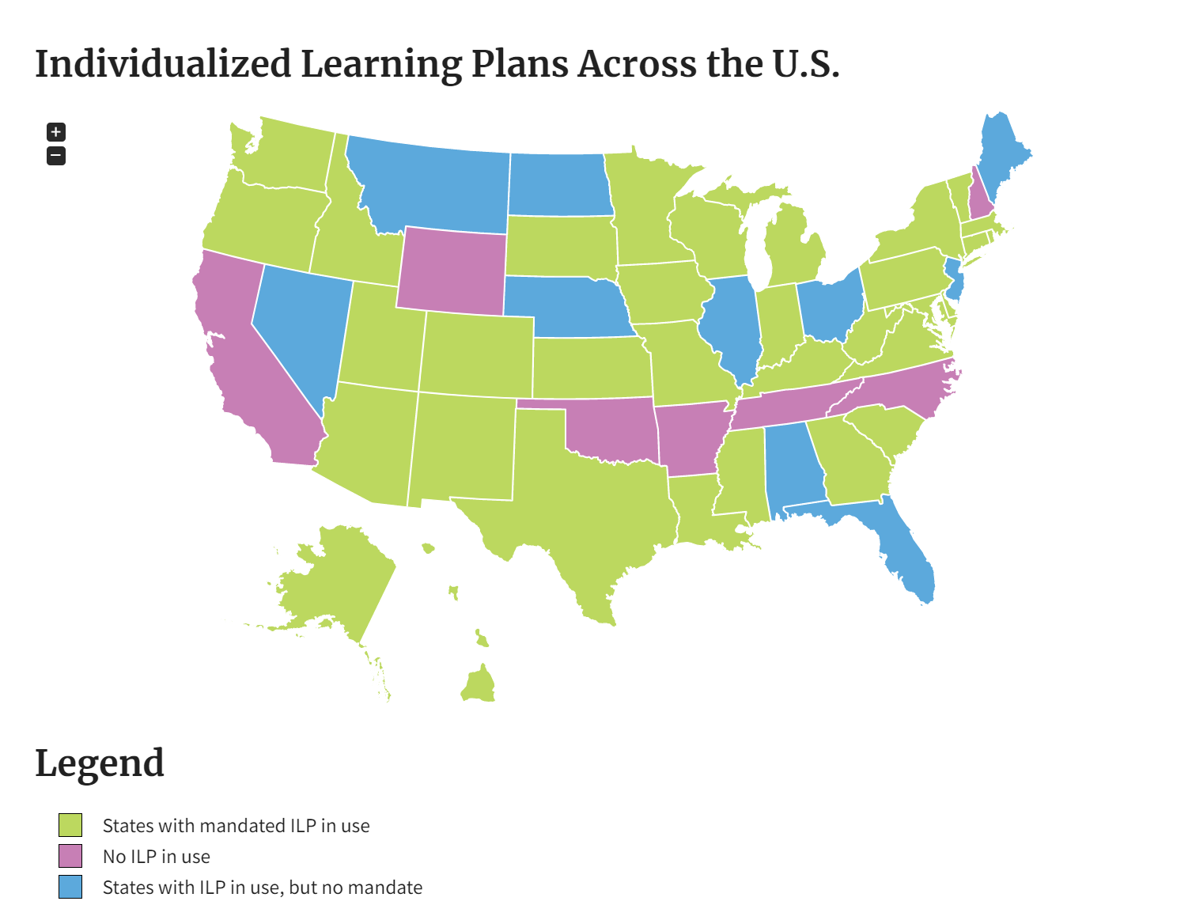
Notes:
We are going to spend a little time discussing Individual Learning Plans since this has really been identified as a potential area that could impact career development systemically. These plans can be used as an academic and career planning tool and their use varies in states.
With an emoji of your choosing, please share how you FEEL about your state’s ILP (or whatever you call it)? *this will be an entertaining way of gaining a temperature of the groups attitude towards ILPs :)
‹#›

Slide 29
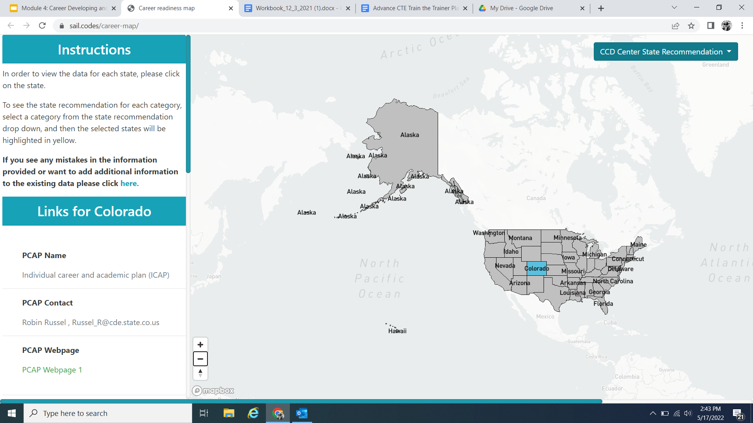
Coalition for Career Development National Interactive Map on Career Readiness Components
Notes:
https://sail.codes/career-map/

Slide 30
State Placeholder
[Placeholder to add state/local information on how ILPs/ICAPs are administered in your state/local level]

Slide 31
ILP Brief - November 2021
Notes:
https://careertech.org/resource/implementing-individual-career-academic-plans

Slide 32
Key Points
Completing a meaningful ICAP process helps learners connect the relevance of education with their career and life goals and select a postsecondary pathway and create academic course plans that support their goals.
When learners are exposed to career pathways, work-based learning and early college experiences through the ICAP process, they are able to think more deeply about their goals earlier and may be more inclined to choose career pathways.

Slide 33
Key Points
ICAPs provide the opportunity for learners to have meaningful conversations and develop relationships with supportive adults, making ICAPs a critical tool to ensure equity in the career development process
Developing a culture of career readiness is necessary to ensure a district and school-wide approach to implementing ICAPs.

Slide 34
Discussion 3
When reflecting on ILPs in action:
What does a Career-Focused Classroom look like?

Slide 35
State and Local Models
Kansas
Massachusetts state and local (Boston)
Iowa
Colorado

Slide 36
Kansas
Model: Career Development Process

Slide 37
Kansas ILPs
https://www.ksde.org/Agency/Division-of-Learning-Services/Career-Standards-and-Assessment-Services/Content-Area-F-L/Individual-Plans-of-Study-IPS-Student

Slide 38
Kansas ILPs
https://www.ksde.org/Agency/Division-of-Learning-Services/Career-Standards-and-Assessment-Services/Content-Area-F-L/Individual-Plans-of-Study-IPS-Student

Slide 39
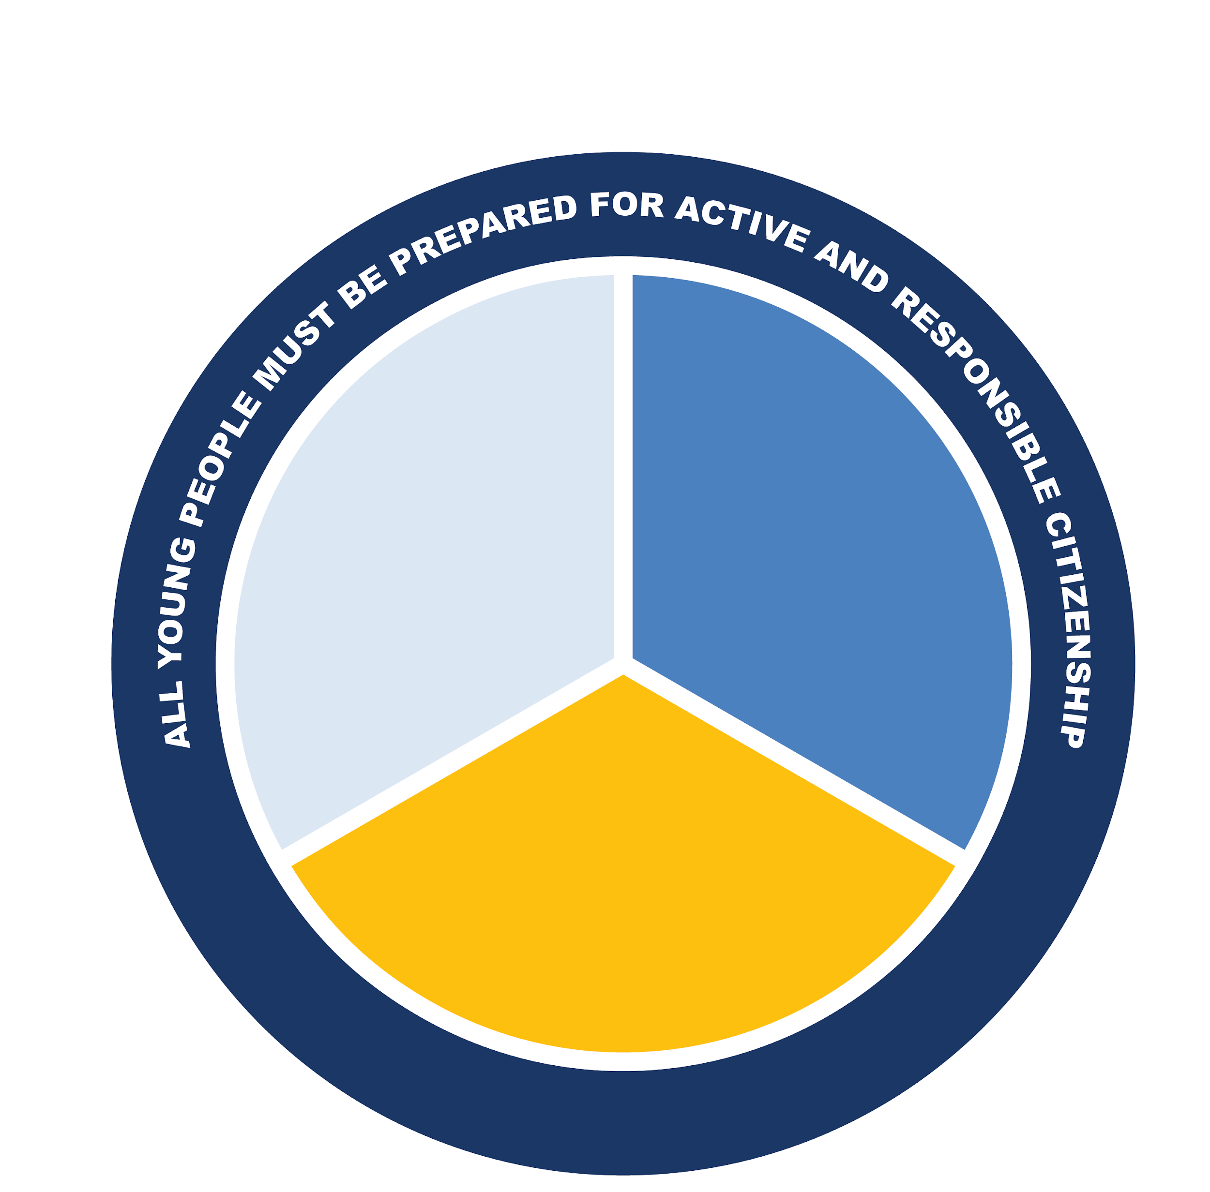
Massachusetts:
College, Career and Civic Ready (CCR)
Who Am I? Personal/Social Domain
Where Am I Going? Career Development
How Do I Get There? Academic and Postsecondary Planning (MyCAP)
Workplace
Readiness
Academic
Learning
Knowledge, Skills, and Experiences for College and Career Readiness, & Civic Preparation
Personal/Social Development

Slide 40
MyCAP Process: CCR Scope and Sequence
Three domains identified in the CCR definition
Each domain is developed for students at every grade level:
Learning Objectives that describe what students should know and be able to do
MyCAP Artifacts will document the learning/skill development, activities, reflections, etc.
Unit Lessons, Strategies and/or Activities
DOMAINS | Learning Objectives | Artifacts/ Assessments | Lesson Plans/ Activities
Personal/ Social
Career Development
Academic, Career and Postsecondary Planning

Slide 41
Creating a MyCAP System
MyCAP team: at least 4-6 from multiple roles: counselor, gen ed teacher, sped/EL teacher, CTE teacher, administrator, etc.
Map CCR Landscape: what do we have, where are there gaps?
Identify Learning Objectives: each domain, every grade
4. Artifact(s): What will be collected, presented, or assessed to demonstrate achievement of learning objectives?
5. Create Lessons: where will they happen, who is leading, what are the key activities
6. Create an implementation plan and gain buy in

Slide 42
Iowa - Individual Career and Academic Plans
Five Essential Components the ICAP must cover: (IA Code 281-49.4(1-5))
Self-Understanding
Career Information
Career Exploration
Postsecondary Exploration
Career and Postsecondary Decision

Slide 43
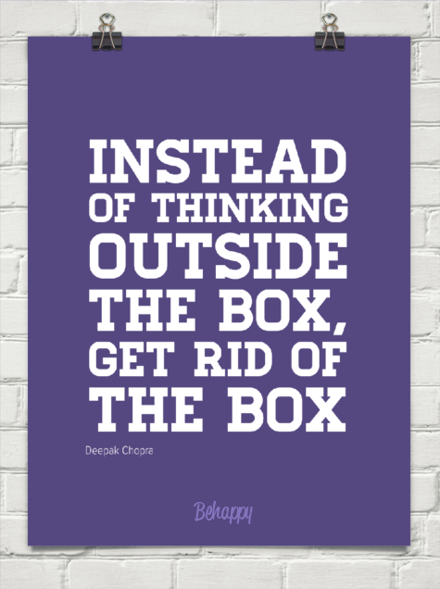
Iowa - Individual Career and Academic Plans
ICAP = Action Verb
= One is always ICAP-ing
= One is never done being ICAP-ed
Continue to create holistic and authentic opportunities for students and faculty/staff.
*borrowed concept/model from Colorado ICAP: Individual Career and Academic Plan (ICAP) | CDE (state.co.us)

Slide 44
Colorado
Model: Meaningful Career Conversations
http://www.cde.state.co.us/postsecondary/pwrplaybookmeaningfulcareerconversations
Notes:
http://www.cde.state.co.us/postsecondary/pwrplaybookmeaningfulcareerconversations

Slide 45
Colorado: Meaningful Career Conversations
https://www.schoolcounselor.org/Publications-Research/Publications/Free-ASCA-Resources/Career-Conversation-Starters
Notes:
https://www.schoolcounselor.org/Publications-Research/Publications/Free-ASCA-Resources/Career-Conversation-Starters

Slide 46
Activity 1: Worksheet Page 4
Identify one strategy that you are currently using for career advising/development.
What would you love to have in place but isn’t there yet? What is your ‘stretch goal”?
How can you help students make connections between their schoolwork and career fields?
Notes:
Prompt attendees to answer in the workbook
Next they should reflect on a stretch goal since this is what we’ll try to ‘reach’ for in the Strategic Action Plan
They should be prepared to share this with (your choice of an) annotation tool on the next slide.
‹#›

Slide 47
Notes:
Remember, NOW NEW NEXT is a main theme for the session and will guide how we reflect about the information shared and make plans to act on it after the workshop.
NOW indicates a reflective moment around what is in place. NOW is an indicator of what you can quickly recite and would share in the metaphorical ‘elevator’ or ‘sidewalk chat’ or ‘dinner party’ or ‘family reunion’ or ‘water cooler’ etc…..[insert whatever is most culturally relevant for you and/or the group here]
NEW will be the space where something is pulled from today's information. An idea, an initiative, new program implementation. A-Ha’s! New nuggets of knowledge. Big or small, the details that are NEW can live here for reference at the end and into session 2.
NEXT is use for looking to the future. What will you try? What will you implement? What will you take action on? What will you want to learn more about? Who else do you need with you to make it happen? ETC…. Structure and strategy around these ideas will accompany you a the end of the session
Again, let’s pause just as we begin to conclude our training: circle back on your NOW NEW NEXT that we did in the beginning. What changed? What can be added? What is different?
Anyone want to share either any of their now, new or next?! Please do. Come off mute, raise hand, put in chat, circle up in small group, popcorn style share out (try to hear from at least 3 people minimum)
Reference Page 2 of the Worksheet

Slide 48
Learning That Works Resource Center
https://www.careertech.org/resource-center
Handout Hub
‹#›
Notes:
Before we conclude for today, please find more information and lots of great borrow-able resources at the Learning the Works Resource Center on Advance CTE’s website
Put the Link in the chat: https://careertech.org/resource-center
Also, you’ll find the Handout Hub in your materials too. If you haven’t already, explore what is in there. We aim to make sure you have what you need to be the best CTE Champion you can and to have this training be as productive and meaningful as possible too.
Put Handout Hub link in chat. It is found in the module folder.
Note the additional page of additional resources and tools on Advance CTE’s homepage. Stay connected to the latest and most up to date reports, initiatives, efforts and more: www.careertech.org
‹#›

Slide 49
Post-Workshop Survey
&
Collective Commitment
(add link or QR code)
Notes:
Survey descriptions is in Facilitator Guide - option to add it to the attendees worksheet.
Collective Commitment is also detailed out in the worksheet. It is not an actual form, more like an option for attendees to keep accountable with their action steps and action planning and take-aways from this training.

Slide 50
Thank You!
Congratulations on beginning to become a CTE Champion!
Insert contact info here:
Insert local resource links here:
Insert next steps or other last thoughts here:
Insert CEU option here:

