Slide 1
WV Career Technical Initiatives
Simulated Workplaces & in|site (an easy button)
Dr. Kathy D’Antoni
Assistant State Superintendent of Schools
West Virginia Department of Education

Slide 2
REALITY CHECK
Employers comments on preparing students for success in the workplace.

Slide 3
DECISION MADE
CHANGE THE CULTURE OF CAREER TECHNICAL EDUCATION

Slide 4
SIMULATED WORKPLACES

Slide 5
BUSINESS PROCESSES AND ENVIRONMENT

Slide 6
ADDITIONAL COMPONENT
TECHNICAL TEAMS

Slide 7
ANNOUNCING in|site

Slide 9
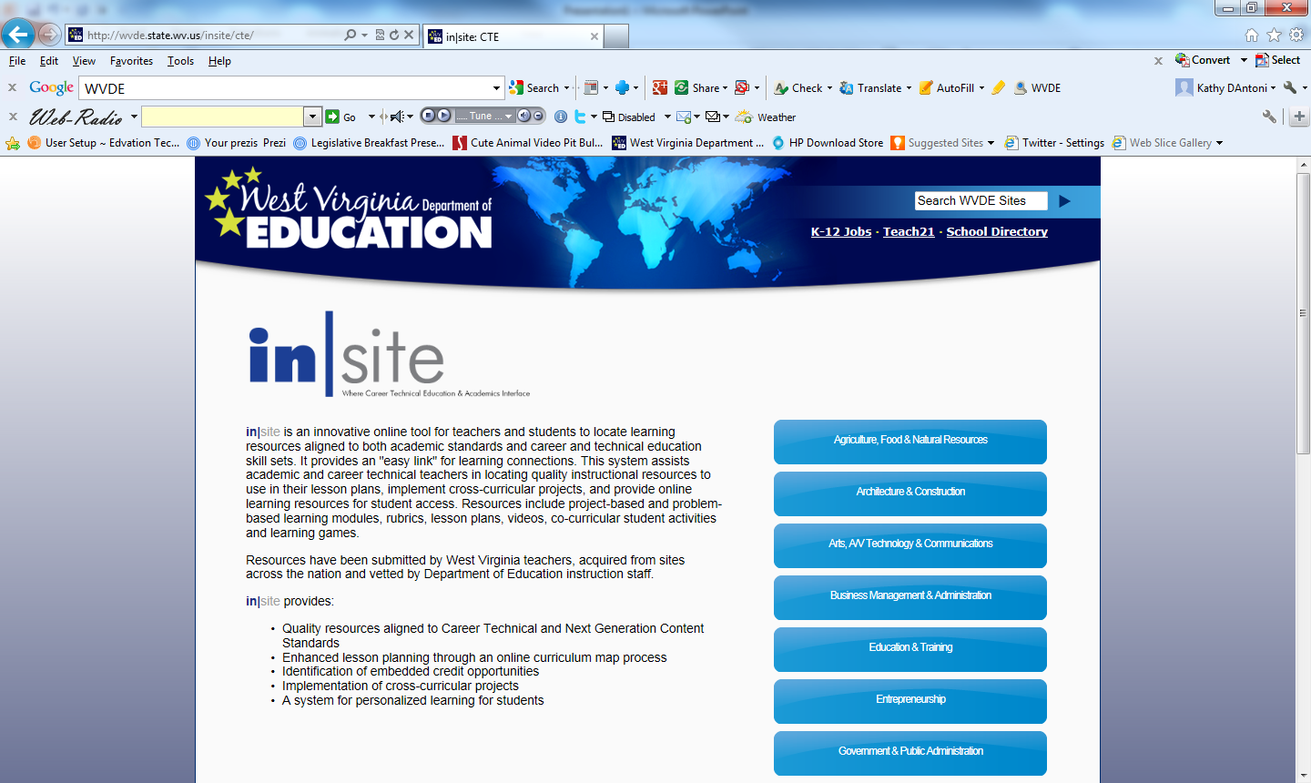

Slide 10
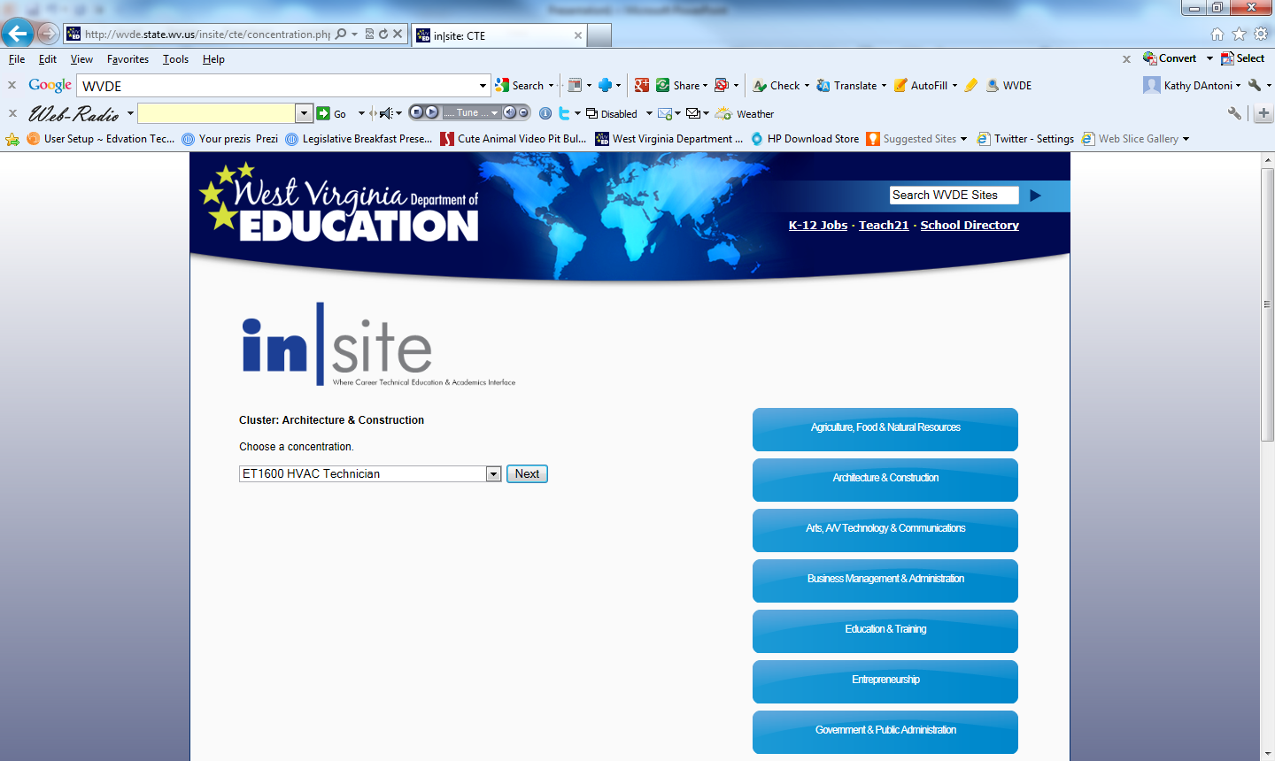

Slide 11
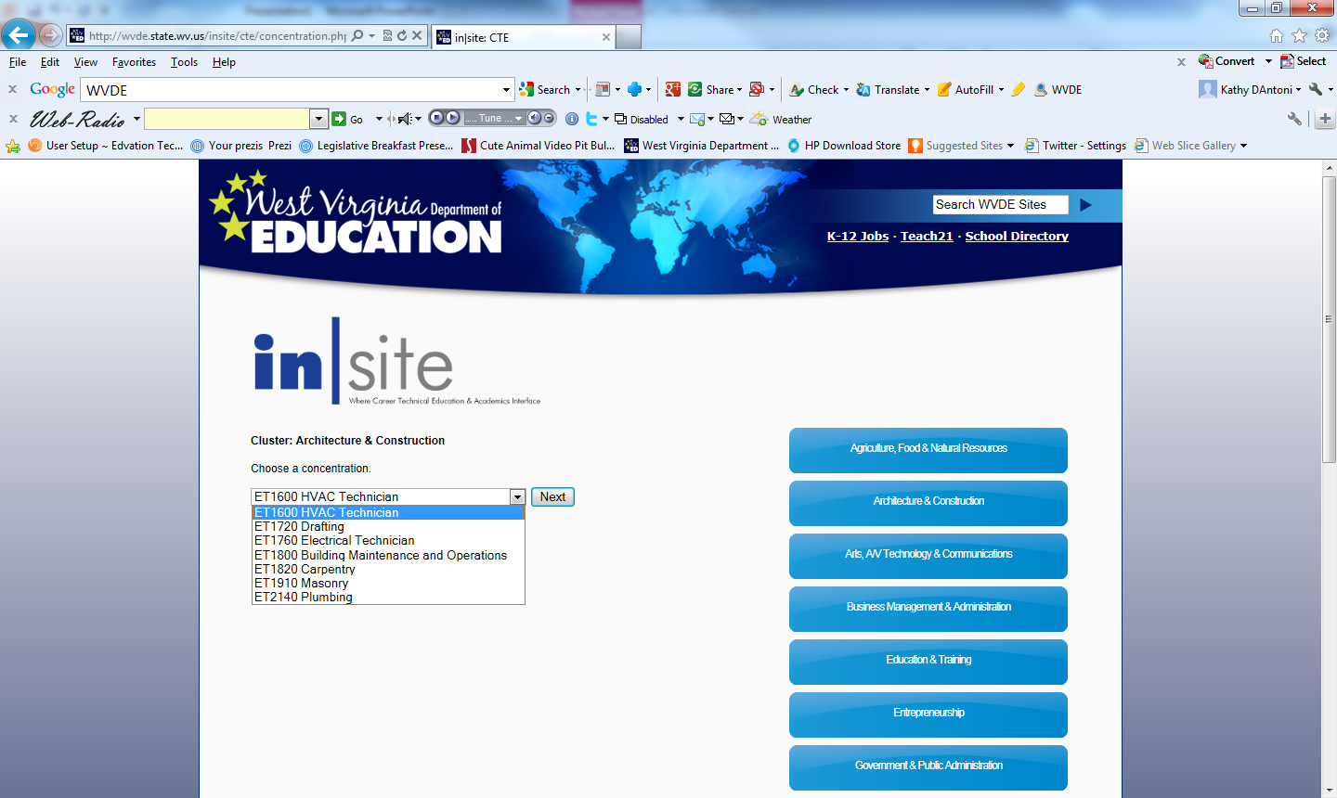

Slide 13
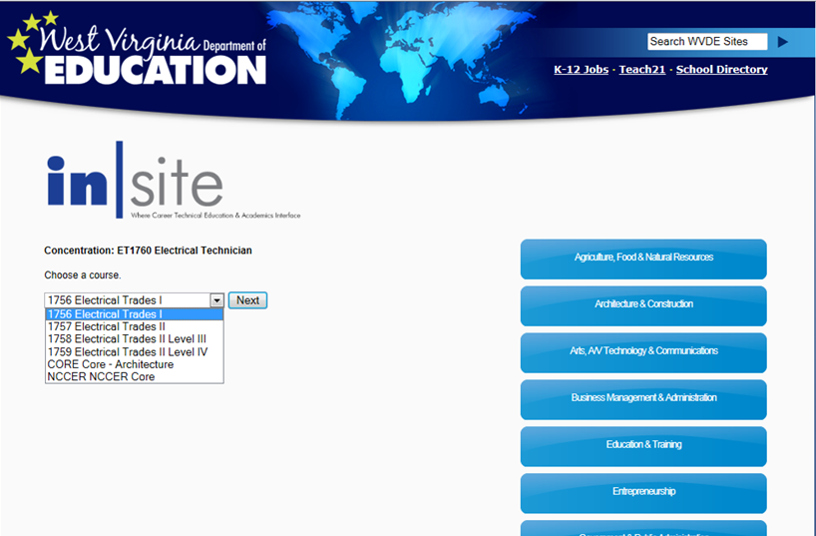

Slide 16
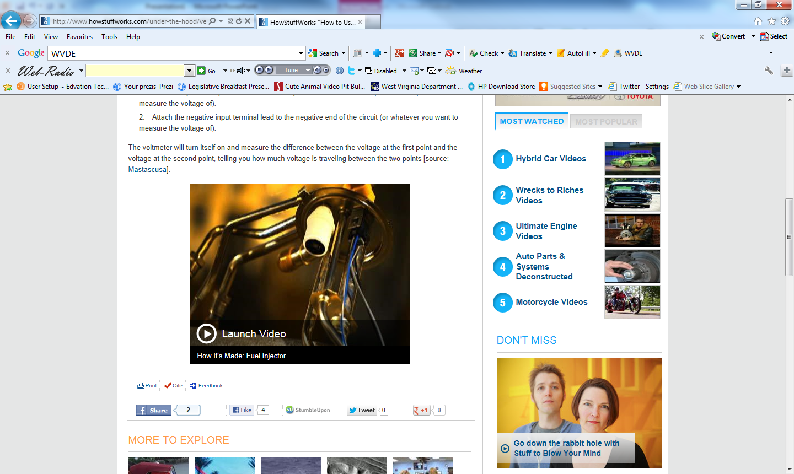

Slide 22
QUESTIONS

