Slide 1
In Tennessee…
At least 55-65 percent of current/future job openings will require some level of postsecondary education.
Presently
Tennessee is 42nd nationally in terms of working adults with at least a two-year degree.
Less than 60 percent of high school graduates in the state go on to postsecondary education.
Without additional strategies in place, only 39 percent of Tennesseans will have a postsecondary credential by 2025.
Source http://www9.georgetown.edu/grad/gppi/hpi/cew/pdfs/tennessee.pdf

Slide 2
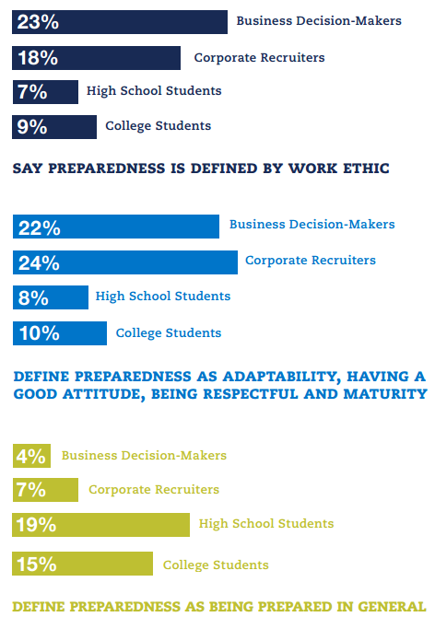
Of respondents*:
62% see lack of preparedness of recent college graduates as a real problem in America today.
74% believe that lack of preparedness contributes to economic problems facing the country today.
*Millennial Preparedness Survey questioned 3,000 respondents across nine audiences and examined skills, traits, use of technology, workplace attitudes and expectations, along with opinions of executives about millennials and vice versa.
Notes:
Brookings Institute, The Character Factor: Measures and Impact of Drive and Prudence, October 22, 2014
Drive and Prudence (ability to make decisions now based on what you want in the future) were EQUALLY important in determining whether a student would graduate as academic attainment.)

Slide 3
Tennessee's Vision for WBL
Every student in Tennessee will prepare for further education and long-term careers in an increasingly complex global economy by exploring careers, understanding their own strengths and interests, and learning through hands-on application of valuable employability skills.
Work-based learning will help ensure a skilled workforce pipeline for Tennessee’s growing industries. It benefits communities and families by promoting thriving local and regional economies.
Educators, industry, communities, and families will collaborate to create a world-class, work-based learning system with broad-based, efficient and effective participation of all stakeholders at statewide, regional, and local levels.

Slide 4
Tennessee’s Revitalized WBL Model:
Industry Awareness
Career Awareness
Career Exploration
Career Preparation
Career Training
Credit-bearing/ “Capstone” Experiences
Progressive Exposure and Learning “K to J”
Exploration
Immersion

Slide 5
Fundamental Qualities of Capstone Work-Based Learning Experiences
Cumulative: A student’s experiences stem from other experiences both inside and outside of the classroom. A WBL experience is not an add-on at the end but an intentional part of a student’s ongoing learning process.
Self-Directed: A student guides his/her own learning experiences and expresses the learning in unique and creative ways.
Portfolio: A student produces evidence of rigorous learning and skills development. This evidence may be a final product, presentation, or performance that allows the student to fully demonstrate or articulate the depth of skills attainment in these areas.

Slide 6
Ensuring Success

Slide 7
Ensuring a Viable Model
Phase
Statewide Assessment of Previous WBL WBL Survey and Focus Groups: 437 survey respondents (CTE directors, counselors, and WBL coordinators), and 225 focus group participants, including more than 75 industry partners
Development Phase of New Policies and Standards Revisions to Tennessee State Board of Education Rules and Policies Revision to Tennessee Department of Education WBL Policy Manual Development of WBL Course Standards
2014-2015 WBL Pilot Program Participating School Districts: Reviewed and approved all changes – Anderson County, Clarksville-Montgomery, Gibson Special School District, Moore County, and Rutherford County Schools
Professional Development WBL Leadership Council – Expert practitioners/trainers WBL Certification Training – Offered in all Grand Divisions WBL PLCs – Promote continuous improvement in every region Local PD Resources: WBL Implementation Guide and WBL Toolbox

Slide 8
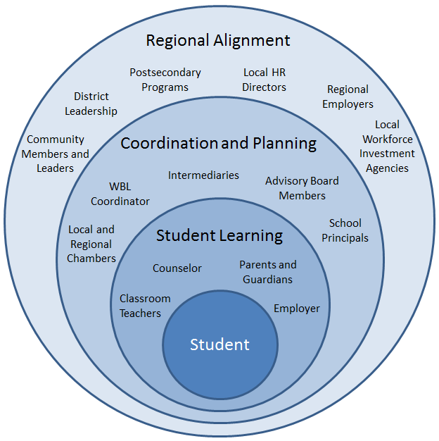
WBL Policy: Student-Centered
Pathways TN Approach to Regional Alignment
Local Accountability and Flexibility
Rigorous Learning Expectations
Notes:
Within the WBL policy guide, you’ll see the following changes to help support student learning first and foremost.

Slide 9
Boots on the Ground
Automotive Teacher
IT
Teacher
Engineering Teacher
Gen. Ed. Teacher
Safety Training
Subject Expertise
Relationships
WBL Career Practicum
WBL Coordinator
Facilitates WBL logistics and Reflection
Notes:
WBL Coordinators can oversee more types of placements (not health science or special education transitions)
WBL counts as a CTE course, with a cap of 25.
WBL can count towards CTE Concentrator status and may be used as 3rd or 4th course in any CTE program of study,
May count towards the 3rd course in area of elective focus when the placement aligns (local decision)

Slide 10
TDOE Pilot Perspective: Successful Practices
Regularly scheduled in-class time: Each week, or every two weeks, bring all students together for the class period to reflect on what they have seen and work on portfolio artifacts.
Offer school-based experiences: Students can meet course standards through school or district-based experiences (school store, greenhouse, etc.) IF a workplace mentor is involved.
Set clear expectations up front: Clearly communicate with parents, students, and counselors that WBL is a capstone class with rigorous requirements rather than “early release.”

Slide 11
Lessons Learned
WBL must be student-centered:
Aligns to the student's selected area of elective focus
Supports student's long-term goals and interests
Produces a portfolio of evidence of employability skills
WBL must be educator-supported:
Requires regularly facilitated reflection time to supplement work experience to meet course standards
Takes time to build employer relationships and support student learning
WBL must be community-aligned:
Provides access to high-demand, high-wage careers
Encourages community ownership and collaboration

