Slide 1
Effectively Communicating
of CTE to Families and Learners
Empowering Students through Career Technical Education & Career Advising
Module 6
[ Somewhere - insert state name/location ]
[ Sometime- insert date]
[Someone - insert Facilitator Name]

Slide 2
Welcome
Notes:
Use this slide as a space saver for the CTE State Lead (or State Lead who is the main contact for this training )to kick off the training with introductions, a welcome and/or a kick off statement encouraging folks to stay engaged in the content and know that it is valued.
While attendees are logging in, prompt them to begin introducing themselves in the chat with: Name, Title, School/District Name
If in-person, wait until slide #5 for introductions of attendees.

Slide 3
Pre-Workshop Survey
(add link or QR code)
Notes:
Instructions in Worksheet for attendees to follow.
See Facilitator Guide for recommendations.

Slide 4
Community Agreements
(see module worksheet)
Notes:
These are a list of norms for attendees to interact with one another, set as the norm for either in-person or virtual trainings - in fact, it was originally designed as a list for virtual training environments.
Optional slide for Facilitators: Knowing that you likely know your audience best, utilize this sample list of training norms, edit and add/delete accordingly. Also apply what norms/agreements are best for in-person or virtual training environments.
The list is hyperlinked in the training worksheet listed in the module folder.

Slide 5
Introductions
In the spirit of being a messenger for Career & Technical Education, finish this sentence in chat:
One of my favorite mottos from TV commercials, podcasts or radio shows/ads is ________________ because _______________.
Notes:
While we gather and attendees trickle in...remind them to introduce themselves in the chat with their Name, Title (mention grade level if relevant), School/District Name
Since we will be talking about messaging today, share with the group what ‘messages’ really stick with you from various media in your life and WHY…..the why will help us dive deeper into messaging strategies in support of being a CTE Champion!
This guiding question has attendees reflect on what messages and stories resonate with them, and to realize that each person has lived experiences that impact their reaction to communications. Share with attendees that this guiding question is a great way to kick off this topic and conversation when delivering it to their peers and others in the future.

Slide 6
Learning Objectives
Gain an understanding of current perceptions and barriers that limit learner and family interest and participation in CTE;
Understand findings on perceptions of CTE based on nationally representative research;
Gain effective and equitable messages and tools to communicate the value of CTE to secondary learners and families;
Practice implementing these messages in oral and written recruitment practices.
Notes:
Advance CTE paired down each module to reflect 5 or less learning objectives. As a facilitator, you may add more if you know you want to with your training group. Double check that these objectives match or align to those listed in the facilitator guide for this module.
**Pro-Tip: animate each bullet point so to emphasize each objective with attendees - less text on the screen at first.
*If you feel so inclined, feel free to take a long pause once done with the last objective and ask attendees: What learning objective would you add to this list because it is a learning moment you hope to gain today?

Slide 7
Notes:
NOW NEW NEXT is a main theme for the session and will guide how we reflect about the information shared and make plans to act on it after the workshop.
Call out the worksheet. We will reference NOW NEW NEXT at least twice in this module.
NOW indicates a reflective moment around what is in place. NOW is an indicator of what you can quickly recite and would share in the metaphorical ‘elevator’ or ‘sidewalk chat’ or ‘dinner party’ or ‘family reunion’ or ‘water cooler’ etc…..[insert whatever is most culturally relevant for you and/or the group here]
NEW will be the space where something is pulled from today's information. An idea, an initiative, new program implementation. A-Ha’s! New nuggets of knowledge. Big or small, the details that are NEW can live here for reference at the end of the module.
NEXT is use for looking to the future. What will you try? What will you implement? What will you take action on? What will you want to learn more about? Who else do you need with you to make it happen? ETC…. Structure and strategy around these ideas will accompany you a the end of the module
Again, we’ll be revisiting during NOW NEW NEXT conversation at the conclusion of this module.

Slide 8
Notes:
Put the link in the chat:
A Shared Vision | Advance CTE (careertech.org)
Include the link for attendees to access or navigate away from this slide to the webpage to explain this section and the next slide too:
A Shared Vision | Advance CTE (careertech.org)
Use this as script, if so compelled:
Without Limits: A Shared Vision for the Future of Career Technical Education (CTE Without Limits) puts forth a bold vision for a cohesive, flexible, and responsive career preparation ecosystem that will close equity gaps in educational outcomes and workforce readiness, and leverage CTE as a catalyst for ensuring each learner can reach success in the career of their choice.
Developed with input from nearly 200 national, state and local education and workforce development leaders and supported by 42 national organizations, CTE Without Limits lays out five inter-connected and equally critical principles:
Each learner engages in a cohesive, flexible, and responsive career preparation ecosystem
Each learner feels welcome in, is supported by, and has the means to succeed in the career preparation ecosystem
Each learner skillfully navigates their own career journey
Each learner’s skills are counted, valued, and portable
Each learner can access CTE without borders
CTE Without Limits is ambitious and forward looking. It puts equity at the center and recognizes that our country needs a CTE system that works for each learner, wherever they are in their career journey and whatever their background.
This vision is not just calling for updates to our CTE, education and workforce systems. Rather, it is calling for a more cohesive, flexible and responsive career preparation ecosystem, with CTE at its nexus, that draws on the capacity of each existing system; leverages these systems’ greatest assets; and pushes for new models of collaboration, learner-centric design and delivery, funding and accountability that create the right incentives and supports.
Only through shared commitment and shared ownership among leaders and practitioners at all levels can we realize the possibility and aspiration of a new career preparation ecosystem that provides each learner with limitless opportunity.
Each learner must have access to and the means to be successful in the career of their choice and will require:
All systems working in concert
A commitment to tearing down the barriers that limit opportunity
CTE to serve as the catalyst to make this vision a reality

Slide 9
Speakers
Explore more by visiting: https://careertech.org/without-limits
Notes:
Take a moment to reiterate the 5 principles of the CTE Without Limits vision.
If applicable to your audience, ask which principle stands out to them the most, which one seems the easiest/hardest, which one(s) are they already doing, etc….

Slide 10
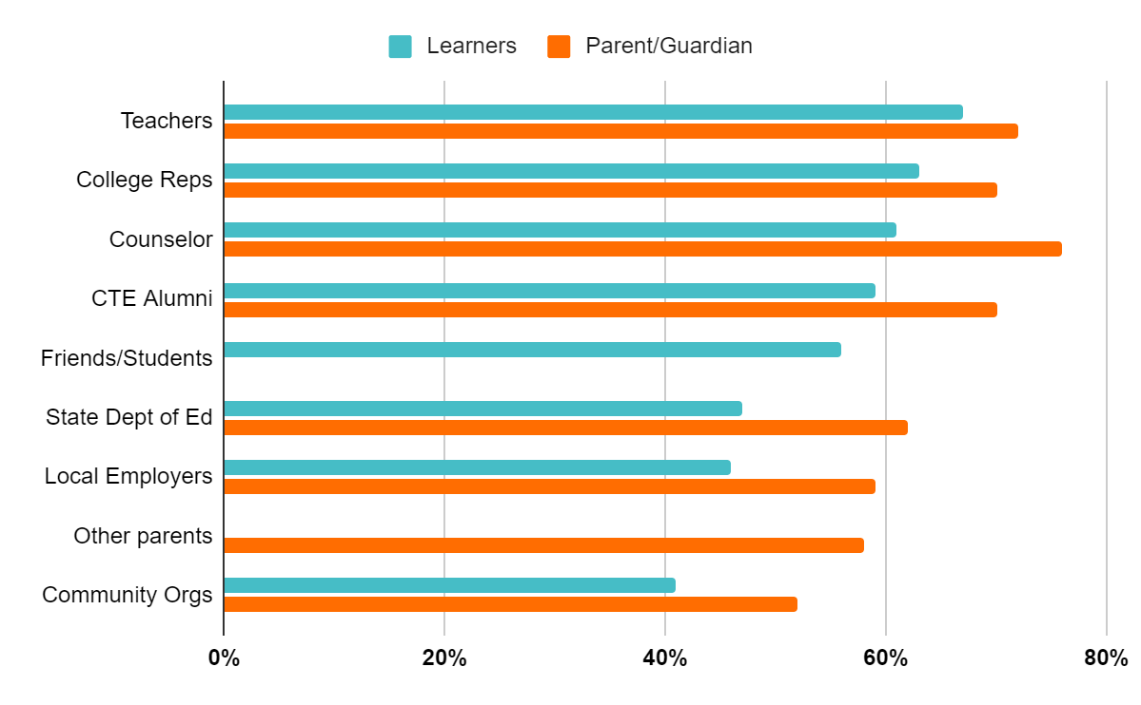
School Counselors Top Source for Information
67% - #1 Learners
76% - #1 Parent/Guardian
Notes:
AS A FRIENDLY REMINDER…..School Counselors are the top trusted messengers for students and families when it comes to conveying information about CTE.
We will review more about the survey in this workshop, but the reason for the development of this specific training is because of this finding: We learned that school counselors and teachers are the most trusted source of information about CTE for students and parents.
Let’s say that outloud again!
YES! What a useful and helpful finding!
Yet it seemed, through this national survey, that school counselors needed support in how to speak about CTE and career advising strategies.
Advance CTE and Siemens discussed strategies for activating school counselors to have an impact on as many counselors throughout the country as possible. The goal was to create an off-the-shelf training in partnership with ASCA and ACTE and guided by the input of an advisory committee. The advisory committee consisted of members of ASCA and ACTE as well as a few State CTE Directors, State Directors of School Counseling, and national experts in school counseling and career development. The members had the opportunity to weigh in and make recommendations throughout the development of the training. The training was first completed in 2019 and updated in 2021. Now here we are in 2022 at it again! Kudos to you each for being a part of this.
‹#›

Slide 11
Our Role
Personal interests/aspirations/aptitudes + Competencies/Skills +
Being informed on where/what
= CTE Champion!
Notes:
The formula for becoming a CTE champion involves the following:
When we help our students/learners get to know their own personal interests, future aspirations and understand their aptitude for future work paired with the competencies and skills they may already have or gain as they continue along their education and employment journeys paired again by knowing what their opportunities for career success in their state, community or anywhere.
When these three areas are focused on with EACH student/learner then that makes us a CTE Champion who remains in touch with economic needs, labor market resources, CTE happenings and changes.
CTE Champions also maintain good connections and collaboration with CTE educators and leaders.
CTE Champions also do not have to be the experts on specific career areas although they DO need to know who does
CTE Champions check their bias at the door. CTE Champions know just enough of CTE logistics, compliance and requirements to be official AND keep apprised of programming, economic, industry (hot jobs) changes. CTE Champions see EACH student as an individual pathway participant, supporting EACH learner obtain what learning and experience fits them best.
How would you describe a CTE Champion?
Are you looking forward to this title?

Slide 12
CTE: From Past to Present
Notes:
It’s clear that there have been dramatic changes from vocational education to Career and Technical Education over the past several decades. CTE is not a program focused solely on high school students who are not going to college; rather CTE links secondary and postsecondary with intentionality. It is broader than a few program areas of the past beyond the “traditional trades,” expanding to 16 Career Clusters (17 in some states) and clearly does not culminate at high school — it is lifelong learning with a continuous need to stay current with industry.
‹#›

Slide 13
CTE: From Past to Present
Notes:
Friendly reminder (from Module 1 if experienced), here’s the shift in perspective about CTE then and CTE now. Local influence may alter the ‘NOW’ stats, please include them if you know them. Have attendees reflect on how CTE was and is now perceived to help message CTE effectively.
Mention that Career Clusters, pathways and alignment will be discuss in more detail later in the workshop.
Encourage folks/x to use these graphics in their own messaging. Note now that the ppt will be shared with them (can be found in the handouts folder).
Please include your personal experiences with CTE as applicable here especially if you have experience in the ‘then’ and ‘now’.
If you feel compelled to engage the audience a bit more, this would be a good time to check with anyone who would want to come off mute and share their own personal experiences with CTE or at the very least, do a scan of their zoom squares to see if anyone is head nodding in agreement or not engaged yet.
‹#›

Slide 14
CTE Prepares Students for Careers of Their Choice
Career Technical Education is an educational option that provides learners with the knowledge, experiences and skills they need to be prepared for college and career
CTE gives purpose to learning by emphasizing real-world skills and practical knowledge within a selected career focus
Students in CTE pathways take specialized courses, in addition to required core courses, at the secondary and postsecondary/adult levels
Notes:
We now use the following statements as a definition for CTE (these are animated so ‘click next’)
it’s an option that prepares students for both college and careers.
Note the key words in this definition — purpose to learning — real-world skills and career focus.
It is NOW not just about “future training” students and preparing them for work. This is the shift.
These statements are beneficial to copy and paste to use them in messaging and any efforts you have for promoting CTE
‹#›

Slide 15
Notes:
NOW NEW NEXT is a main theme for the session and will guide how we reflect about the information shared and make plans to act on it after the workshop.
Call out the worksheet. We will reference NOW NEW NEXT at least twice in this module.
NOW indicates a reflective moment around what is in place. NOW is an indicator of what you can quickly recite and would share in the metaphorical ‘elevator’ or ‘sidewalk chat’ or ‘dinner party’ or ‘family reunion’ or ‘water cooler’ etc…..[insert whatever is most culturally relevant for you and/or the group here]
NEW will be the space where something is pulled from today's information. An idea, an initiative, new program implementation. A-Ha’s! New nuggets of knowledge. Big or small, the details that are NEW can live here for reference at the end of the module.
NEXT is use for looking to the future. What will you try? What will you implement? What will you take action on? What will you want to learn more about? Who else do you need with you to make it happen? ETC…. Structure and strategy around these ideas will accompany you a the end of the module
Again, we’ll be revisiting during NOW NEW NEXT conversation at the conclusion of this module.

Slide 16
Discussion #1:
What current tools do you currently use to recruit learners into CTE programs?
What is your biggest challenge communicating CTE to learners?
What messages do you currently use to ‘sell’ CTE?

Slide 17
National Messaging Research
Notes:
Use this slide as a space saver for the CTE State Lead (or State Lead who is the main contact for this training )to kick off the training with introductions, a welcome and/or a kick off statement encouraging folks to stay engaged in the content and know that it is valued.
While attendees are logging in, prompt them to begin introducing themselves in the chat with: Name, Title, School/District Name
If in-person, wait until slide #5 for introductions of attendees.

Slide 18
Background
Partnership with Siemens Foundation to address stagnant recruitment into Career Technical Education (CTE) programs that are vital to a skilled workforce.
Goals: Develop effective, equitable recruitment practices that frame CTE as meeting the needs and goals of families and empower stakeholders to put research into action.
2 rounds of research: 2017 and 2020

Slide 19
Research Terminology
This research explored what middle and high school families are looking for in their education and what messages resonates with them about CTE.
Prospective Families: Learners and parents/guardians interested in but not currently participating in CTE
Current Families: Learners and parents/guardians who’s learner is participating in one or more classes in a CTE program of study

Slide 20
CTE Still Delivers for Families
53% of Current CTE Families/Learners Very Satisfied
with overall school experience
(88% satisfied)
28% Prospective Families/Learners Very Satisfied with overall school experience
(75% satisfied)
Source: https://careertech.org/resource/communicating-CTE-recruitment
Notes:
Despite the recent global pandemic and alternative learning environments, many of which were solely virtual, the statistics are still on our side. CTE still delivers for our students and families. The responsiveness that we each took part in the last two years is leaving our students and families satisfied.
Research Link: https://careertech.org/resource/communicating-CTE-recruitment

Slide 21
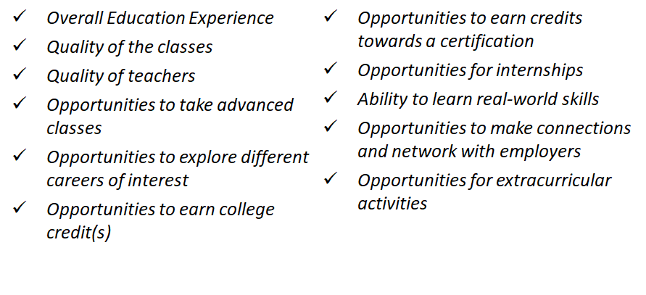
CTE Families More Satisfied with Education Quality and Opportunities
Those participating in CTE and their parent/guardian are more satisfied than those not involved in CTE in regards to:
Notes:
Here’s a number of benefits of being enrolled in CTE that have been proven to keep students and families more satisfied in their education experience as compared to students and families that are NOT in CTE programming (yet). The great news is that families in CTE are more satisfied in many aspects of their education, not just those that are CTE-focused.
Feel free to utilize this list of benefits for your own messaging ideas or posting on a webpage or making a flyer or just when speaking.

Slide 22
Families Desire Key Aspects of CTE in Education
Top Aspect | % Ranked Top 2 CURRENT | % Ranked Top 2 PROSPECTIVE
Opportunities to take classes that focus on gaining skills in a specific field | 51% | 46%
Opportunities to take classes for career exploration | 40% | 50%
Opportunities to take AP, IB, & other advanced classes | 36% | 36%
Opportunities for an internship | 28% | 20%
Opportunities to participate on clubs and extracurriculars | 16% | 16%
Opportunities to take classes in the arts (visual, performance, etc.) | 15% | 17%
Opportunities to participate in sports | 15% | 15%
Notes:
This slide highlights one of our messaging focuses- what parts of education are families most attracted to to ‘Prepare to the Real World?’
One of the biggest findings is that families are looking for career exploration and skillbuilding in their education
This chart reflects all the options families chose as their top two most important aspect of education in the national survey.
Career Exploration and Skill Building are the top choices at 40-50% compared to four other choices at 15-20%
Prospective families favored career exploration over skillbuilding, whereas current families favored skillbuilding (this is not surprising)
We could consider these findings when messaging to families - prospective families may not know what CTE has to offer or what career path to follow
Families want key aspects of CTE in their education, and CTE is one of the few path currently to have those opportunities

Slide 23
Most Effective Message: Preparation for the Real World
Continues top message from 2017 research
Top message across participation, race, and income
Reinforces top outcomes/benefits desired from CTE
Gives purpose to learning by emphasizing real‐world skills and practical knowledge
Students receive hands‐on training, mentoring, and internships from employers in their community.
help students explore different options before they start college or a career, and get them ready for the real world.
Notes:
*The bullet points are animated. Click for them to show up. Mention that the words in bold are useful for messaging and we recommend using them one websites, flyers, marketing materials and speaking them when guiding and teaching.
Here is the most effective message that resonated with all groups in both 2017 and now, despite significant transformations to learning and work, in 2020 and beyond the message was chosen over a more economic-focused message and a message focused on the value of CTE in making connections and building social capital.
These bullet points are the description that we gave families for this message The tangible benefits that make CTE a unique experience — such as real-world skills, mentoring and internships — are things that really resonated with both parents and students and are key to highlight when talking to them about their education options.
Later on in this section we’ll cut down this description into some key messages.
‹#›

Slide 24
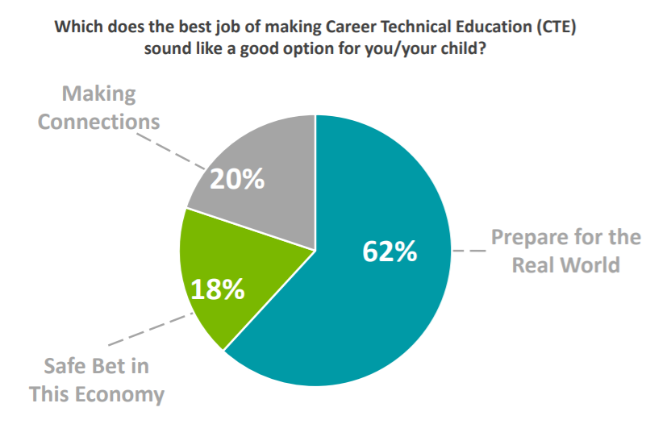
Message Testing
Notes:
This slide highlights one of our messaging focuses- what parts of education are families most attracted to to ‘Prepare to the Real World?’
One of the biggest findings is that families are looking for career exploration and skillbuilding in their education
This chart reflects all the options families chose as their top two most important aspect of education in the national survey.
Career Exploration and Skill Building are the top choices at 40-50% compared to four other choices at 15-20%
Prospective families favored career exploration over skillbuilding, whereas current families favored skillbuilding (this is not surprising)
We could consider these findings when messaging to families - prospective families may not know what CTE has to offer or what career path to follow
Families want key aspects of CTE in their education, and CTE is one of the few path currently to have those opportunities

Slide 25
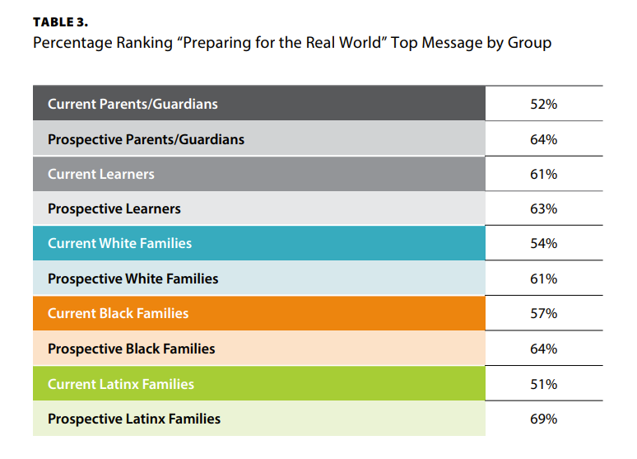
Equitable Message Impact
Notes:
Here’s a number of benefits of being enrolled in CTE that have been proven to keep students and families more satisfied in their education experience as compared to students and families that are NOT in CTE programming (yet). The great news is that families in CTE are more satisfied in many aspects of their education, not just those that are CTE-focused.
Feel free to utilize this list of benefits for your own messaging ideas or posting on a webpage or making a flyer or just when speaking.

Slide 26
CTE Benefits and Outcomes: Finding Passion A Top Priority
Prospective and current parent/guardians and learner placed finding a career passion in their top two outcomes and benefits of CTE out of 22 options.
Finding a career passion was ranked above finding a well-paying job, earning college credit, and having experiences that stand out on college and job applications
Top CTE Benefits
and Outcomes for Prospective Families
Preparing for the Real World | Finding career passion
Getting hands-on experience | Learning life skills
Discovering “right fit” for career
Notes:
The next layer to messaging CTE the best we can is exploring what families want to get out of career exploration and skill building, and this slide looks at the benefits and outcomes families are looking for from CTE.
You’ll saw the #1 outcome on the previous slide, Preparing for the Real World, but this slide focuses on the #2 outocme. Finding a career passion was universally the number 2 message.
Bullet point #2 on this slide is especially important because what employers and policymakers see as benefits from CTE are not necessarily the top priority for families
Families want to combine opportunity with passion to help their learner (student) find a career that aligns with their interests
If we were to compare the survey results of 2020 vs. 2017, we found passion to be important in 2017, and felt it had to be elevated in 2020 because it was so prominent even considering all the upheaval that has occurred.
In our focus groups, we had families where parents/guardians had lost their jobs due to COVID. Even still, they wanted their learner to have a job they love and makes a difference
*ANIMATION: Click for the orange talking points to show up on the slide once you are done sharing the two bullet points.
In this orange box are lists of the top benefits found in the research that aligns with everything else already previous discussed
We recommend using the orange box as messages for talking with students and families about CTE and in fact every stakeholders could benefit from these messages.

Slide 27
CTE Has Grown, But Awareness Struggles Remain
2020: Over 11 million learners are enrolled in CTE programs nationwide
2017: Just 29% of prospective parents and learners have heard of “Career Technical Education”
While over 30% of White and Black prospective parents had heard of CTE, only 7% of Latinx parents were familiar with the term
Notes:
Participation in CTE is growing, yet many families continue to not be aware of CTE, particularly historically marginalized populations.
This is our work. This is why we are each here. Why we’ve spent the last two days together. We want each learner to be aware of and have access to these experiences. We can only do so if you we use messages that resonate with students about the benefit of these experiences and ensure each student can equitable access these experiences. Then you’ll be a CTE champion.
Just a bit more to go!
‹#›

Slide 28
2022 ECMC Question the Quo Poll
50 percent of high school students surveyed believe they can achieve career success without obtaining a four-degree.
20 point drop (71% to 51%) in the percentage of student planning to obtain a four-year degree between May 2020 and May 2022
81% named learning skills to be successful in the real world a top criteria when choosing a path beyond high school.
4 out of 10 high school students surveyed are concerned about not being prepared for a job after college
https://questionthequo.org/media/3954/qtq-survey-5-digital-report.pdf
Notes:
Advance CTE’s research is backed up by other relevant surveys that have found similar type of results. A growing body of evidence shows that residents of the United States are more concerned about career preparation and want the public education system to offer more options.
The Question to Quo campaign, developed by the ECMC Group, who are a nonprofit corporation whose vision is to empower underserved communities to thrive through education, aims to raise awareness among student of all paths to higher education and career success, and empower learners to find the career path they are passionate about. They have conducted three polls of high school students between 2020 and 2021.
(here’s more about them:https://www.ecmcgroup.org/)
This reflects similar finding in a Phi Delta Kappa Educational Foundation’s 2017 survey of the public attitudes to public school that found 82% of Americans support job or career skills classes even if that means students might spend less time in academic classes
Are you seeing similar outcomes in your students right now? Thumbs up, down or sideways emojis are welcomed.
‹#›

Slide 29
Notes:
NOW NEW NEXT is a main theme for the session and will guide how we reflect about the information shared and make plans to act on it after the workshop.
Call out the worksheet. We will reference NOW NEW NEXT at least twice in this module.
NOW indicates a reflective moment around what is in place. NOW is an indicator of what you can quickly recite and would share in the metaphorical ‘elevator’ or ‘sidewalk chat’ or ‘dinner party’ or ‘family reunion’ or ‘water cooler’ etc…..[insert whatever is most culturally relevant for you and/or the group here]
NEW will be the space where something is pulled from today's information. An idea, an initiative, new program implementation. A-Ha’s! New nuggets of knowledge. Big or small, the details that are NEW can live here for reference at the end of the module.
NEXT is use for looking to the future. What will you try? What will you implement? What will you take action on? What will you want to learn more about? Who else do you need with you to make it happen? ETC…. Structure and strategy around these ideas will accompany you a the end of the module
Again, we’ll be revisiting during NOW NEW NEXT conversation at the conclusion of this module.

Slide 30
Discussion 2:
What finding do you think would resonate most with your students/families?
How do these findings impact your current messaging?

Slide 31
Core Messages for Learners and Families
Notes:
Direct attendees to the words and phrases listed in the Worksheet. Also, some reflective prompts and space for notes.
How can we, as CTE Champions - being teachers, educators, school counselors, advisors or other impactful roles use the research we just went over in their messaging for learners and families? In the following slides will break CTE down into simple messaging.
‹#›

Slide 32
Message Implementation
CTE needs messengers to address awareness and perception challenges
Look for opportunities to incorporate CTE messaging into career advisement for learners and parents
Consider how to build trust to place learner needs at the center of your conversations about CTE
Notes:
As school counselors considering recommendations for improving career advising, it is important to note that a common understanding and the most impactful messaging tactics for CTE are also integrated systemically into career advising.
As was indicated earlier in this workshop, CTE has an awareness challenge and needs messengers. And school counselors are go-to messengers. We each play a role in messaging. We each play a role in Career Advising too.
Career advising is also in need of enhancements to ensure that students, parents and families are aware of bias-free viable options during and post-high school.
Before any messaging begins, building trust is critical to message resonance. Advance CTE’s research indicated that parents of Black and Latinx families were significant more comfortable consulting a counselor than Black and Latinx learners.
Now for messaging - we are going to spend some time explicitly looking at how we can consistently deliver the overarching message of “Preparing for the Real World” and its subsequent message layers about CTE to enhance the opportunities for students to explore CTE.
As we do this, consider all that has been discussed during this workshop, including high-quality CTE programs of study and the impact on students and parents’ attitudes. Moreover, begin to consider how you can weave CTE opportunities into some of your existing career advising strategies or design new activities to address the communication of CTE to various stakeholder groups.
We’ll be wrapping up our day together with this as our final topic.
‹#›

Slide 33
Core Messages and Motivators
Explore careers to find their passion
Have more options for career and college success
CTE Learners...
Gain real-world skills
Notes:
*This slide is animated, the triangle shows up with a click. Then from top, right then left the other text shows up on click.
A message triangle for core messages includes the three most important things or core motivators for someone to understand about a specific issue. In this case, from our research with families and students, we know that the following messages most resonate with families and students based on what our research shows what is important in their education and their education goals:
CTE Learners explore careers to find their passion
CTE Learners gain real-world skills
CTE Learners have more options for career and college success
Note that this is learner-focused on the benefits and value it provides for the student, not about the system. Additionally, families chose finding a career passion over a paycheck and experience for college and job applications, so that is an important shift to how you may be used to hearing about CTE in terms of making more money.
These can be a key message whether you’re speaking 1 on 1 with a parent or student, working to create a brochure on CTE options, speaking at a career advisement day, etc. These are the three most important messages to utilize en communicating with families and students.

Slide 34
Messaging Do’s and Don’ts
Do....
Be consistent and reinforce key messages
Utilize learners to tell CTE success stories
Be specific about how CTE works, particularly hands-on experiences
Engage and inform educators closest to learners about CTE
Emphasize CTE learners are more satisfied with their education
Emphasize CTE’s value in preparing for college and career success
Don’t...
Position CTE and college as an “either/or”
Position CTE as a ‘different’ high school experience
Push financial benefits of CTE career pathways over finding passion
Do all the talking - elevate the learner voice
Neglect message tailoring
Forget about retention messages
CTE Learners...
Notes:
**Note: this slide is animated. The Do list shows first on click. Then the Don’t list shows next on click.
These are the Do’s and Don’ts that are encouraged. Ask attendees, what are some other suggestions to add to either list? Anything causing conflict or curiosity? What has worked well so far in messaging CTE and was has been found to not be effective?

Slide 35
Sample Supportive Statements
CTE programs allow students to explore a range of options for their future — inside and outside of the classroom
CTE provides the skills and confidence students need to pursue career options, discover their passions, and get on a path to success
CTE takes students even further during their high school experience — providing opportunities to prepare for and excel in college and career through specialized classes, opportunities for college credit, and making connections with others with similar interests
Notes:
These are sample supportive statements for each of the key messages to use in whatever materials you create or in engagements you have with students and parents. Reference PAGE 4 in the workbook.
We recommend and see value in getting familiar with these statements. In marketing, it is believed that humans need to hear something 11 times for it to “stick.” Thus, it is important to repeat these words and statements frequently to be the best CTE champion we can!
‹#›

Slide 36
Words Not to Use
High quality
Workforce (students)
In-demand fields, e.g., IT, STEM, manufacturing (students)
Words that put down high school
Investment
‹#›
Notes:
Helpful tidbits here on what words, phrases or terms were not found to be received well or preferred when respondents of the national survey were asked. This is just as helpful a messaging technique as what words to use.
*List is animated so click for the words to show up.
“High quality” brought in a lot of questions about whether or not the student’s program was quality. If you’re promoting a program, it should be high quality, you don’t need to say it.
“Workforce” was fine with parents but made students feel like a cog in a machine. Not individualized enough for them. Students didn’t like it. Families did.
“In-demand fields” were great with parents but too limiting with students. They want to know the full range of Career Clusters and opportunities. Again, this term didn’t work with students.
We know from other surveys that families are generally satisfied with their home high school; this means that ‘putting down’ high school was not an effective way to promote CTE. There may be tradeoffs — such as having to go to a tech center — but making the messaging sound that ‘putting down’ traditional high school to promote CTE was not successful when those messages were tested.
The term “investment” brought up a lot of questions about whether or not CTE costs more, etc. So we don’t recommend this term for either audience. This also goes back to the preference for passion as a top outcome
‹#›

Slide 37
Messaging Resources
https://careertech.org/recruitmentstrategies
Core Messages resource with the messaging triangle and key supporting messages for historically marginalized populations
Dos and Don’ts which detail how to use the messages and how not to use them
Fact Sheet with key statistics that reinforce CTE’s value and benefits
Updated message card and other printed material templates,
Updated social media guide with tips and example on how to reach audiences effectively and equitably
CTE 101 Video - effective at improving perceptions of CTE
Notes:
Put this in chat: https://careertech.org/recruitmentstrategies
We talked about Perkins V earlier in this session. As a friendly reminder, CTE programming is funded by a national federal grant that goes to each state and each state determines how to use the funding. It is unfortunate though important to note that Perkins V funding cannot be used for recruitment activities or marketing.
This makes our jobs as messengers a bit more challenging! We have to get creative on using different funding sources to create messaging materials. This makes the work you do to effectively communicate CTE to students even more important. Advance CTE has supplemental resources that can be used and customized to put the research into action.
Think about how to utilize your own student talent. think about business classes and project based learning as well as local community stakeholders and their businesses. Just as some ideas.
Advance CTE has our back though. Be sure to visit and take advantage of the materials already made for us on this website: https://careertech.org/recruitmentstrategies
IF TIME: Go to website and review resources or at the very least pop the link into the chat.
‹#›

Slide 39
Activity 1: Message Implementation
Explore careers to find their passion
Have more options for career and college success
CTE Learners...
Gain real-world skills
Notes:
*This slide is animated, the triangle shows up with a click. Then from top, right then left the other text shows up on click.
A message triangle for core messages includes the three most important things or core motivators for someone to understand about a specific issue. In this case, from our research with families and students, we know that the following messages most resonate with families and students based on what our research shows what is important in their education and their education goals:
CTE Learners explore careers to find their passion
CTE Learners gain real-world skills
CTE Learners have more options for career and college success
Note that this is learner-focused on the benefits and value it provides for the student, not about the system. Additionally, families chose finding a career passion over a paycheck and experience for college and job applications, so that is an important shift to how you may be used to hearing about CTE in terms of making more money.
These can be a key message whether you’re speaking 1 on 1 with a parent or student, working to create a brochure on CTE options, speaking at a career advisement day, etc. These are the three most important messages to utilize en communicating with families and students.

Slide 40
Activity 1: Message Implementation
Let’s practice communicating CTE!
Elevator Pitch
Equipping your stakeholders
Updating your website
Updating your handouts
Notes:
See page 5 of the Worksheet.
Encourage attendees to really leverage this activity to support immediate actions they can take to shift perceptions and effectively message CTE to learners and families. These artifacts can be used as CEU credit evidence, these can be shared across attendees to help support the borrowing of promising practices.
We also want to reiterate the ‘power’ of being intentional to equity and inclusion in our messaging so, please encourage attendees to also participate in Module 5: Addressing Implicit Bias in Career Development and be thoughtful about leveraging the use of ‘every’ or ‘each’ versus ‘all’ when designing communication artifacts. If interested, share slide 15, 33-34 and 38 from Module 5. Linked here: https://docs.google.com/presentation/d/1o4_iXyEt8y2cMJ_MLF2Kf1Y4ZQdgSo6M4W2ssBLY0Ro/edit?usp=sharing
**Option to make this activity more like a ‘homework’ assignment post-training so to encourage a deep dive into doing an inventory of words/images on website or handouts that can be edited to support the outcomes of this module. It could also be homework for ‘teams’ to compose and buy-in elevator speeches that inevitable help equip stakeholders with effective messaging.

Slide 41
Notes:
Remember, NOW NEW NEXT is a main theme for the session and will guide how we reflect about the information shared and make plans to act on it after the workshop.
NOW indicates a reflective moment around what is in place. NOW is an indicator of what you can quickly recite and would share in the metaphorical ‘elevator’ or ‘sidewalk chat’ or ‘dinner party’ or ‘family reunion’ or ‘water cooler’ etc…..[insert whatever is most culturally relevant for you and/or the group here]
NEW will be the space where something is pulled from today's information. An idea, an initiative, new program implementation. A-Ha’s! New nuggets of knowledge. Big or small, the details that are NEW can live here for reference at the end and into session 2.
NEXT is use for looking to the future. What will you try? What will you implement? What will you take action on? What will you want to learn more about? Who else do you need with you to make it happen? ETC…. Structure and strategy around these ideas will accompany you a the end of the session
Again, let’s pause just as we begin to conclude our training: circle back on your NOW NEW NEXT that we did in the beginning. What changed? What can be added? What is different?
Anyone want to share either any of their now, new or next?! Please do. Come off mute, raise hand, put in chat, circle up in small group, popcorn style share out (try to hear from at least 3 people minimum)
Reference Page 2 of the Worksheet

Slide 42
Learning That Works Resource Center
https://www.careertech.org/resource-center
Handout Hub
‹#›
Notes:
Before we conclude for today, please find more information and lots of great borrow-able resources at the Learning the Works Resource Center on Advance CTE’s website
Put the Link in the chat: https://careertech.org/resource-center
Also, you’ll find the Handout Hub in your materials too. If you haven’t already, explore what is in there. We aim to make sure you have what you need to be the best CTE Champion you can and to have this training be as productive and meaningful as possible too.
Put Handout Hub link in chat. It is found in the module folder.
Note the additional page of additional resources and tools on Advance CTE’s homepage. Stay connected to the latest and most up to date reports, initiatives, efforts and more: www.careertech.org
‹#›

Slide 43
Post-Workshop Survey
&
Collective Commitment
(add link or QR code)
Notes:
Survey descriptions is in Facilitator Guide - option to add it to the attendees worksheet.
Collective Commitment is also detailed out in the worksheet. It is not an actual form, more like an option for attendees to keep accountable with their action steps and action planning and take-aways from this training.

Slide 44
Thank You!
Congratulations on beginning to become a CTE Champion!
Insert contact info here:
Insert local resource links here:
Insert next steps or other last thoughts here:
Insert CEU option here:

