Slide 2
Panelists
LInda Van Doren, Ed.D., VP of Education
Emily Griffith Technical College
Lancelot Gooden, Ed.D., Provost
Valencia College
Brandon Hensley, Associate Dean of CTE
McDowell Technical Community College
Jodi Adams, Instructor
University of Louisville
Moderators
James E. Bartlett, II, Ph.D., Associate Professor
Michelle E. Bartlett, Ph.D., Assistant Professor
Old Dominion University

Slide 3
Problem
Workforce Demand
Aging Workforce
Funding Constraints
Competition from Industry
Credentialing and Experience
Limited Pipeline
Perceptions and CTE Stigma
Insufficient Investment
Limited Professional Development

Slide 4
What is Research Telling Us
Supply and Demand Discrepancy
Regional Disparities
Sector Differences
Recruiting & Retaining
Roles of CTE Teachers

Slide 5
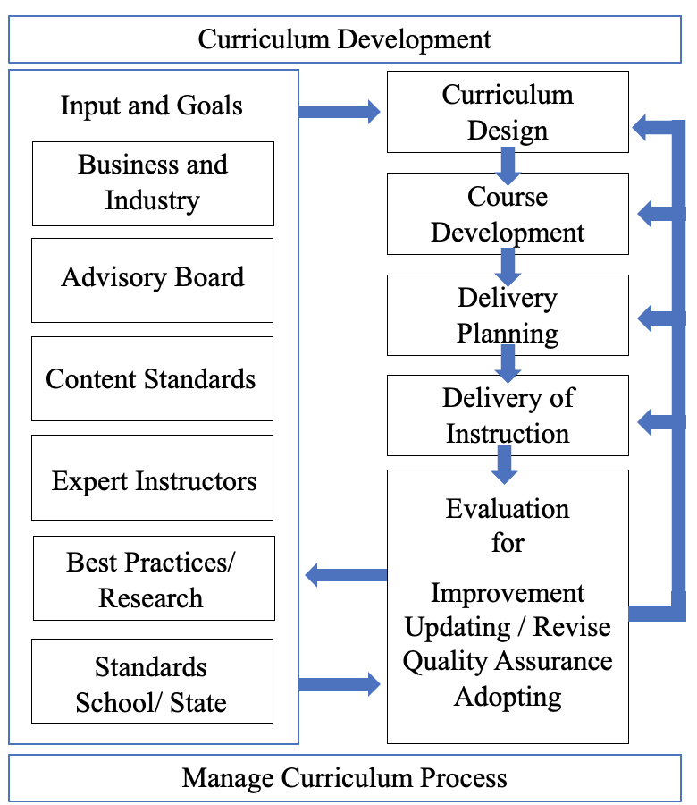
Roles of The CTE Instructor

Slide 6
Identify the Scope and Causes
Build a Network of Advocates
Raise Awareness
Collect and Share Data
Advocate for Policy Changes
Promote Alternative Pathways to Teaching
Collaborate with Educational Institutions
Engage with Industry Partners
Support and Mentor CTE Teachers
Monitor Progress and Evaluate
Partnerships
Research
Advocacy
Notes:
Reducing the career and technical education (CTE) teacher shortage requires a multifaceted approach that involves advocacy, research, and collaboration with various stakeholders. As a researcher aiming to provide advocacy, here are some steps you can take to address the CTE teacher shortage:
Identify the Scope and Causes: Begin by conducting comprehensive research to understand the extent of the CTE teacher shortage in different regions. Identify the root causes of the shortage, which may include low pay, lack of professional development opportunities, limited career advancement prospects, or negative perceptions about CTE teaching careers.
Build a Network of Advocates: Connect with other researchers, educators, policymakers, and organizations who are also concerned about the CTE teacher shortage. Collaborate and share insights to develop a united front for advocacy efforts.
Raise Awareness: Utilize various platforms, such as conferences, workshops, webinars, and social media, to raise awareness about the importance of CTE and the critical need for qualified teachers in this field. Educate the public, policymakers, and stakeholders about the impact of the shortage on students and the economy.
Collect and Share Data: Collect data on the shortage's impact on schools, students, and communities. This data will help illustrate the severity of the problem and provide evidence for the need for action. Publish research papers, reports, and articles to share your findings widely.
Advocate for Policy Changes: Engage with policymakers at the local, state, and federal levels to advocate for policy changes that support CTE teacher recruitment and retention. This could include increased funding for CTE programs, salary enhancements, improved professional development opportunities, and incentives for individuals considering CTE teaching careers.
Promote Alternative Pathways to Teaching: Advocate for alternative pathways to become a CTE teacher, such as streamlined certification processes, apprenticeship programs, or partnerships with industry professionals who want to transition into teaching.
Collaborate with Educational Institutions: Work closely with universities, colleges, and teacher preparation programs to ensure they are adequately preparing future CTE teachers for the demands of the profession. Advocate for relevant coursework, hands-on training, and support networks for aspiring CTE educators.
Engage with Industry Partners: Collaborate with local businesses and industries to promote the value of CTE education and its impact on the workforce. Encourage businesses to invest in CTE programs and create opportunities for teacher externships or internships to enhance educators' real-world knowledge.
Support and Mentor CTE Teachers: Offer support and mentorship programs for current CTE teachers to help improve job satisfaction and retention. Addressing the challenges they face and providing professional development opportunities can enhance their effectiveness and commitment to the profession.
Monitor Progress and Evaluate: Continuously assess the impact of advocacy efforts and policy changes. Measure improvements in teacher recruitment, retention rates, student enrollment in CTE programs, and the overall perception of CTE teaching careers.
Remember that reducing the CTE teacher shortage requires a sustained and collaborative effort. By combining research, advocacy, and partnerships, you can contribute to meaningful change in the field of career and technical education.

Slide 7
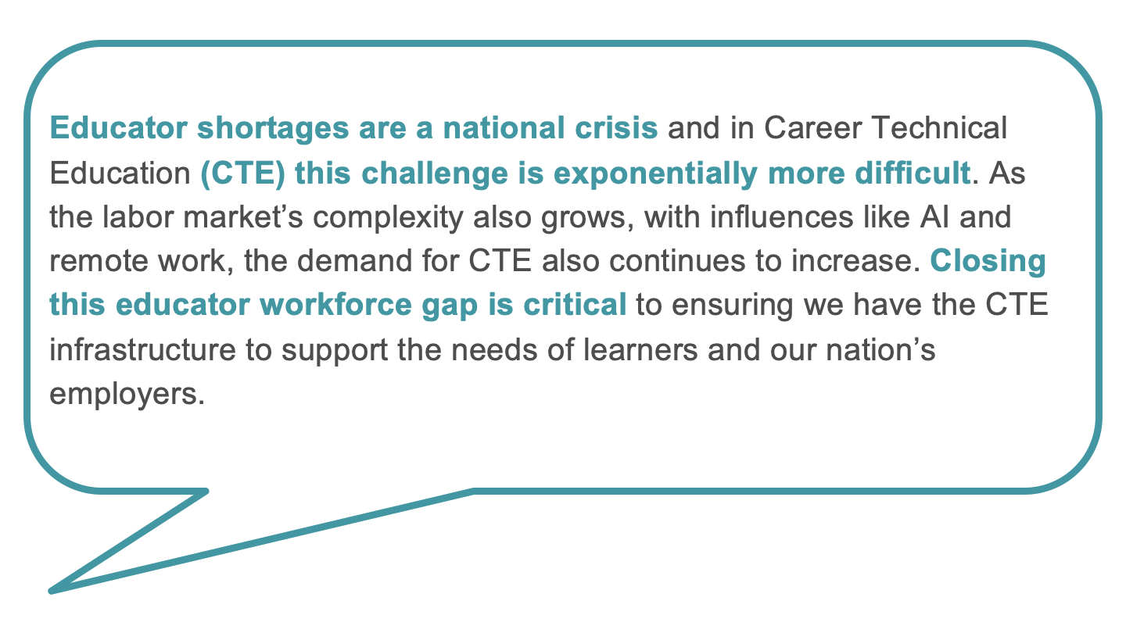

Slide 8
The Shortage of Postsecondary CTE Instructors
Where are the biggest shortages; (impact on single person department - full-time faculty)
How do part-time faculty help
CTE areas
How is policy impacting the demand for the field? (transfer/dual enrollment)
Impact of industry salary and the workforce demand
Where are people going?
What are the main reasons behind the educator shortages in CTE, and how have they been exacerbated by factors like AI and remote work?
How is inability to pay for prep time impacting teacher shortage?

Slide 9
Preparing Postsecondary CTE Instructors
How is the credentialing process working for postsecondary states
Bridge program from industry to the classroom
Workforce source
Apprenticeship
How is dual enrollment impacting how CTE Instructors are prepared to enter the field?

Slide 10
Training Postsecondary CTE Instructors
What are your schools or other schools you know of doing to providing or professional development for new CTE instructors?
Instructional design and teaching
Experts not teachers
What programs that help with professional development?
Tech Ed - Makes educator

Slide 11
Recruiting Postsecondary CTE Instructors
How can industry professionals be encouraged to become part of the CTE educator workforce, bringing their real-world expertise into the classroom?
Are they paying CTE teachers more than other areas?
Hard to find
Hard to retain
What are levers to get people to enter or stay
Salary

Slide 12
How do we Expand and Diversify the Field?

Slide 13
Q&A

Slide 14
careertech.org
@CTEWorks
301-588-9630
Contact:
Brandon Hensley, Associate Dean of Career and Technical Education, McDowell Tech - gbhensl3@ncsu.edu
Jodi Adams, Instructor, University of Louisville - jodi.adams@education.ky.gov
Linda Van Doren, Ed.D., VP of Education, Emily Griffith Technical College - linda.vandoren@emilygriffith.edu
Lancelot Gooden, Ed.D., Provost, Valencia College, lgooden5@valenciacollege.edu
James E. Bartlett, II, Ph.D., Associate Professor of Postsecondary Education and Workforce Development, Old Dominion University, jbartlet@odu.edu
Michelle E. Bartlett, Ph.D., Teaching Associate Professor of Postsecondary Education and Workforce Development, Old Dominion University, mbartlet@odu.edu
Notes:
Speakers contact information

