Slide 1
Examining the Potential of Industry-Recognized Credentials in High School to Advance Learner Success
Advance CTE – January 24, 2023 Webinar
Matt Giani
Research Associate Professor, Department of Sociology
Faculty Affiliate, Texas Behavioral Science and Policy Institute, Population Research Center
The University of Texas at Austin
Amber Northern
Senior Vice President for Research
Thomas B. Fordham Institute

Slide 2
Why the need for IRCs?
Escalating tuition costs
More awareness that students can make middle-class wages without a college degree depending on their training and where they live
Lack of preparedness for college
Drop out rates and student debt
Many young people saying they aren't learning job-ready skills in HS (devaluing of HS degree)
Notes:
Content slide w/o bullets

Slide 3
Looking Ahead
How else can we transform the high school experience for students so as to significantly boost their wages and career prospects once they are in the workforce?
Stress the key roles of high schools—and middle schools, too—in helping students figure out their career interests and aptitudes.
Embrace approaches that are much more ambitious than IRCs, such as serious youth apprenticeship programs.
Encourage stackable credentials.
Make state accountability systems more selective regarding which high school IRCs count in their college- and career-ready indices.
Notes:
Content slide w/o bullets

Slide 4
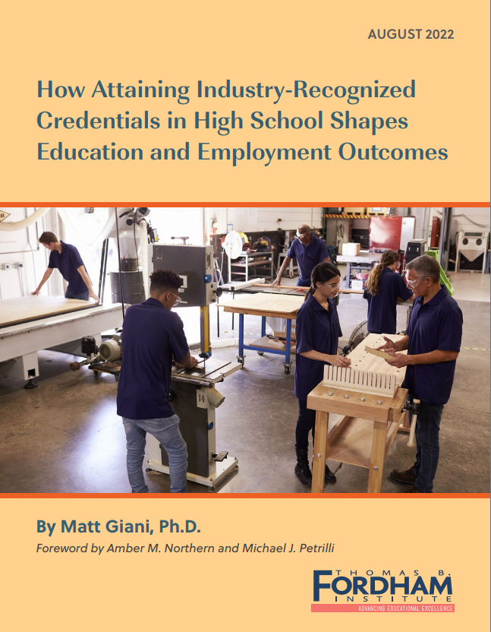
Study Overview
TEA began collecting IRC¹ data in 2017
Used Texas’s SLDS data (Texas Education Research Center)
2017-19 HS graduate cohorts (~1,000,000 students)
Examined predictors of IRC receipt and how IRCs shape college and employment outcomes
Conducted interviews and focus groups with 12 students in CTE programs that lead to IRCs
¹Texas refers to certifications as industry-based certifications (IBCs)
Notes:
Content slide w/o bullets

Slide 5
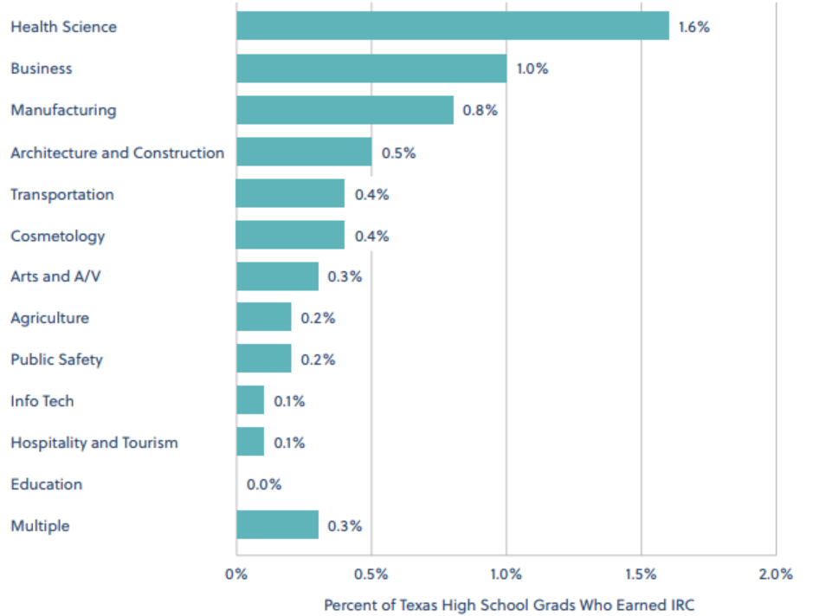
Distribution of IRCs by Subject/CTE Cluster
Health Science and Business (MS Office) dominated IRCs
IRCs in many fields (IT, Hospitality, Education) are quite rare
IRCs in multiple subjects is somewhat common
Notes:
Content slide w/o bullets

Slide 6
Q1: How much do IRCs help students find jobs?
Not at all
A little
A moderate amount
A lot

Slide 7
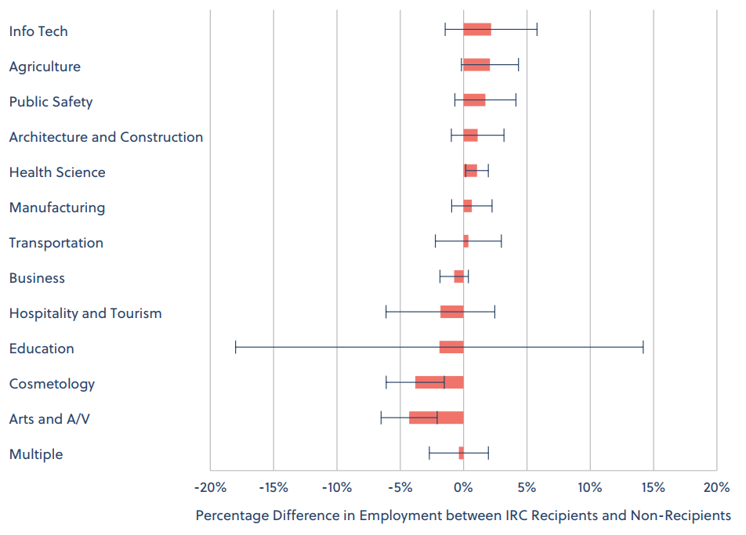
Finding #1: IRCs are not related to
first-year employment
Not at all
A little
A moderate amount
A lot

Slide 8
Q2: How much do IRCs boost earnings?
Not at all
A little
A moderate amount
A lot

Slide 9
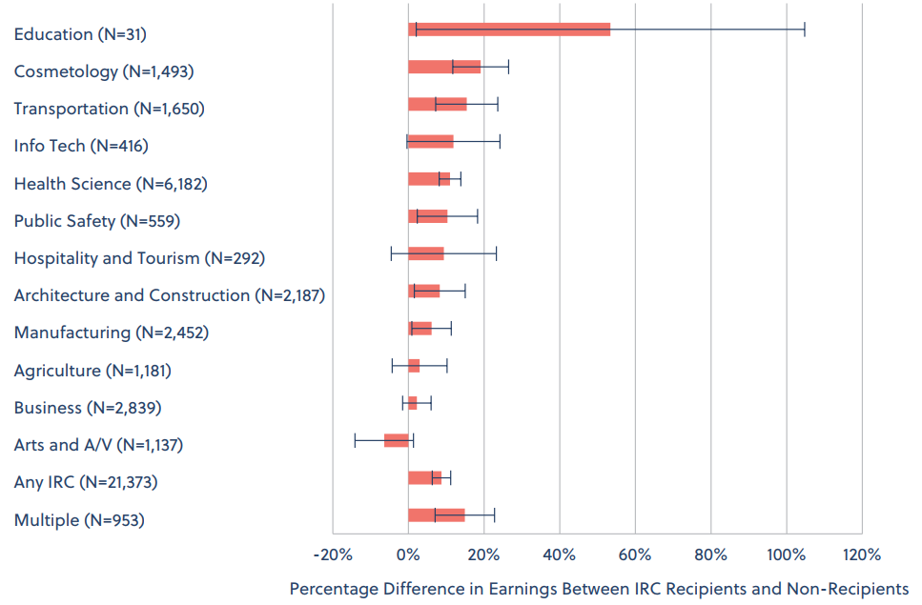
Finding #2: Many IRCs are positively related to earnings
Not at all
A little
A moderate amount
A lot

Slide 10
Q3: How equal is the earnings benefit of IRCs across demographic groups?
Very unequal
Somewhat unequal
Somewhat equal
Very equal

Slide 11
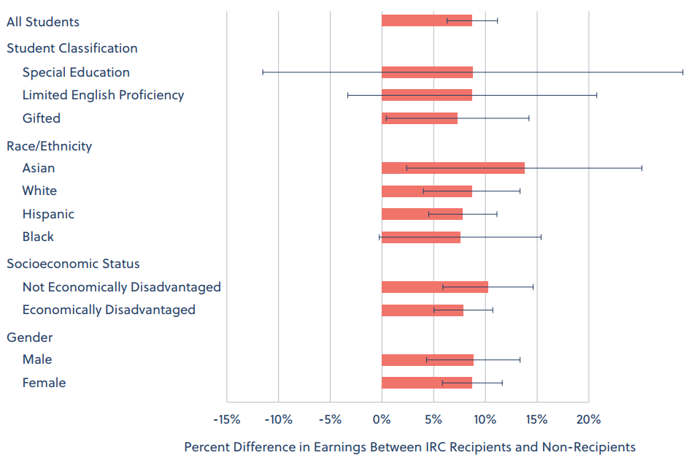
Finding #3: The earnings benefit is very equivalent across demographic groups
Very unequal
Somewhat unequal
Somewhat equal
Very equal

Slide 12
Q4: How do IRCs relate to students’ likelihood of going to college?
Large decrease
Small decrease
Small increase
Large increase

Slide 13
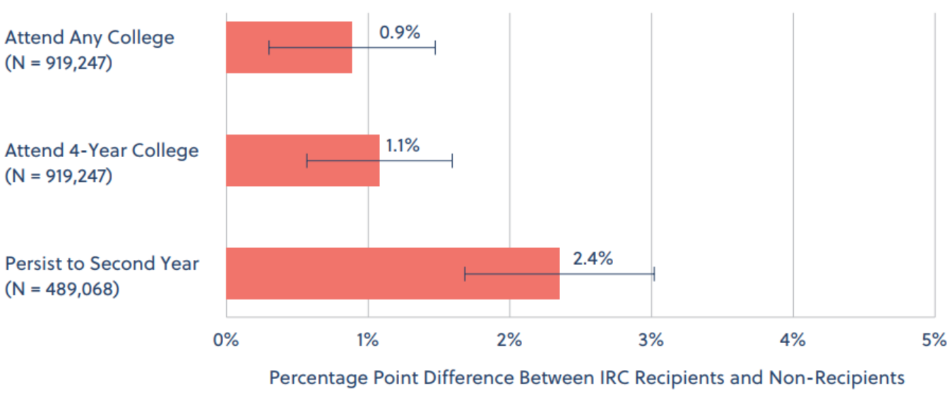
Finding #4: IRC recipients slightly more likely to go to college compared to non-recipients
Large decrease
Small decrease
Small increase
Large increase

Slide 14
Q5: How aligned are IRCs with students’ college majors and jobs?
Very misaligned
Somewhat misaligned
Somewhat aligned
Very aligned

Slide 15
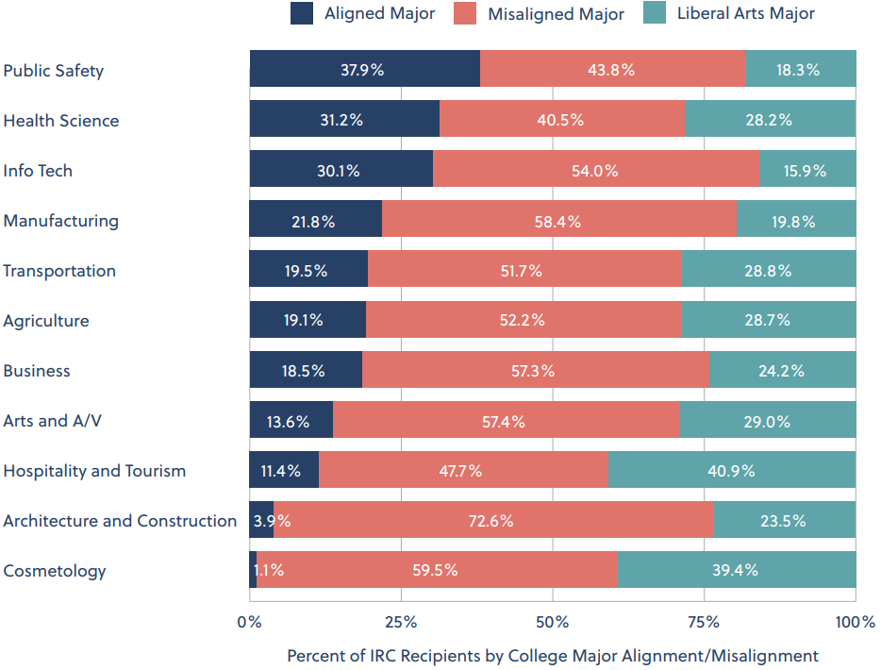
Finding #5: IRCs are very misaligned with college majors and employment
Very misaligned
Somewhat misaligned
Somewhat aligned
Very aligned

Slide 16
Q6: What factor most strongly shapes which students earn IRCs?
Race/ethnicity
SES
Gender
Disability status
Test scores
Coursework
The school students’ attend
Geography (e.g. rural/urban)

Slide 17
Finding #6: Schools matter most!
Race/ethnicity
SES
Gender
Disability status
Test scores
Coursework
The school students attend
Geography (e.g. rural/urban)
Schools explain 50-80% of the variation in IRC receipt depending on IRC subject
However…
School demographics don’t matter
School achievement doesn’t matter
School model (e.g. Early College High School, T-STEM Academy, etc.) doesn’t matter
Why do schools matter? I don’t know!

Slide 18
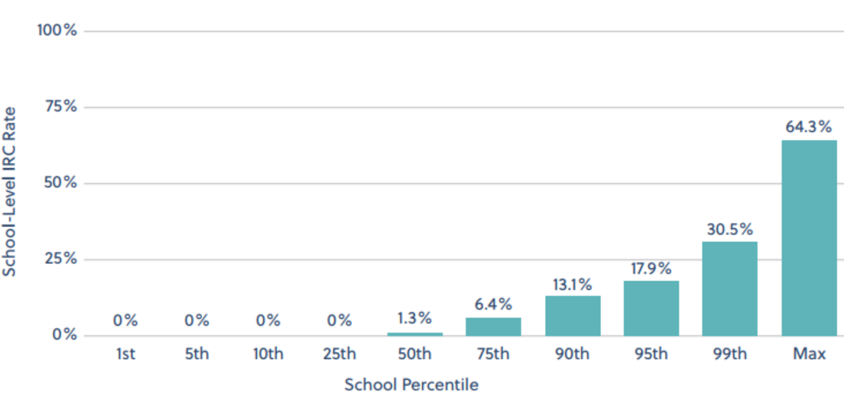
Finding #6: Schools matter most!

Slide 19
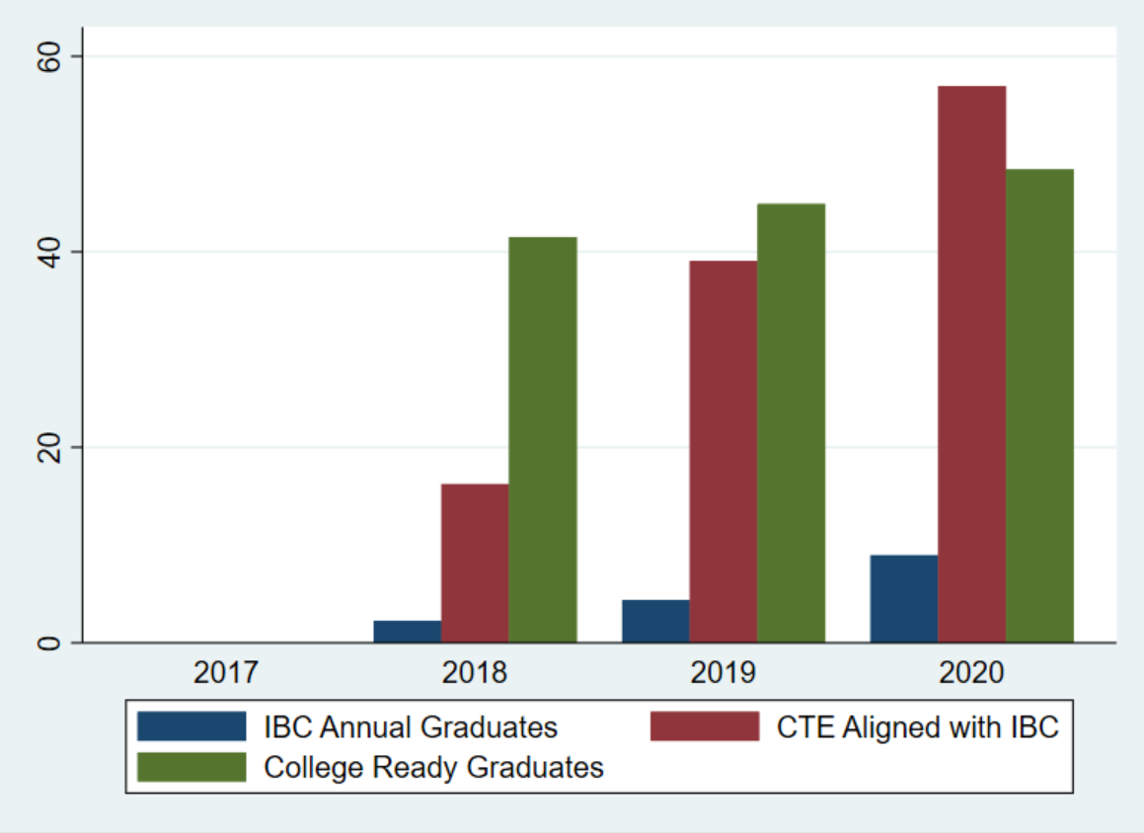
How are schools responding to CTE/IBC policy?
Supplemental analysis of school-level metrics on Texas Advanced Performance Reports (TAPR)
Three metrics:
1) IBC graduates
2) Graduates completing CTE coursework aligned with IBC
3) College ready graduates
Both IBC and aligned CTE rates increased much faster than college ready rates

Slide 20
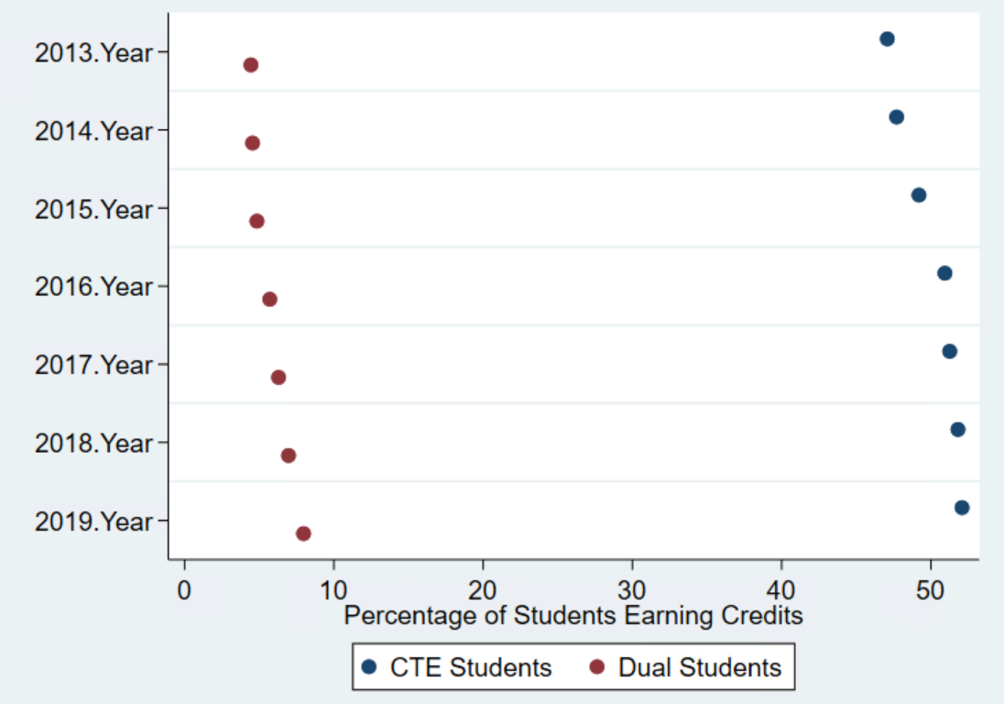
Are students taking more CTE courses?
Supplemental analysis of HS transcript data
Percentage of students taking dual-credit each year increased most from 2016-2019
CTE course-taking increased from 2013-2016 but stagnated from 2017-2019

Slide 21
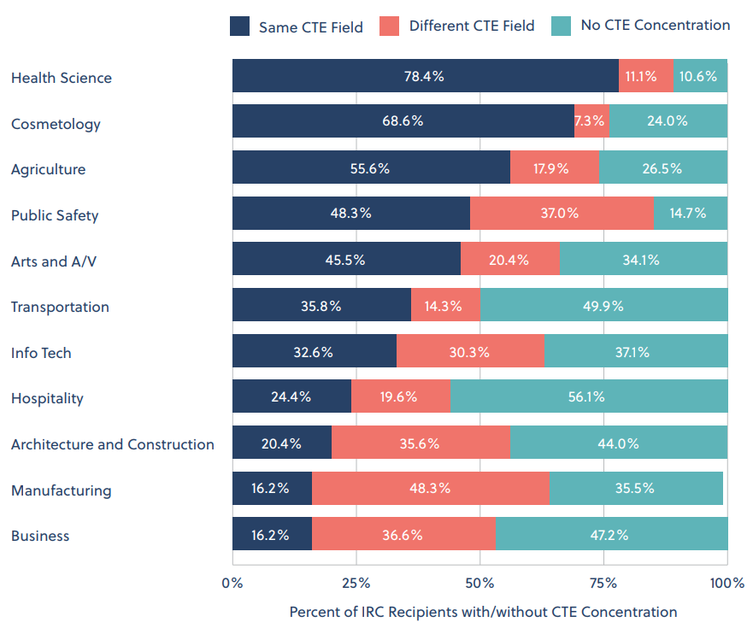
Many IRC recipients are not concentrating in aligned CTE clusters
Substantial variation across CTE clusters in alignment between IRC subject and CTE concentration
Half of IRC recipients in some clusters did not concentrate in any CTE field
~84% of IRC recipients in fields such as manufacturing and business did not concentrate in that subject

Slide 22
Discussion
IRCs provide modest and equal earnings boost for all demographic groups without strongly deterring students from college
Are IRCs game-changers? Probably not.
Should we let all IRCs count equivalently in state policy? Probably not.
Should we consider students to be “career ready” because they earned an IRC? Probably not.
Do we need more research on IRCs? Probably not.
Just kidding, we definitely do!
Notes:
Content slide w/o bullets

Slide 23
I look forward to your questions!
Matt Giani
Research Associate Professor
Department of Sociology
The University of Texas at Austin matt.giani@austin.utexas.edu

