Slide 1


Navigating Implementation of the Modernized National Career Clusters® Framework
Introducing the updated learner-centered and industry-responsive National Career Clusters Framework.
September 2025
CAREERTECH.ORG

Slide 2
Slide Deck Purpose (can be removed after reading)
This slide deck is intended to provide a general background about the newly modernized National Career Clusters Framework
This slide deck is created by and the intellectual property of Advance CTE, the steward of the Framework
Slides can be added or deleted to align with audience needs, but the content of slides should not be changed

Slide 3

The Rapidly Changing World of Work
2002: Introduction of the original National Career Clusters® Framework. What else happened in 2002?
First iPod released
Launch of Google News
Launch of Amazon Web Services
Over half of US jobs only require limited digital skills
Facebook, YouTube, and the Android operating systems do not exist.
Gig work, hybrid and remote work, drones, and digital media are not common occupational vocabulary

Slide 4
The Rapidly Changing World of Work
The world of work has changed dramatically and continues to transform.
Twenty years ago, many of today’s careers did not exist.
Other existing careers now require a new set of skills.
And there will be new careers that we are just beginning to imagine.
The world of learning must respond.

Slide 5

Background

Slide 6
Purpose Statement
The National Career Clusters Framework provides structural alignment and a common language to bridge education and work, empowering each learner to explore, decide on, and prepare for dynamic and evolving careers.

Slide 7
About Advance CTE
ADVANCE CTE MISSION
Support state Career Technical Education (CTE) leadership to advance high-quality CTE policies, programs and pathways that ensure career and college success for each learner. Advance CTE serves as the steward of the National Career Clusters Framework.
A CENTURY OF SERVICE
Advance CTE is the longest-standing national non-profit representing State CTE Directors and leaders responsible for secondary, postsecondary and adult CTE.
SUPPORTING STATE LEADERS
Advance CTE has members from all 50 states and three territories.
AREAS OF FOCUS
Advance CTE supports its members through federal advocacy, virtual and in-person convening space, technical assistance and development of resources
OUR REACH
Advance CTE participates in over a dozen national initiations to expand the footprint and impact of high-quality, CTE.

Slide 8

Framework Purpose and Users
Career Exploration & Advising
CTE Program Design
Industry Alignment & Collaboration
Administration & Staffing
Notes:
Information for each category: https://careertech.org/career-clusters/your-place-in-the-framework/.

Slide 9
The Original National Career Clusters® Framework
Launched in 2002, the original National Career Clusters Framework was designed to:
encompass the entire world of work
collect educational groupings using common knowledge and skill statements
guide learners through an aligned program of study that leads to a career-oriented future
16
Career Clusters
Developed as a new means to organize CTE programs
79
Career Pathways
To help learners navigate their way to greater success in college and career.

Slide 10

The Modernized National Career Clusters® Framework

Slide 11
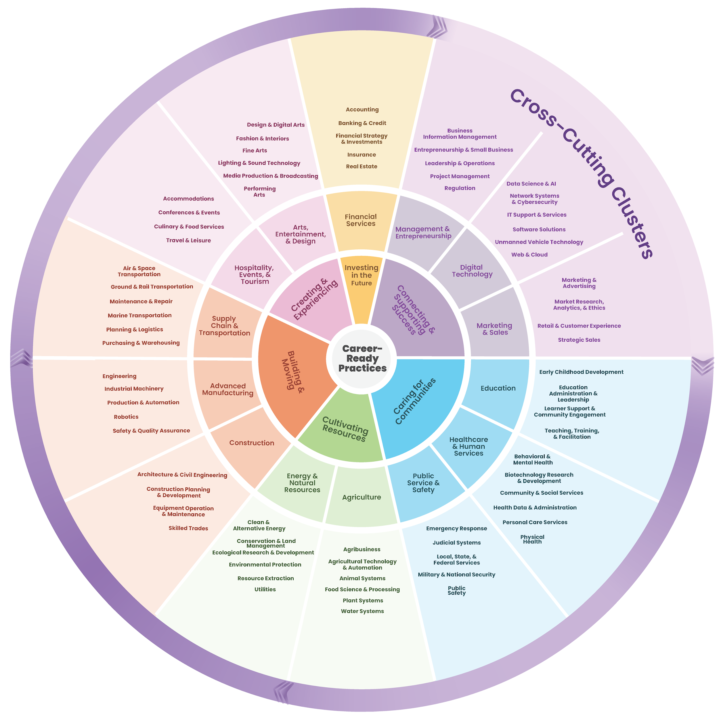
The Need for a Modernized Framework
The Framework:
Wheel Version

Slide 12
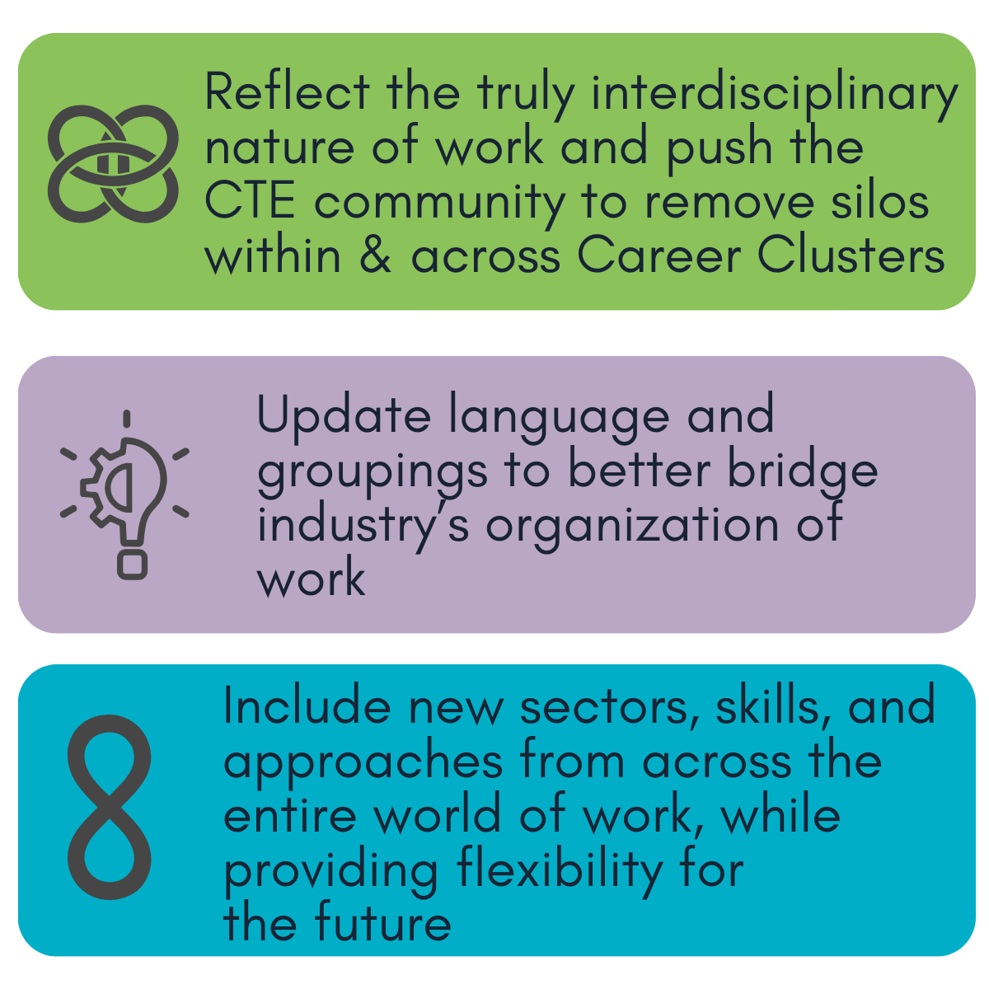
The Need for a Modernized Framework

Slide 13
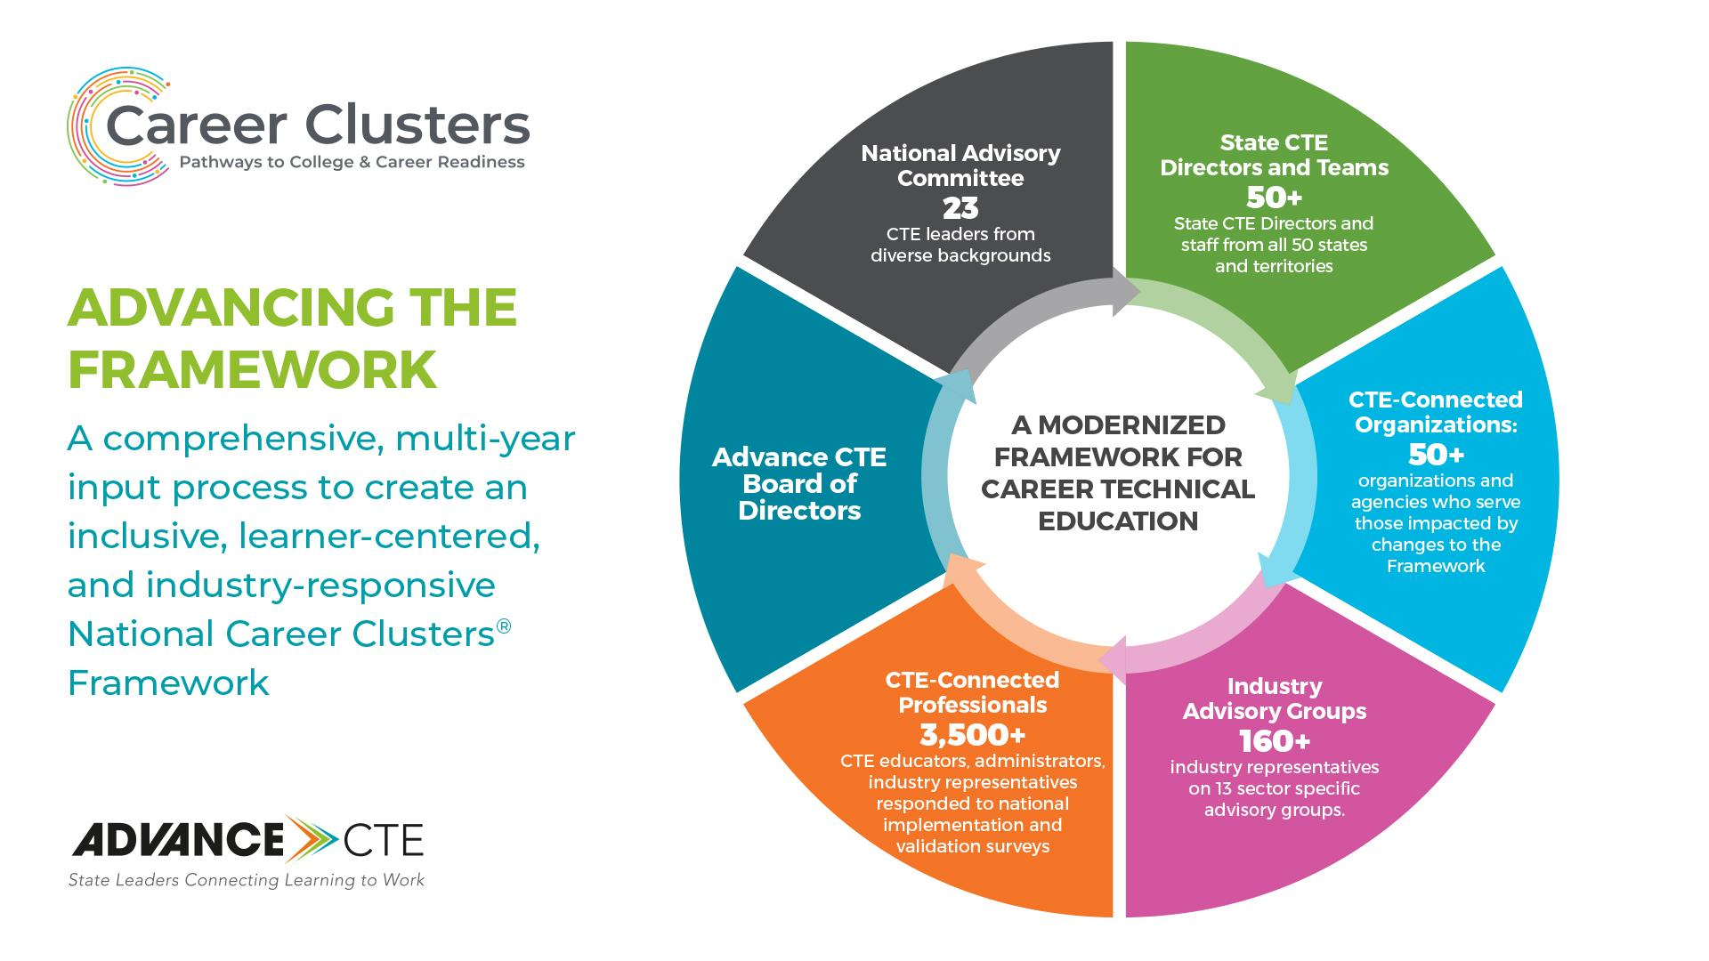
An Inclusive Process

Slide 14
Career Clusters Impact
The modernized Framework transforms:
PATHWAYS
SYSTEMS
LIVES
to be more personalized and better meet the needs of learners, industry, and communities.
by breaking down silos between sectors, disciplines, and systems.
by preparing learners of all ages and backgrounds for dynamic and high-opportunity careers

Slide 15
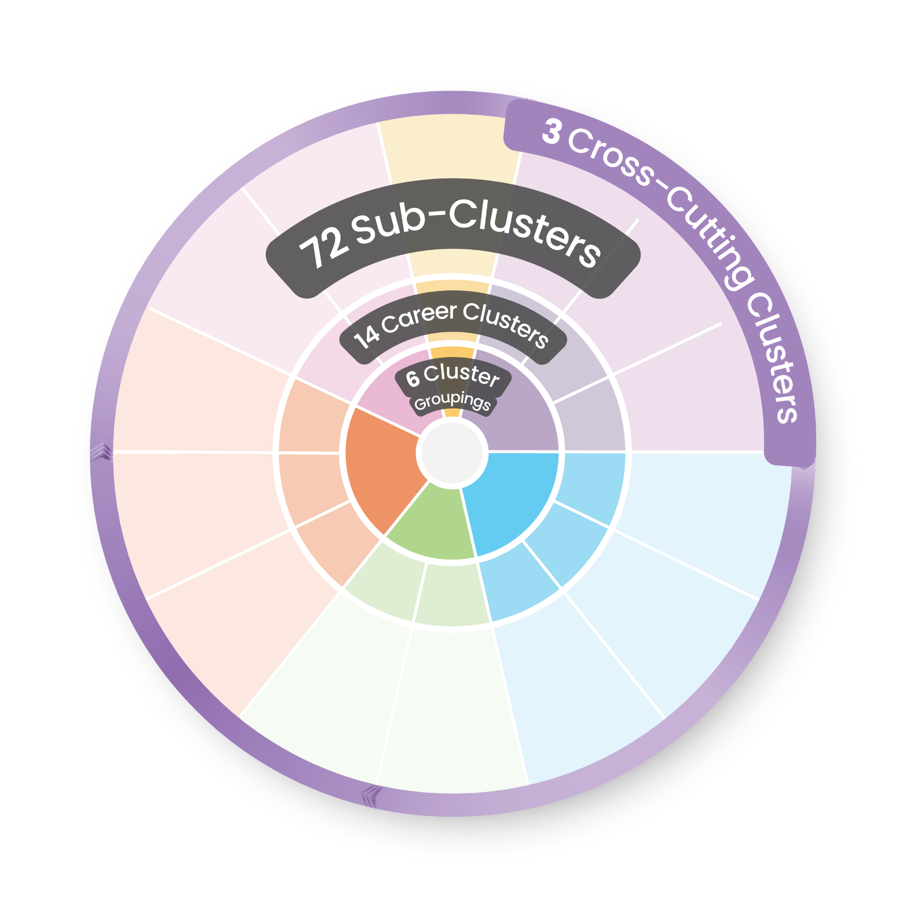
The National Career Clusters Framework
Career Clusters
14
Sub-Clusters (NEW)
72

Slide 16
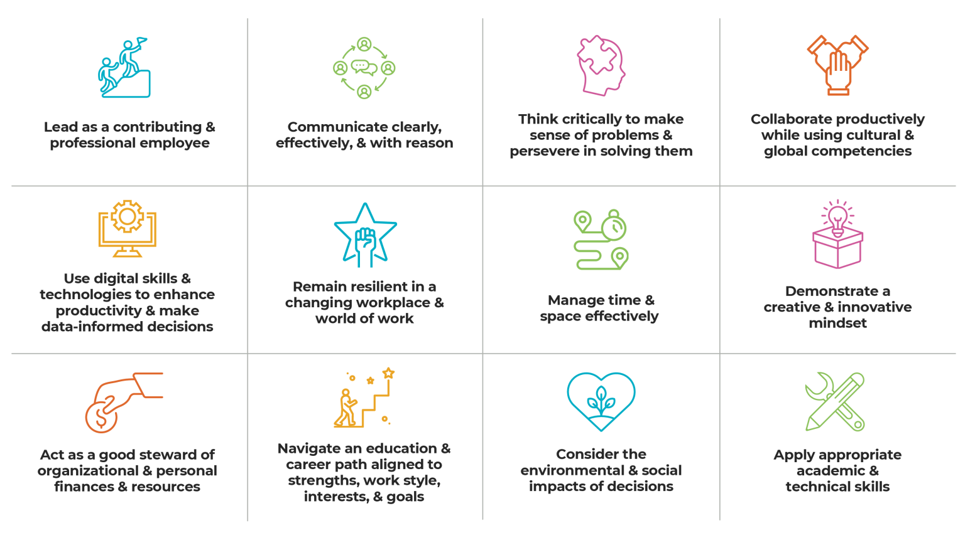
Layer: Career Ready Practices (CRP)
Built on a meta-analysis of over 30 different listings of general professional skills developed by industry and educational institutions, represent the skills needed to succeed in the modern workplace.
These 12 practices should be embedded across the pre-kindergarten to workforce continuum and within each Career Cluster.

Slide 17
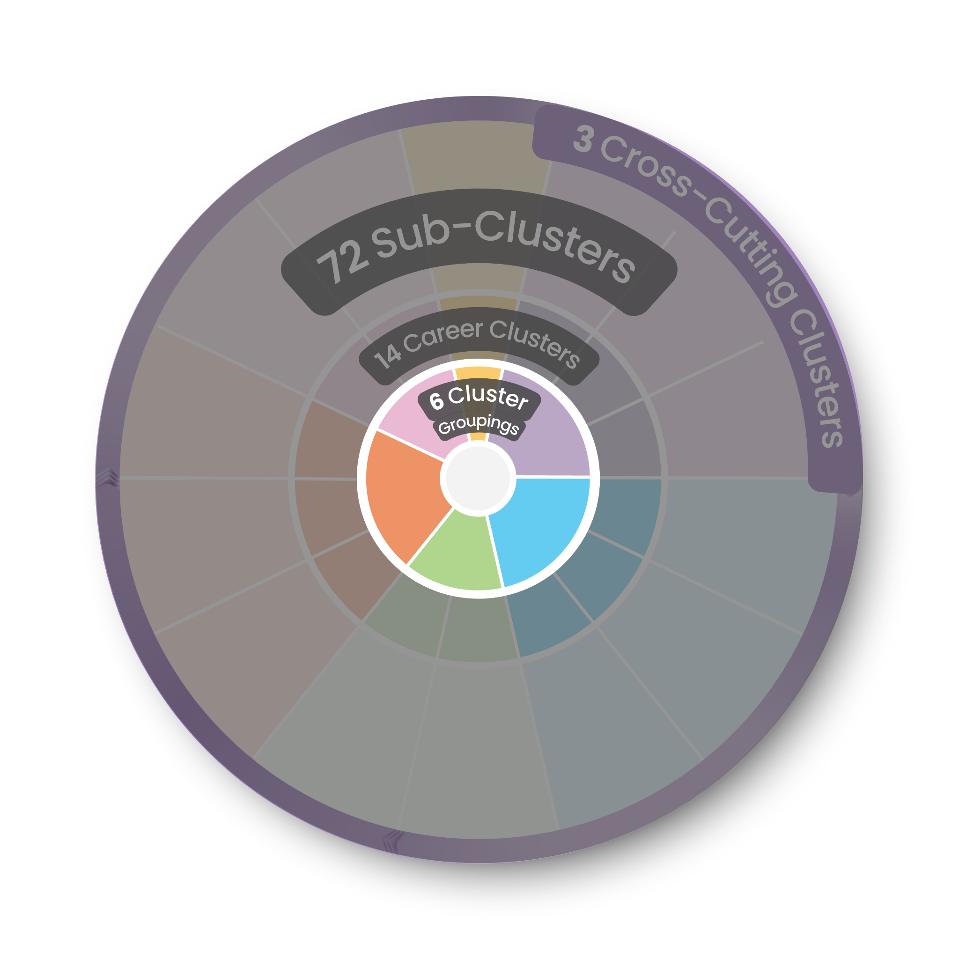
Layer: Cluster Groupings
Large purpose-driven meta-sectors that help guide young people toward Clusters that are aligned with their interests, their sense of purpose, and the impact they want to make on their communities
Aid learners to see career opportunities across multiple Career Clusters
Career
Ready
Practices

Slide 18
Cluster Groupings
Building & Moving
Caring for Communities
Connecting & Supporting Success
Creating & Experiencing
Cultivating Resources
Investing in the Future

Slide 19
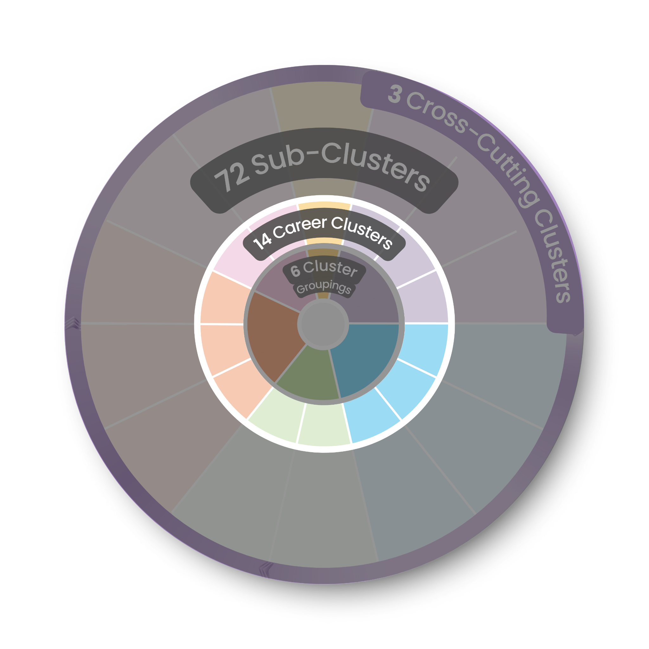
Layer: Career Clusters
Industry sectors as defined by groupings from Standard Occupational Classification (SOC) and North American Industry Classification System (NAICS) codes
States have historically used this as a foundation for CTE program of study design
Career
Ready
Practices

Slide 20
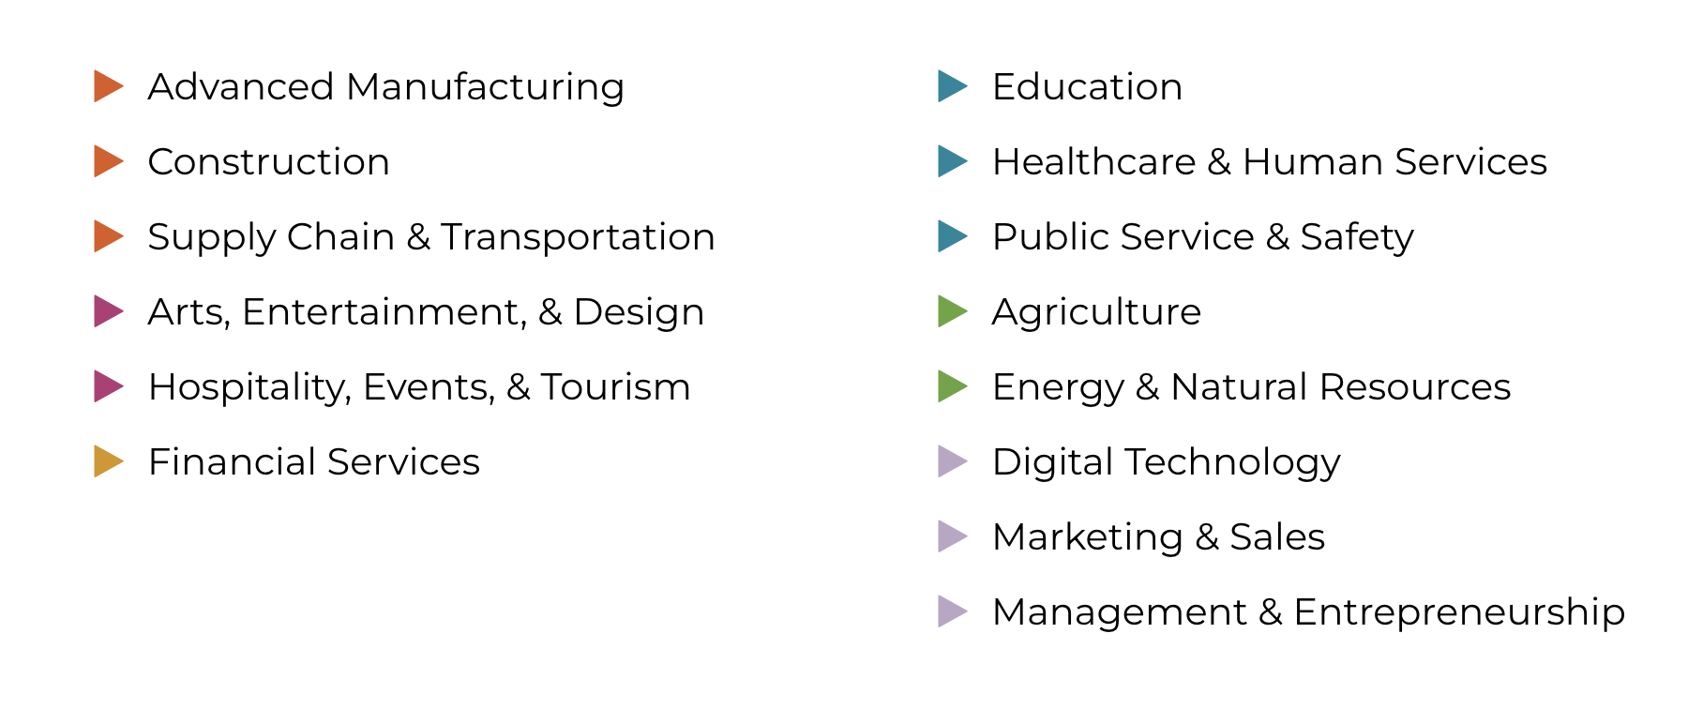
Modernized Career Clusters
14
Career Clusters

Slide 21
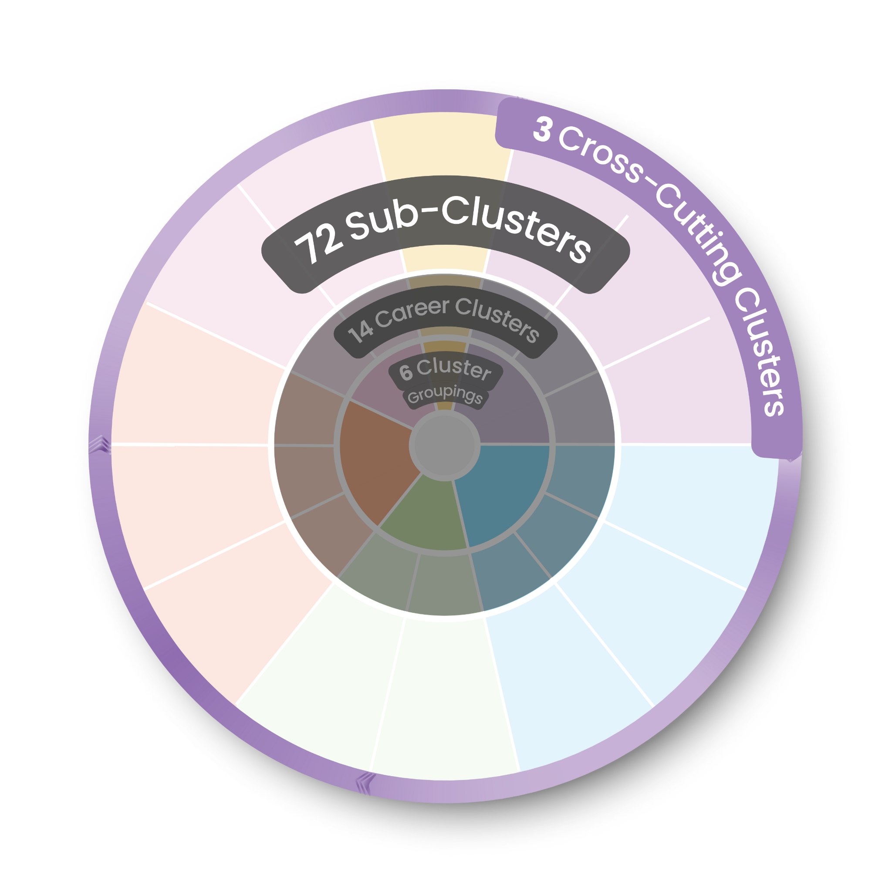
Layer: Sub-Clusters
Major groupings of career areas within a given field that have similar skills as defined by industry area
Each Cluster contains multiple Sub-Clusters
Can be customized to align with state and community labor market data and program structure
Career
Ready
Practices

Slide 22
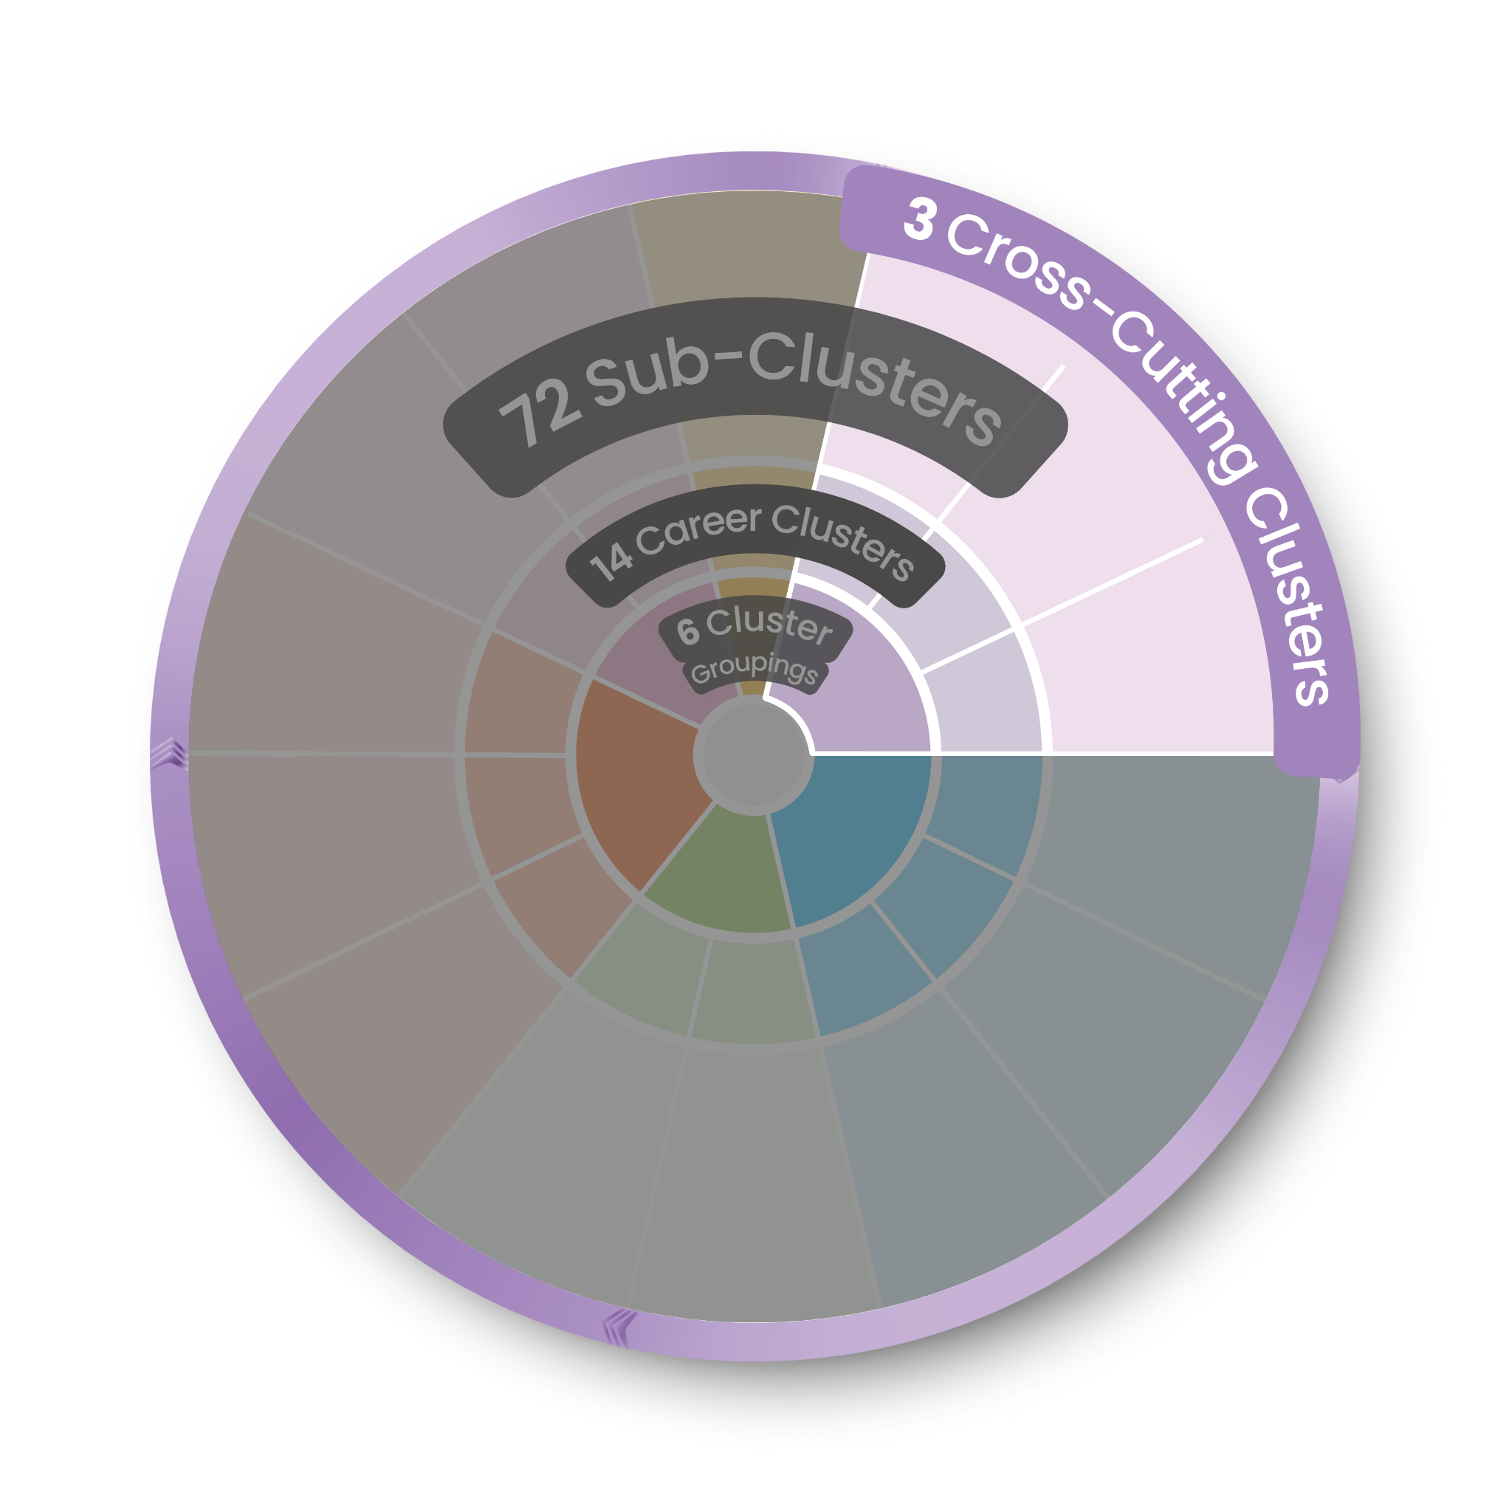
Layer: Cross-Cutting Clusters
Clusters that are based on both sector-specific and contextualized functions instead of purely discrete industry sectors. These Clusters have both Sub-Clusters and implications for courses taken in all other Career Clusters
Cross-Cutting Clusters are both a standalone Cluster but can also be combined with other Career Clusters
Career
Ready
Practices

Slide 23
Summary of Major Changes
Nothing was removed, only reorganized - everything is located somewhere
Modernization of world of work
Inclusion of Energy into Framework
Introduction of major modern industry focuses, including advanced technologies, automation, robotics, etc.
IT was expanded to Digital Technology

Slide 24
Summary of Major Changes
More reflective of industry sectors
Law and Public Safety, Government and Public Administration combined
Natural Resources moved from Agriculture to Energy
Combined Health Sciences & Human Services into Healthcare & Human Services
Dissolution of STEM cluster
Development of Cross-Cutting Career Clusters
State-level customizability

Slide 25
Katahdin Javner, 2023-2024 SkillsUSA National Officer
“
Learners will be able to have direct access to careers that are just now being created. There will be better access to resources and opportunities to support skills development in new and changing fields like artificial intelligence or those like agriculture that are evolving and intersecting with other industries.
With this Framework, there will truly be no better time to be a learner.
”

Slide 26
Exploring the Cross-Cutting Career Clusters

Slide 27

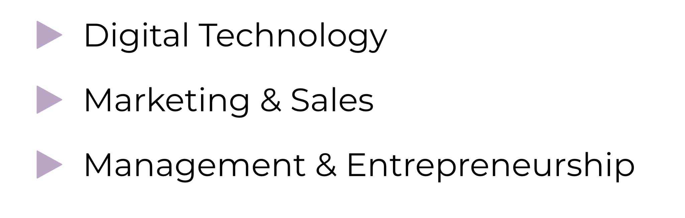
Cross-Cutting Clusters

Slide 28
Case Study: Austal
Digital Technology
CAD/CAM
Controls designer
Imaging specialist
Security engineer
Management & Entrepreneurship
Fitout Manager
Program coordinator
Operations manager
Marketing & Sales
Business development
Events specialist
Packaging and sales
All roles have knowledge of maritime, manufacturing, or other industry specific information as preferred qualification

Slide 29
Cross-Cutting Clusters Two Ways
Learner A
Loves working with drones
Takes two courses in drone technology and programming
Wants a contextualized application for drones
Takes an Ag capstone that involves WBL experience with agricultural surveying company
Learner B
Grew up in rural community
Wants to be a farmer but is interested in how drones could be used
Takes a drone technology course
Takes the same Capstone as Learner A

Slide 30
Potential Use Cases of Cross-Cutting Clusters
Capstone courses in entrepreneurship, data science, or market research that count towards any program of study.
Flexibility in courses in a Career Cluster that can/should be taught across multiple Clusters (e.g., digital design, operations, welding)
Integrated programs of study that draw across Career Clusters, such as Artificial Intelligence & Robotics (Digital Technology and Advanced Manufacturing) or Media Production & Advertising (Arts, Entertainment, & Design and Marketing & Sales).

Slide 31
Cross-Cutting Clusters in Practice
North Carolina using Digital Technology Cross-Cutting to help fulfill Computer Science graduation requirement
Iowa leveraging Cross-Cutting content in exploratory and early CTE courses
Delaware maximizing on incorporation of project-based learning in Cross-Cutting courses to support contextualized instruction
Virginia, North Carolina, and Georgia allow entrepreneurship to count towards any program of study

Slide 32
Impacts and Opportunities for Innovation

Slide 33
The Implementation Phase
Three Principles of Implementation
IT WILL
TAKE TIME
ADVANCE CTE SUPPORT & PARTNERSHIP
STATE-DRIVEN PROCESS

Slide 34
Priority Policy Areas for Alignment & Innovation
Maximizing the Framework requires policy changes that allow for more dynamic and personalized CTE programs for every learner:
Program of Study Design and Sequencing
Data System Design, Collection, & Analysis
Career Advising & Exploration
Educator and Learner Credentialing
Industry and Labor Market Information Alignment
Postsecondary Alignment
& Connections

Slide 35
National Implementation: Where We Are
Most states adopting Framework with little customization or minor edits
Career Technical Student Organization (CTSOs) aligning competitions & programs to Framework
Updated wheel design based on feedback from the field
Currently developing new resources for state leaders
O*Net updated and aligned to modernized Framework
Fall 2025: States required to collect Perkins V data for 2027 USED Consolidated Annual Report (CAR) based on current Career Clusters

Slide 36
[STATE NAME]: Where We Are
[Implementation Update #1 - FILL IN]
[FILL IN]
[FILL IN]
[FILL IN]
[FILL IN]
[FILL IN]

Slide 37
Enhancing Systems Alignment
All Secondary and Postsecondary Pathways
Work-Based Learning Content Design & Promotion
Career Advising & Exploration
Labor Market Information
Imagine all of these systems/experiences using aligned Cluster language in their design:
Job Descriptions
Statewide Data Systems

Slide 38
Expanding Learner Agency
Through the Framework, we can uplift learners’
Voice
Choice
Opportunity
Expand learner self-advocacy and participation in policy making/program development
Learners can make data-informed and educator-supported decisions about their future
Course/pathways offerings and instruction align with learner interest and employer/labor needs

Slide 39
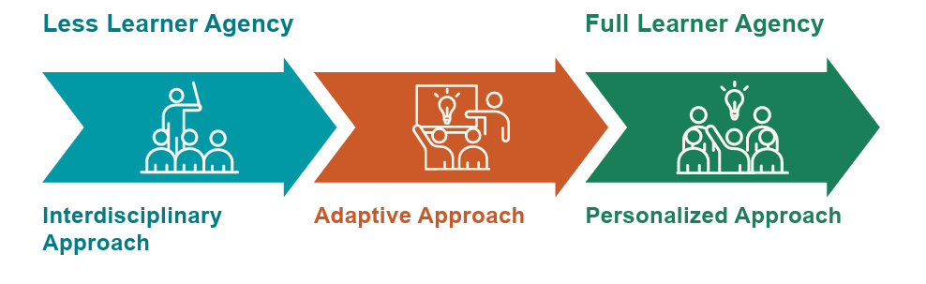
Enhancing Pathways Personalization
Fully integrated that combines content across multiple Career Clusters
Involve learners in design
Set or customizable course sequence
Menu of course topics and structures across multiple Career Clusters
Learners drive design
Full customized course design and sequence
Learners drive design with guidance from advising professional
Similar to ‘independent study’

Slide 40
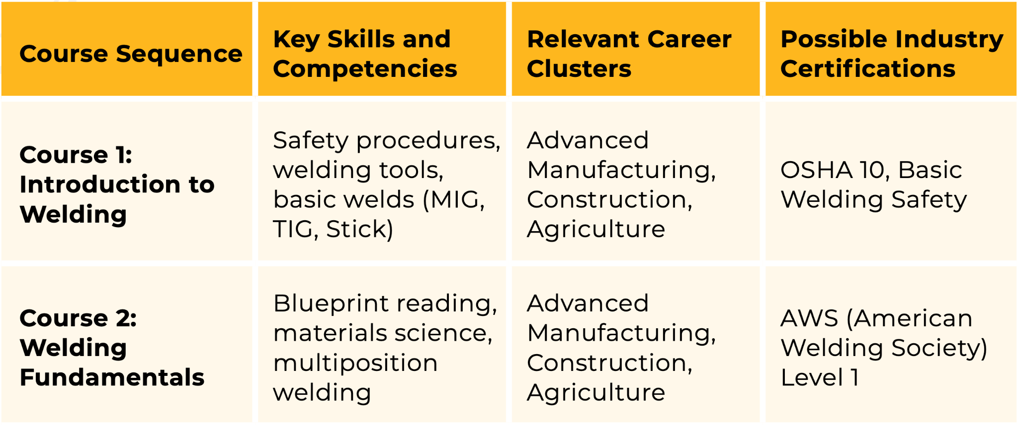
Interdisciplinary Approach: Welding

Slide 41
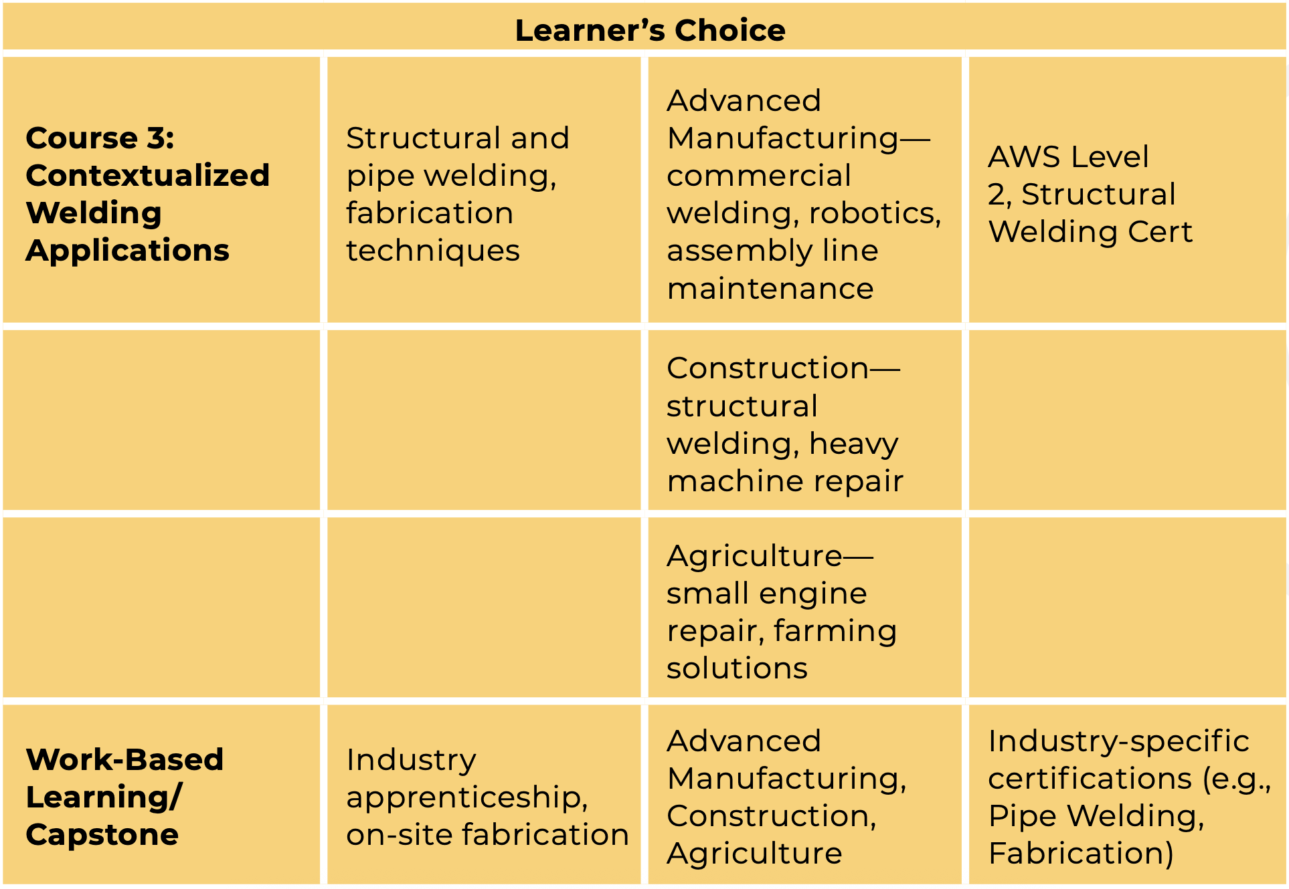
Interdisciplinary Approach: Welding

Slide 42
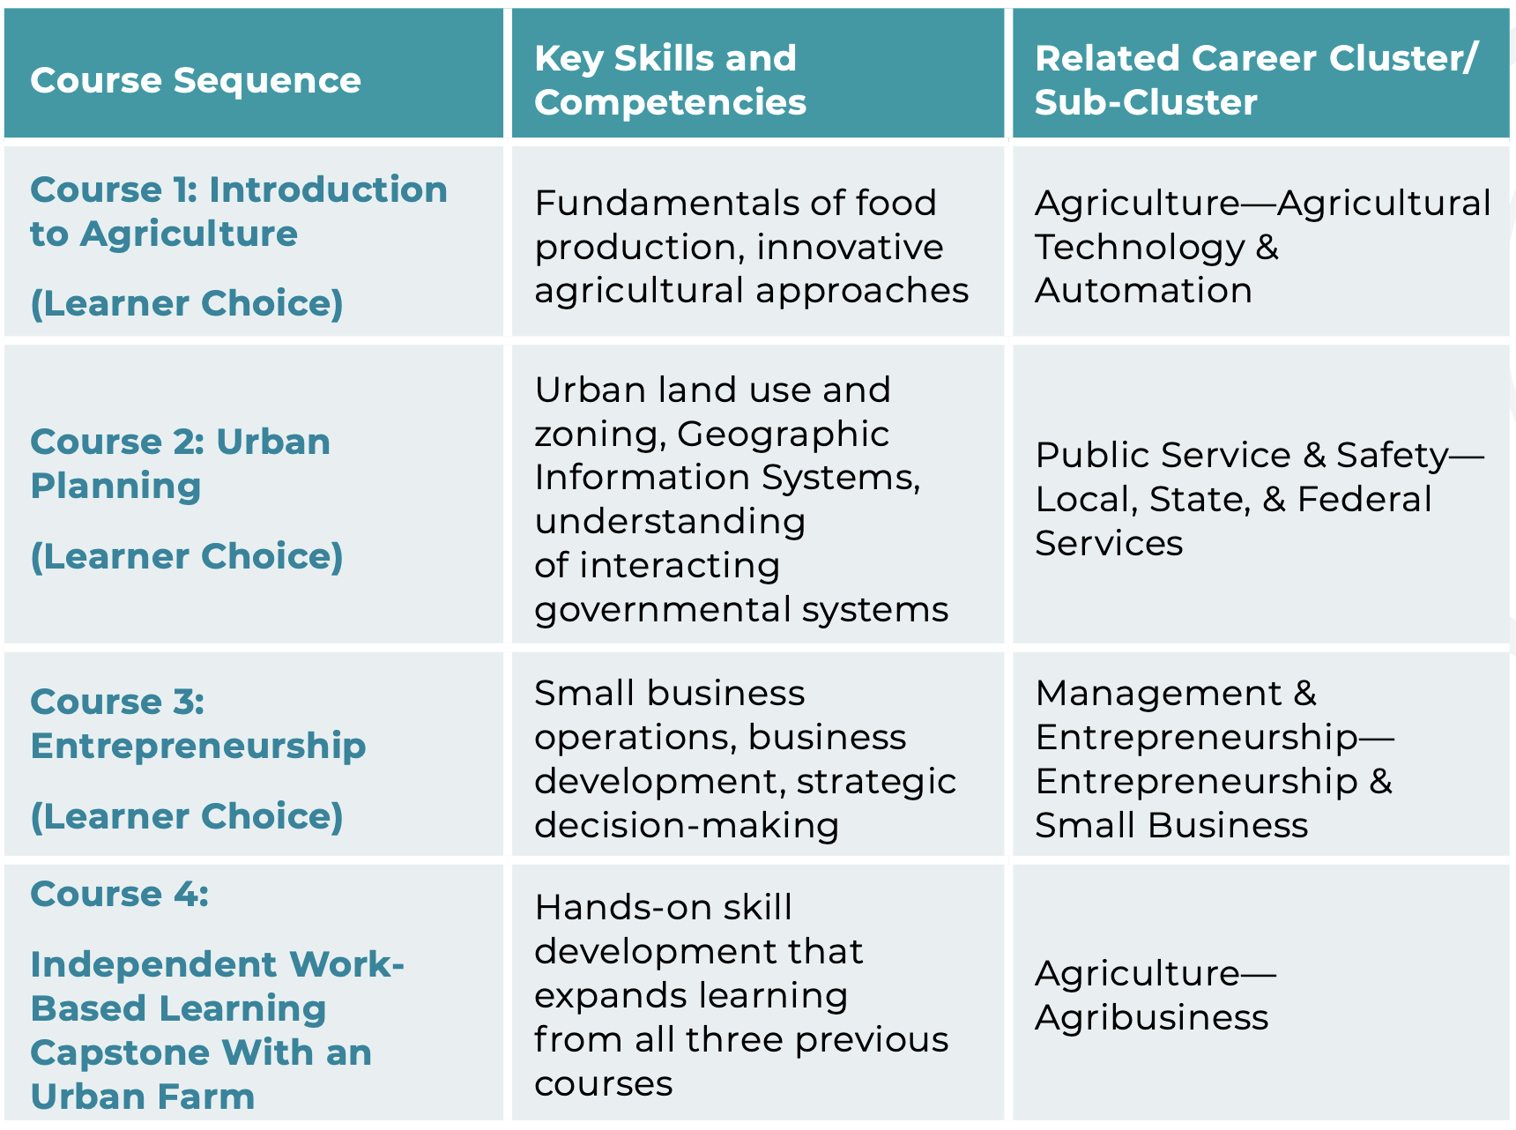
Personalized Pathway: Urban Farming

Slide 43
OPTIONAL: CTSO Systems Impacted
Competitive Events
BPA: Workplace Skills Assessment Program
Chapter Activities
Skillbuilding, Projects, Employer Engagement, etc.
Technical Standards
CTSO-based or National (BPA: NBEA, CSTA, AICPA)
Future: Program of Study
Expansion of Skills and Careers for Inclusion
Membership Eligibility
Varies by organization and state
Classroom Curriculum

Slide 44

Explainer and Implementation Resources
Framework Resources

Slide 45
Resource Areas
Framework Guidebook: Description of all Clusters and Sub-Clusters
Crosswalk: Original Framework to Modernized Framework, Clusters to SOC, NAICS, CIP codes
Implementation Support: Initial Policy Pushes, Four Policy Briefs, CTSO Implementation
Learner Tools: Project Graphics, Industry Sector Profiles, Career Interest Survey
Explainers: Framework History, Interdisciplinary Elements, Technical Report, Methodology
Connectors: Framework and STEM, Family & Consumer Sciences, Green Workforce

Slide 46
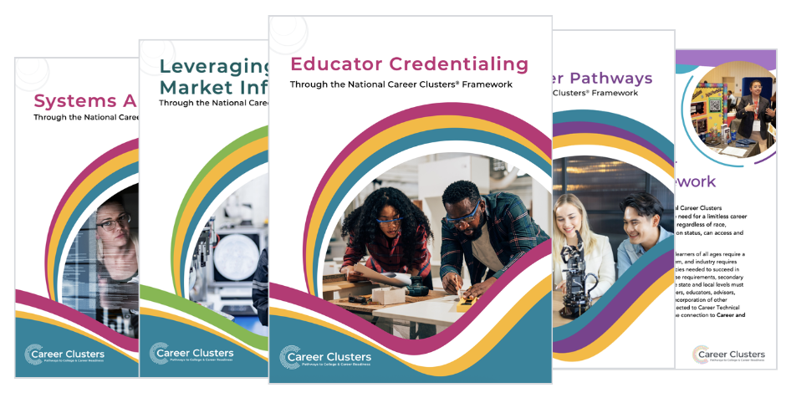
Implementation Guidance Briefs
Four Policy Profiles: Flexible Pathways, Systems Alignment, Educator Credentialing, LMI
Priority areas for the ideal state
State examples
Reflection questions
Program of study examples

Slide 47
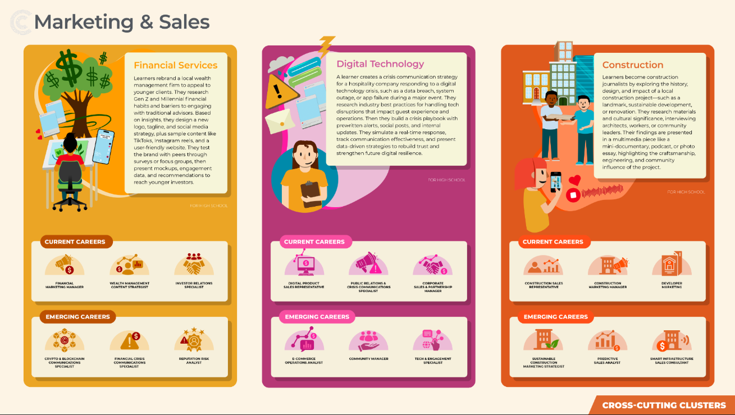
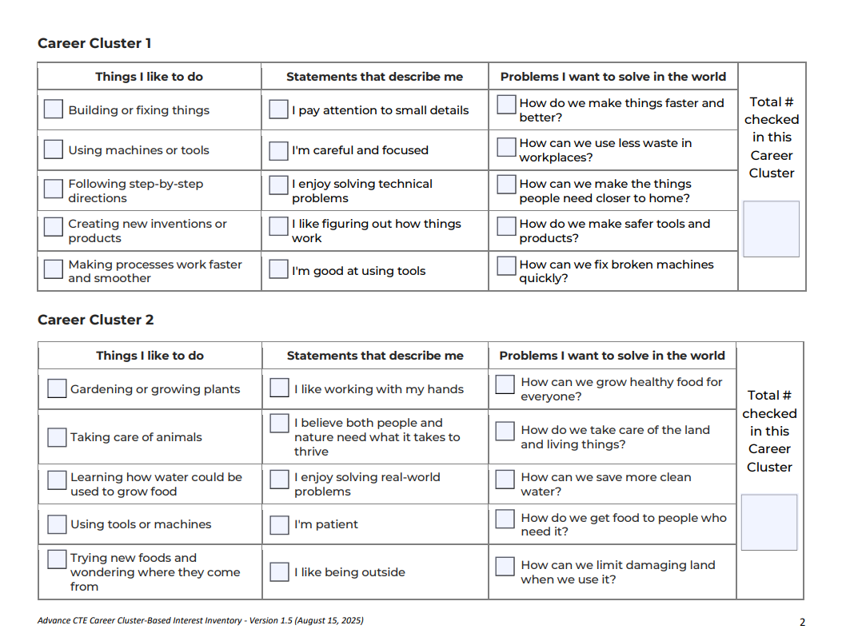

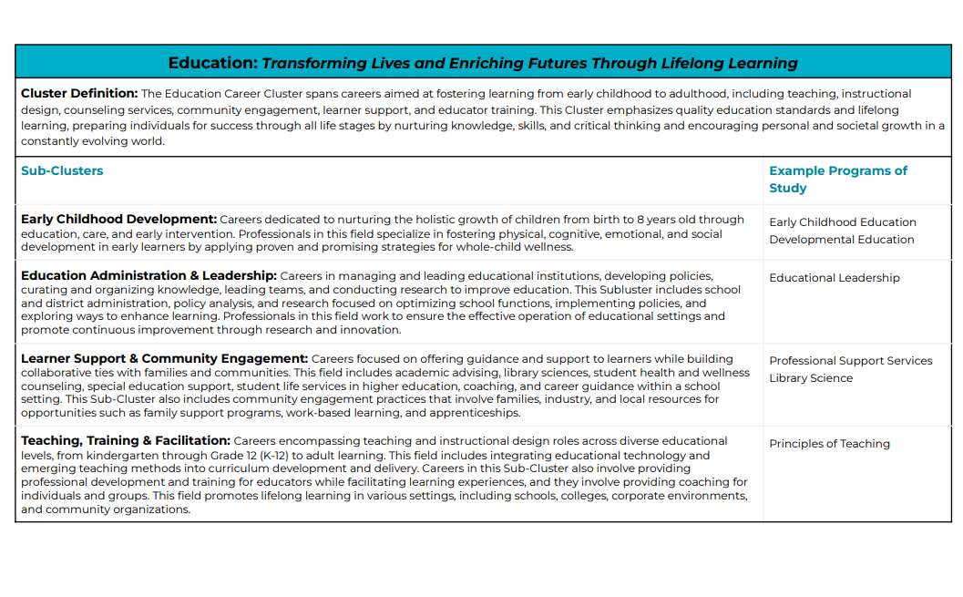
Resources for Learners
Career Interest Surveys
Industry Sector Profiles
Cluster Project One-Pagers
Guidebook

Slide 48
Getting Started
Explore the Framework
Raise Awareness
Navigate our website and resources to get a better understanding of the Framework, and share with others!
Meet with key partners to discuss what the new Framework means for your state/community
Sign up to stay updated on the latest resources and news about the Framework!
Assess Policies
Create Timeline
Review existing resources, policies, and practice to compile where the Framework is used and how
Develop a timeline for implementation and key milestones/stages

Slide 49
Q&A

Slide 50
Advance CTE Contact
careerclusters@careertech.org
NAME
TITLE
Organization
Email

