Slide 1
Advancing the Framework
Creating an Inclusive, Learner-centered, and Industry Responsive National Career Clusters® Framework
2024 Update
CAREERTECH.ORG

Slide 2
OVERVIEW
Advance CTE is currently in the process of modernizing the National Career Clusters® Framework to be more reflective of the current and future world of work. This update will provide information about that process including:
Who is Advance CTE?
What is the National Career Clusters® Framework?
Why is the Framework being updated?
How is the Framework being updated and who is involved in the process?
What is the timeline for launching the new Framework?
How will the new Framework be implemented?
Notes:
This slide provides an overview of what will be shared in the presentation.

Slide 3
ABOUT ADVANCE CTE
ADVANCE CTE MISSION
Support state Career Technical Education (CTE) leadership to advance high-quality and equitable CTE policies, programs and pathways that ensure career and college success for each learner.
A CENTURY OF SERVICE
Advance CTE is the longest-standing national non-profit representing State CTE Directors and leaders responsible for secondary, postsecondary and adult CTE.
SUPPORTING STATE LEADERS
Advance CTE has members from all 50 states and three territories.
AREAS OF FOCUS
Advance CTE supports its members through federal advocacy, virtual and in-person convening space, technical assistance and development of resources
OUR REACH
Advance CTE participates in over a dozen national initiations to expand the footprint and impact of high-quality, CTE.
Notes:
If your audience is already familiar with Advance CTE, you may wish to eliminate these background slides, but a key point to make is that Advance CTE has been the steward of the National Career Clusters Framework since its inception.

Slide 4
CTE WITHOUT LIMITS
SHARED VISION
MONTANA
$126,942
Developed with input from nearly 200 national, state and local education and workforce development leaders.
NEW YORK
$126,942
SHARED SUPPORT
Supported by over 40 national organizational partners and over 1,000 state and local CTE leaders.
CALIFORNIA
$126,942
RESOURCE REPERTOIRE
Over one dozen resources to raise awareness of the vision and map steps towards implementation and realization.
TEXAS
$126,942
SUSTAINED SUPPORT
In 2022, 23 states received technical assistance to implement CTE Without Limits.
Notes:
Advance CTE has been consistently committed to driving innovation in CTE, and has created four visions for the field over the past two decades. The current vison CTE without limits, is a driving force for how the modernized Career Clusters can be implemented in a deeper and more impactful manner for every learner.

Slide 5
The Current National Career Clusters® Framework
Launched in 2002, the current National Career Clusters Framework is designed to:
collect educational groupings using common knowledge and skill statements
guide learners through an aligned program of study that leads to a career-oriented future
16
Career Clusters
Developed as a new means to organize CTE programs
79
Career Pathways
To help learners navigate their way to greater success in college and career.
Notes:
The next two slides are primarily for audiences who are not familiar with the current National Career Clusters Framework. This provides context for what the Framework is now to ground the changes that are ahead.

Slide 6
The National Career Clusters® Framework
The current National Career Clusters Framework has been the central building block to achieving consistently designed and high-quality CTE programs. It is an organizing tool for:
developing programs of study bridging secondary and postsecondary systems.
designing curriculum and informing instruction.
creating individual student plans of study for a complete range of career options.
establishing Common Career Technical Core standards with performance measures.
providing language to better connect CTE programs with industry.
providing meaningful, career-relevant education experiences to learners
Notes:
The modernization process is not a reflection that the Framework is not working.
It has been the backbone of our nation’s CTE programs that states have used to build and organized their programs around.
The current effort is a modernization process intended to strengthen the Framework as outlined in the next slide.

Slide 7
Modernization Basics

Slide 8
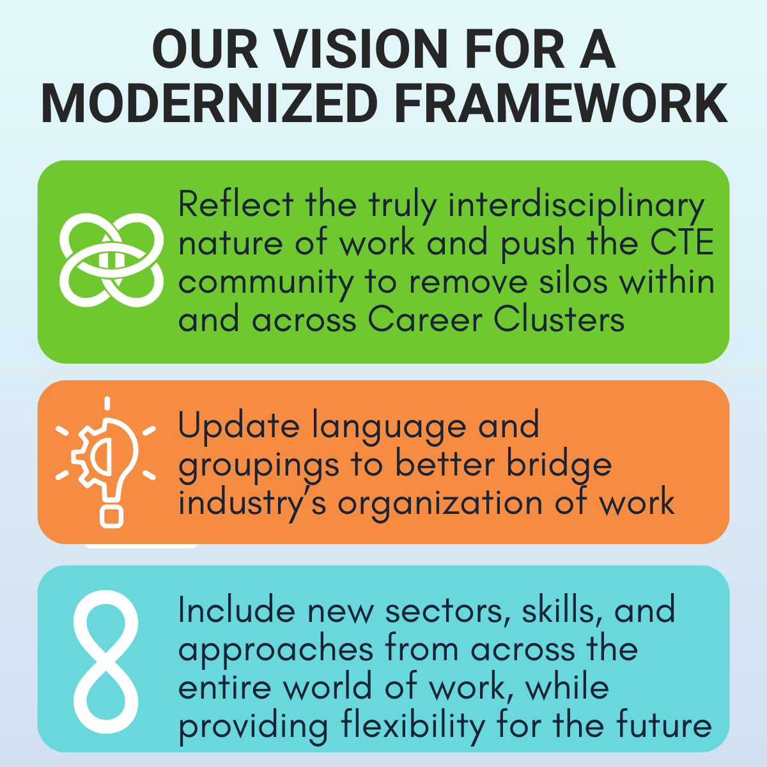
Why Modernize the Career Clusters® Framework?
The Need for A Modernized Framework Since the Framework’s creation in 2002, there have been tremendous shifts in the labor market, the nature of work and the workplace, and the role of technology. The current Framework does not reflect these changes.
Notes:
The Framework is being modernized to make it more responsive to the needs of industry and learners seeking good-paying jobs and sustainable career pathways.
A modernized Framework will:
reflect the truly interdisciplinary nature of work through more interconnections across clusters;
update language and groupings to better bridge industry’s organization of work with education;
include new sectors, skills, and approaches from the entire world of work, while providing flexibility for the future.
allow each state to implement the Framework to meet the needs of learners and labor markets they serve.

Slide 9
The Benefits of a Modernized National Career Clusters® Framework
Learners
Have access to more personalized paths to living wage jobs.
CTE Educators
Can align, design, and deliver programs that better reflect the interdisciplinary nature of work and the clusters.
Industries
Can hire learners with a lifelong learning worldview whose interests, skills, and work-based experiences align with industry sector and hiring needs.
State CTE Leaders
Can design programs and experiences that are more responsive to industry needs.
Gain skills for a variety of careers
More connected career readiness language that acts as a bridge between industry and education.
Provide resources and guidance to local leaders that reflect the needs of the modern workplace.
Enhances connection between in- and out of-classroom experiences, such as work-based learning.
Allows for stronger career exploration and advising models.
. Utilize language to describe their future careers more aligned with what is used by industry
….and so many more!
Notes:
This modernization strives to benefit all users of the current Framework.

Slide 10
The Modernization Methodology
Decisions about the structure of a modernized Framework is being developed based on:
Analyses of the North American Industry Classification System (NAICS) and Standard Occupation Codes (SOC)
Input from 13 sector specific Industry Advisory Groups
Sector-specific labor
market research validated by industry professionals
in each sector.
National surveys of the current Framework’s use, strengths and weaknesses
Direct input from the CTE community through member workshops and educator and partner organization input groups
State –level gap analysis of how the current Framework is being implemented and adapted
Notes:
The methodology behind the modernization process was intended to make the Framework more industry based, learner-centered, and more responsive to what will be continual transformations to the world of work.
This was both accomplished through analysis of industry classifications and with substantial input from industry advisory groups.
It is important to note that while the Framework is based on national data, it is—as it always has been—designed to be flexible so that states can adopt and adapt it based on their specific labor market needs.

Slide 11
An Inclusive Process
Notes:
Fully maximizing our methodology and achieving buy-in on a modernization Framework required an deep, ongoing, and inclusive input process from all members of the CTE community.
This graphic illustrates the structures that were created by Advance CTE to gather, process, and make decisions about applications on the input collected based on the methodology just shared. This has resulted in input from over 2,500 CTE professionals during the input phase, with many more to come during the next phase of work.

Slide 12
Expected Changes
The Framework is changing, but this is not a complete overhaul. Advance CTE anticipates:
Nothing in the current Framework to be removed.
Some reorganization and consolidation of existing Career Clusters.
New Career Clusters added based on labor market research.
More attention to be focused on the interdisciplinarity of clusters, particularly those that include careers that cut across all other sectors such as digital technology.
In the final analysis, the Framework will be modernized but many aspects of the current Framework are likely to be carried forward.
Notes:
The Framework is changing, but this is not a complete overhaul.
While there will be some reorganization and additions, nothing has been removed.
At this point, we anticipate that sectors, sub-sectors, and their embedded occupations will be added rather than removed from the Framework.
There will be some consolidation of existing Career Clusters and new Career Clusters added based on labor market research and feedback from industry representatives and stakeholders.
In the final analysis, it is likely that this will be an update rather than a complete overhaul, as many aspects of the current Framework are likely to be carried forward.

Slide 13
The Road Ahead

Slide 14
Where We Are Now
Advance CTE has concluded the Framework validation stage that began in March 2024.
June 2024
Draft Framework unveiled with more than 1,000+ participants at public webinar
June-July 2024
Public validation survey with over 1,400 responses
Summer 2024
Survey and validation phase analysis and testing against modern Framework methodology
October 2024
Release of final modernized National Career Clusters Framework
Summer 2024
Finalization and Board of Directors approval of final Framework
Fall 2024
Resource development and preparation for Framework implementation
Notes:
While the validation phase has ended, this is just the beginning of the process to make decisions on what final changes to make to the Framework and a multi-year implementation process.

Slide 15
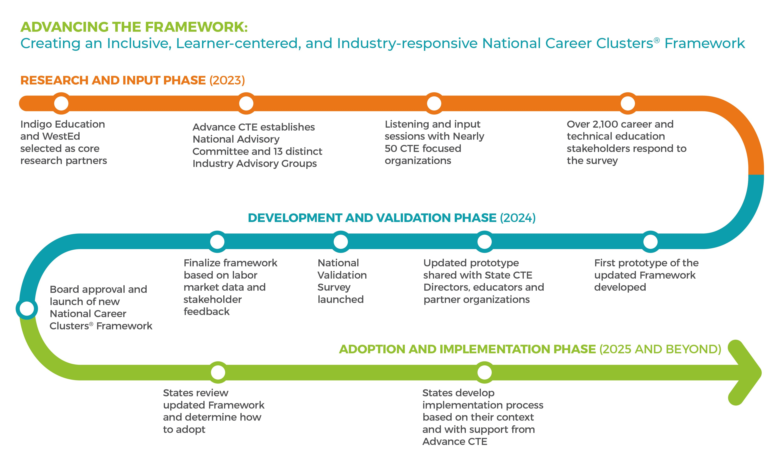
The Modernization Timeline
Notes:
This graphic shows the road Advance CTE and the CTE community have traveled so far towards modernization, and the road ahead.
There are a few key points to keep in mind about validation and implementation, which will be explained on the next slide.

Slide 16
The Implementation Phase
Three Principles of Implementation
A State-driven Process
It Will Take Time
Advance CTE Partnership
Notes:
Talking points to explain the principles:
A state driven process. States will design and execute an implementation strategy that adopts the entire Framework, or incorporates elements of the Framework into existing systems, to organize their CTE programs based on what makes the most sense for state, regional and local job markets.
It will take time. States will determine the pace of adoption and implementation. The goal is to ensure that the Framework is used to strengthen CTE programs now and for the future. That will take time.
Advance CTE is your partner. Advance CTE will work closely with states during the implementation phase providing both general resources and materials and working on state-specific needs that align with the pace at which the state chooses to adopt the Framework.

Slide 17
Preparing States for Implementation
Advance CTE will partner with states in the implementation phase, providing tools and resources, including:
Policy Guidance
To help address a variety of issues that may arise including teacher credentialing, reporting, and potential legislative or policy changes at the state level.
Communication Tools & Resources
To help states explain changes to the Framework and the implications for programs, courses of study, instruction and more.
Framework Crosswalks
To explain changes that were made in the modernization process and how the components of the current Framework are incorporated in the new Framework.
Industry Profiles
To help explain the connections between the updated clusters and how industry is organized.
Notes:
Advance CTE is preparing for changes that may be required due to the modernized Framework in areas including program of study structure, educator credentialing, state staff structure, Career Technical Student Organization (CTSO) alignment, data collection, legislative initiatives, and more.
Advance CTE will also provide state-specific and cohorted technical assistance to support state implementation, regardless of the speed at which you update the Career Clusters in your state.

Slide 18
Preparing for Implementation
Advance CTE will partner with national organizations and partners in the implementation phase, providing tools and resources, including:
Curriculum and Standards Development
Support organizations in updating curriculum tools aligned to the new Framework.
Resource Support
Provide advice and review resources that provide guidance on Framework adoption and implementation to partner clients and members
Career
Exploration
Offer support to develop new structures and curriculum for connecting Framework and career exploration
Co-Branding
Partner with Career Technical Student Organizations (CTSOs) to identify Clusters aligned to program priorities
Share national model standards with Advance CTE
Notes:
Advance will also work with national organization that support CTE and implementation of the Framework to develop tools, standards, and guidance that align to the new Framework and meet the diverse needs of states and specific industry sectors.

Slide 19
ADDITIONAL RESOURCES
The Advancing the Framework page includes many additional resources including:
Frequently Asked Questions
Common Myths about Modernized Framework
Communication Tools for communicating with CTE professionals
Information about the modernization process
And more!
Questions about the initiative?
Email careerclusters@careertech.org

