Slide 1
2025 Spring Convening
Atlanta, Georgia
May 5, 2025

Slide 2
Welcome Reception and Recognition Ceremony
5:00 - 7:00 pm
Awards beginning around 5:30 pm

Slide 3
Thank you for all that you’ve done over the past five years!
Without your collective stewardship of this project and this work, this initiative would have been as successful as it was.
You are all champions!

Slide 4
Secondary Pathways Champions
Boston
Marsha Inniss Mitchell
Denver
Samantha Haviland
Indianapolis
Jenny Berry
Nashville
Matt Nelson

Slide 5
Postsecondary Champions
Boston
Gail Stubbs
Columbus
Lauren Jones
Randy Smith
Dallas
Milan Sevak
Vicky Esparza
Denver
Adrienne Martinez
Indianapolis
Matt Rust
Nashville
Kim Silverman
Amy Aldridge

Slide 6
Workforce Champions
Boston
Jimmy Wyman
Columbus
Opal Brant
Indianapolis
Betsy Davis
Chelsea Meldrum
Nashville
Megan O’Roark
Mitchell Marquez

Slide 7
Fearless Leaders
Boston
Marinell Rousmaniere
LaVonia Montoute
Columbus
Calista Smith
Denver
Rana Tarkenton
Michelle Camacho Liu
Dallas
Richard Owens
Indianapolis
Marie Mackintosh
Nate Klinck
Nashville
Daryl Curry
National
Kate Kreamer Kathleen Mathers Leslie Sale

Slide 8
Champion Coaches & Liaisons
ESG Site Coaches
Heather Justice
Cynthia Liston
Alissa Peltzman
Advance CTE Liaisons
Dan Hinderliter
Tunisha Hobson
Haley Wing
Evaluation Champions
Laura Rasmussen Foster
Sandra Staklis

Slide 9
All-Around Rockstars!
ESG
Kristin Baddour
Kelly Van Beveren
Sara Francis
Cindy Deitsch
Advance CTE
Laura Maldonado
Velie Sando
Stacy Whitehouse
JPMC Champion Partners
David Croom
Suganthi Simon

Slide 10
Rookie of the Year
Perfect Attendance

Slide 11
2025 Spring Convening
Atlanta, Georgia
May 6, 2025

Slide 12
NSrn Group Photo
8:45 am

Slide 13
Welcome
9:00 - 9:15 am

Slide 14
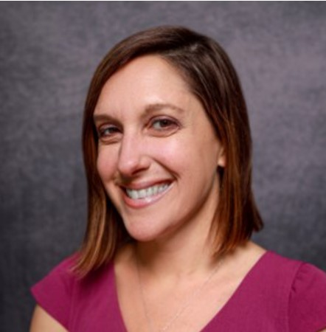
Welcome to the final NSrn convening!
Kate Kreamer
Executive Director
Advance CTE

Slide 15


Slide 16
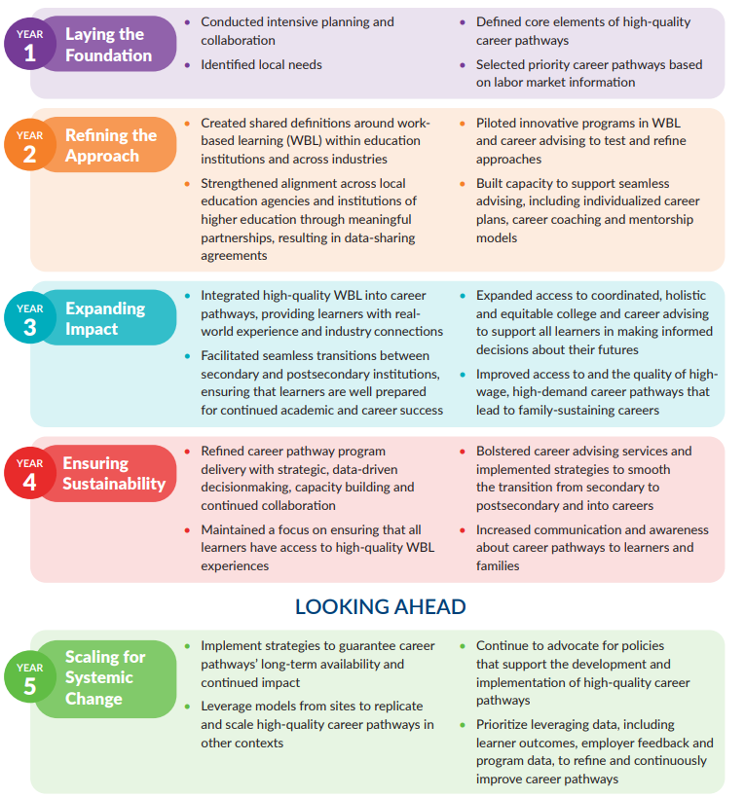

Slide 17
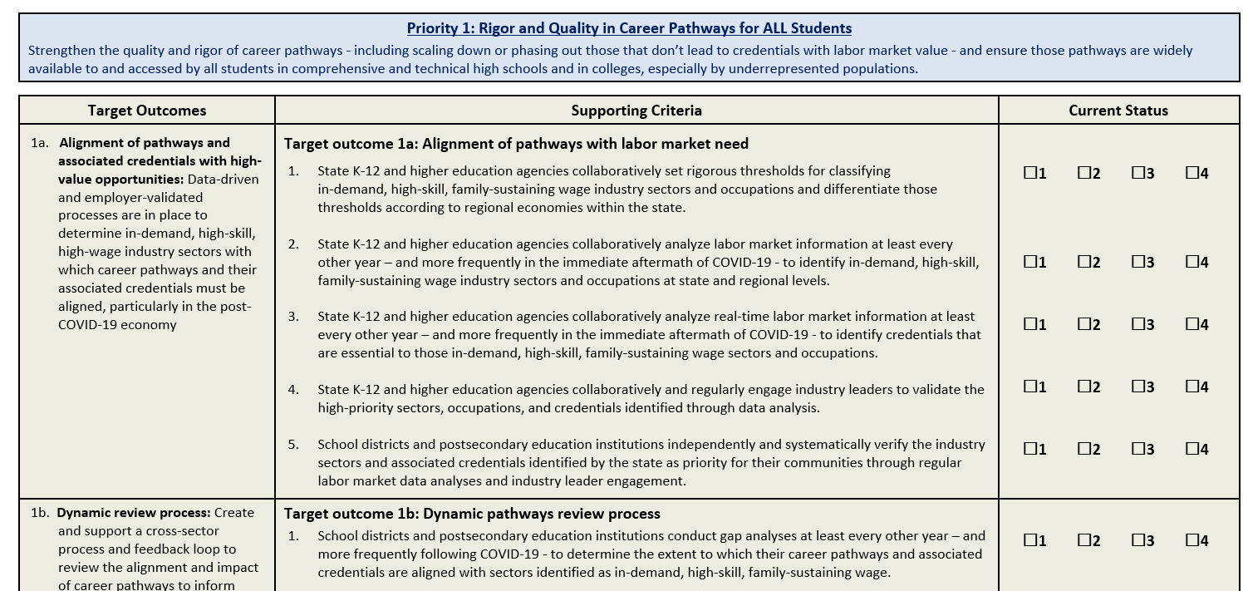
How Many of You Remember This:

Slide 18
Afternoon Agenda
12 - 1 pm | Lunch
1 - 1:30 pm | Personal Reflections: The Impact of NSrn on My Approach to Pathways, Partnership, and Leadership
1:30 - 2:15 pm | Leading with Purpose
2:15 - 2:30 pm | Looking Back, Moving Forward: Reflections from JPMC

Slide 19
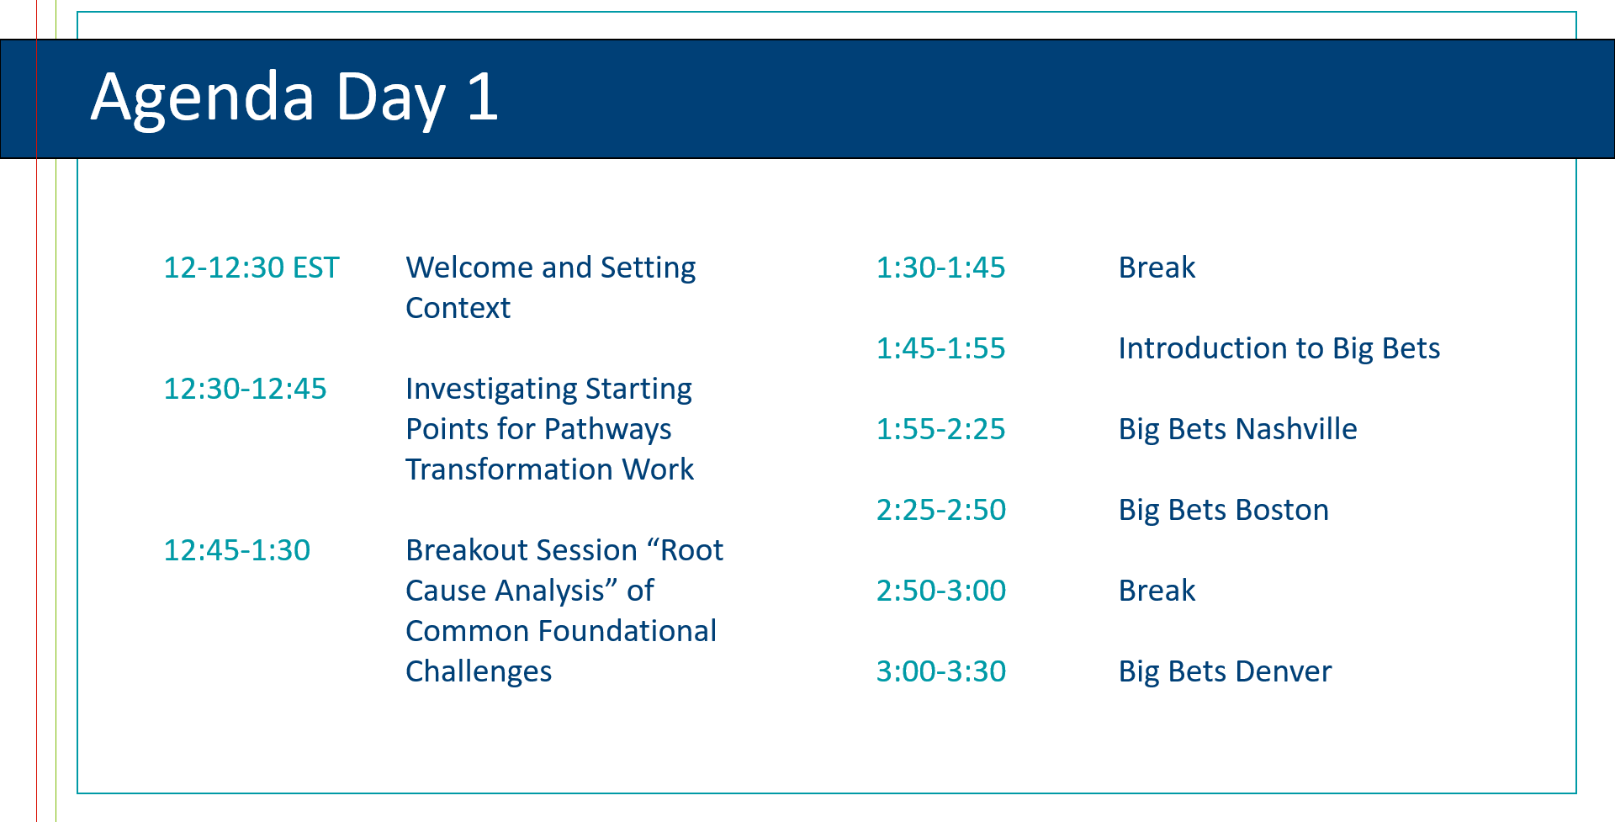

Slide 20
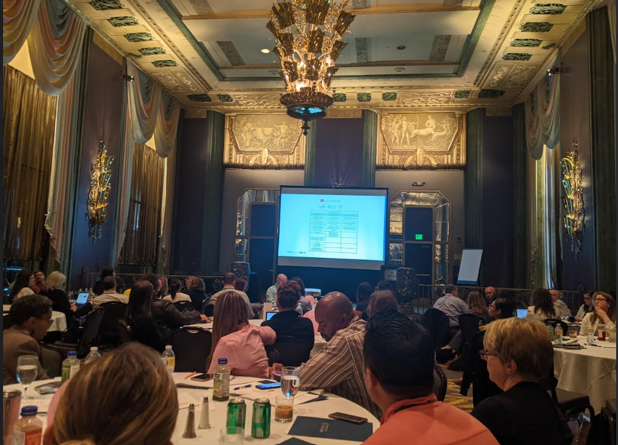

Slide 21
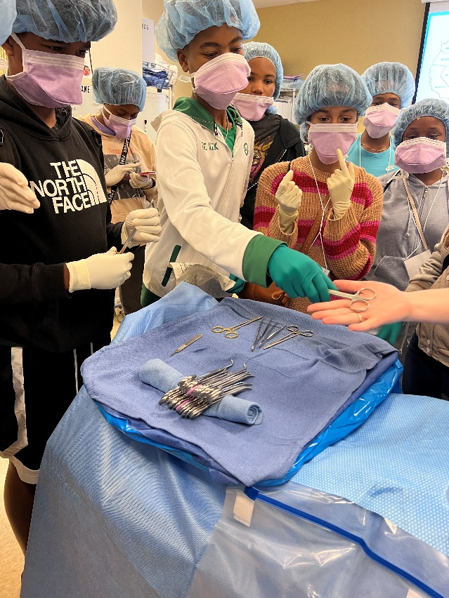

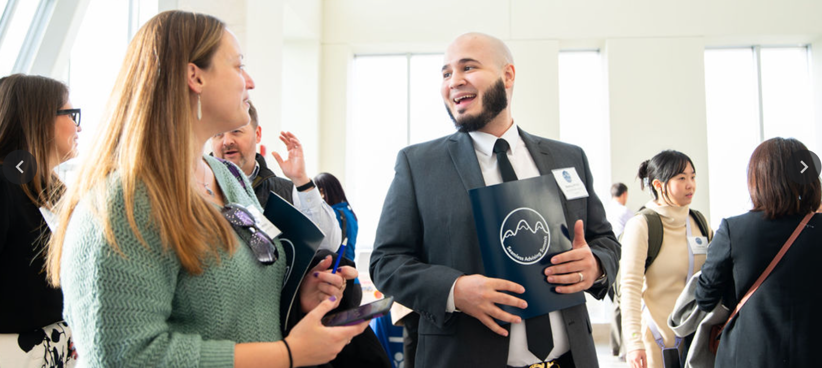
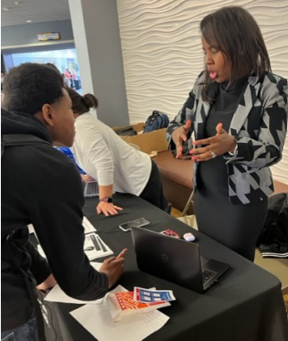
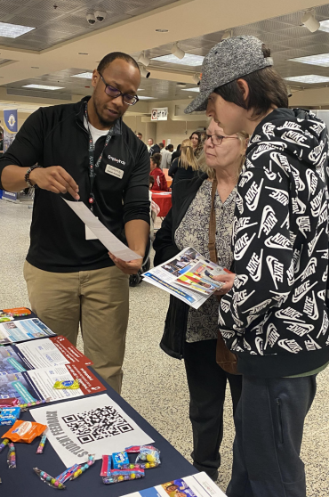
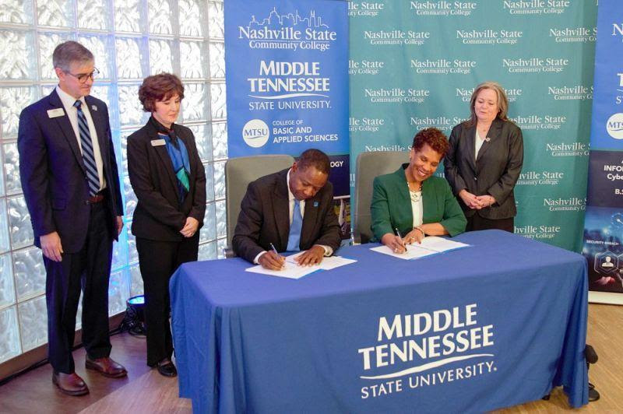
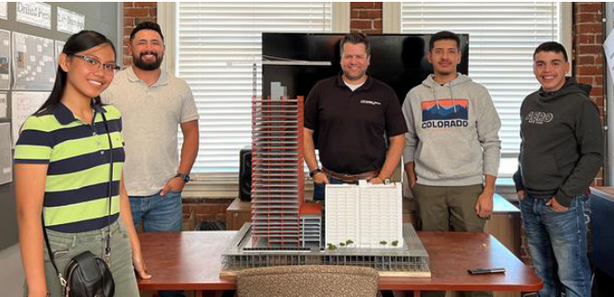
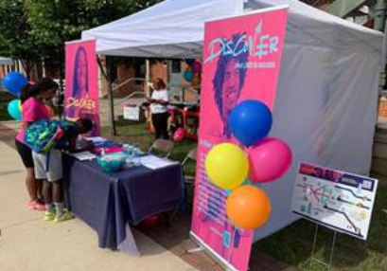

Slide 22


Slide 23

Notes:
How do we make sure this work continues - and in a way that continues to reach the students that benefit the most from quality career pathways?
How do we build the next generation of leaders within your organizations to keep the work going in years to come?
How do we continue to tell the story to broaden the tent?

Slide 24


Slide 25
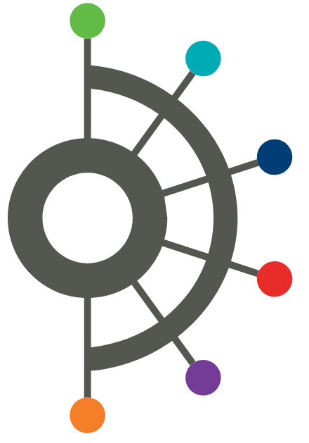
Convening Objectives
Strengthen relationships within the NSrn community through engaging activities and collaborative discussions designed to build long-term support.
Celebrate and reflect on learnings across the five years of New Skills ready network.

Slide 26
Morning Agenda
8 - 8:45 am | Networking Breakfast
8:45 - 9am | Group Photo & Transition to Programming
9 - 9:15 am | Welcome
9:15 - 10:15 am | NSrn History Museum: From Vision to Impact
10:15 - 10:45 am | Museum Tour & Snack Break
10:45 am - 12 pm | NSrn History Museum: From Network to Next Steps

Slide 27
NSrn History Museum
From Vision to Impact (9:15 - 10:15 am)
Museum Tour + Snack Break (10:15 – 10:30am)
From Network to Next Steps (10:45 am - 12pm)

Slide 28
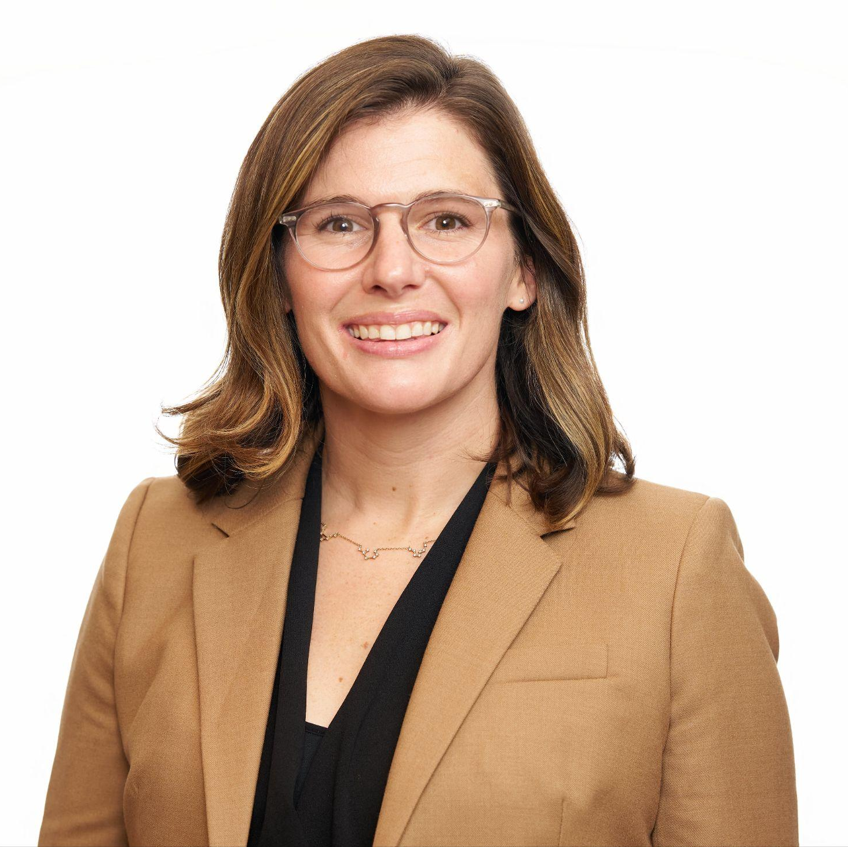
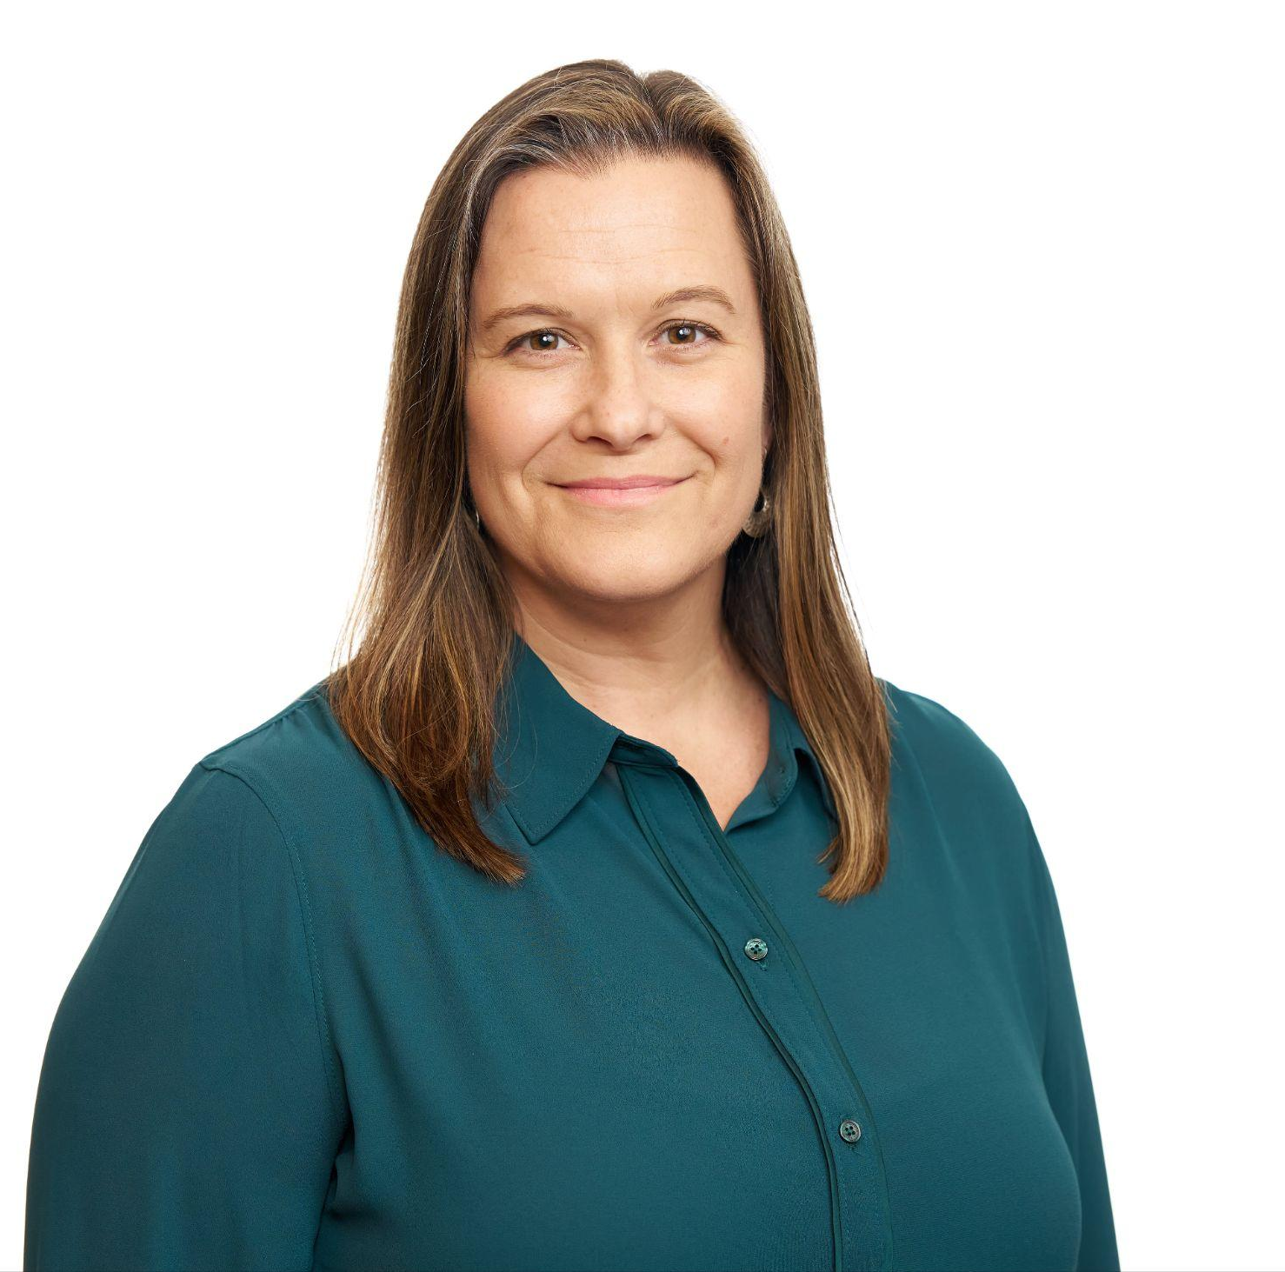
NSrn History Museum
Heather Justice
Senior Director
Education Strategy Group
Leslie Sale
Senior Associate
Education Strategy Group

Slide 29
NSrn History Museum, Part I: From Vision to Impact

Slide 30

Collective Curation: The New Skills Story
Previous convenings have captured wins and breakthroughs as a moment-in-time
Today, we will step back and with a more holistic view, celebrate the incredible breadth and depth of work you have accomplished over the last 5 years
To do so, each site will be the curator of their own story and when combined, we will tell the full story of NSrn, from vision to impact
Notes:
Previous convenings have included celebratory elements - lifting up best practices, highlighting major breakthroughs, etc - but it's often celebrating a moment in time.
This exercise is meant to take a more holistic view of the work and accomplishments, telling the complete story of NSrn
On the walls, there is the start of our NSrn timeline and our collective work together with major milestones for the network prepopulated
Highlight some of the key milestones
While there are a few site-specific examples already featured, the story is yours to tell and we want sites help in elevating the full scale of NSrn work

Slide 31

Gallery Walk #1:
Explore the Start of Our NSrn Exhibit

Slide 32


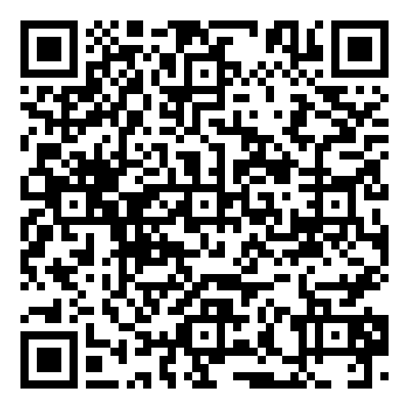



Telling Your Site’s NSrn Story: Building Milestone Markers
We recommend dating each milestone card to easily populate the timeline in the next step!
And don’t forget to use the resources provided with the QR code to help build your markers!
With your site team, brainstorm and document your major milestones on a marker card. Each milestone marker care has an icon to help identify the type of milestone:
Enactment of a system or policy change
Implementation of new or enhanced programming
Execution of an event
Establishment of a new partnership
Other breakthroughs

Slide 33

Populate the Timeline
Divide milestones across your team and begin adding them to the timeline in the appropriate spot.
Each milestone marker should already have tape adhered. Just remove the protective layer and start sticking!

Slide 34


Take a tour of the newly-curated New Skills exhibit!
Stop by the museum cafe and as you sip, snack, and explore, consider:
What are you personally most proud of?
Reflecting on the goals your team set when you started, how far have you come?
Seeing other site milestones, is anything missing from your site’s story?
What congratulations or celebrations would you want to offer other site teams?

Slide 35
NSrn History Museum, Part II: From Network to Next Steps
Notes:
Have guests return to their seats for Part II

Slide 36







Notes:
Presenter framing: Part of the beauty of the NSrn is that despite bringing together six urban center teams from across the country, each with different contexts and conditions in an effort to reach common goals including increasing postsecondary and workforce opportunities for students through high-quality pathways, work-based learning, and advising supports. By collaboratively working towards these goals, each site contributed expertise and learnings and benefitted from the experience of other sites’ wins and roadblocks.

Slide 37

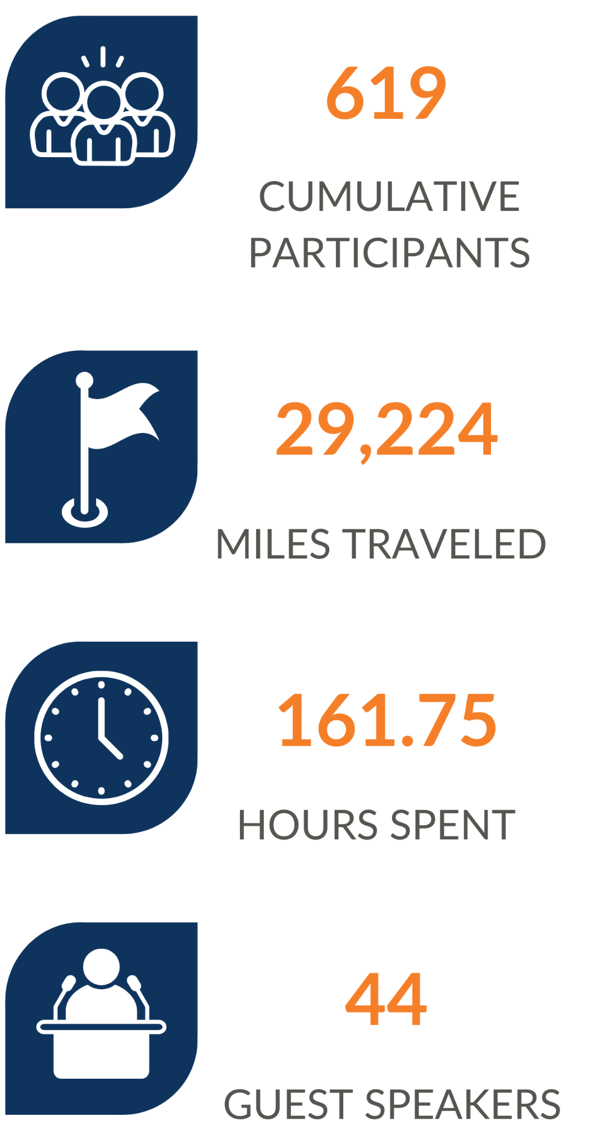




: WRAPPED
Notes:
Let’s take a look over the last 5 years and try to quantify the effort the folks in this room have put into this work we care so deeply about:
(first click)
6 sites, 5 years, 10 convenings (3 virtual, 7 in-person), 916 cumulative attendees
(second click)
who collectively traveled 29,224 miles
spent 161.75 hours together
listened to 44 guest speakers
(third click)
all leading to the nearly 60,000 students enrolled in high quality pathways in across these 6 sites.
Some pretty incredible work!

Slide 38

The Power of the Network: Cross-Site Discussions
Group 1
Group 2
Group 3
Marinell Rousmaniere
Opal Brant
Milan Sevak
Michelle Camacho Liu
Betsy Davis
Mitchell Marquez
LaVonia Montoute
Lauren Jones
Richard Owens
Jennifer Barry
Amy Aldridge
Marsha Inniss Mitchell
Vicky Esparza
Samantha Haviland
Matt Rust
Chelsea Meldrum
Group 4
Group 5
Gail Stubbs
Randy Smith
Rana Tarkenton
Nate Klinck
Daryl Curry
Adrienne Martinez
Marie Mackintosh
Calista Smith
Matt Nelson
Kim Silverman

Slide 39
The Power of the Network: Cross-Site Discussions
Group 1
Group 2
Group 3
Marinell Rousmaniere
Calista Smith
Richard Owens
Michelle Camacho Liu
Mitchell Marquez
Chelsea Meldrum
Nate Klinck
LaVonia Montoute
Opal Brant
Rana Tarkenton
Daryl Curry
Marie Mackintosh
Betsy Davis
Gail Stubbs
Lauren Jones
Vicky Esparza
Amy Aldridge
Group 4
Group 5
Randy Smith
Milan Sevak
Kim Silverman
Matt Rust
Adrienne Martinez
Marsha Inniss Mitchell
Samantha Haviland
Jennifer Berry
Matt Nelson

Slide 40
The Power of the Network: Cross-Site Discussions
Where did your site team benefit from cross-site collaboration? How did this impact or influence your work or approach to implementation?
Where did your site team benefit from learning sessions at convenings? How did this impact or influence your work or approach to implementation?
Where could your site team have benefitted from more support from the network?
Where will your team leverage what your team has learned in the next phase of work?

Slide 41

Site Debriefs & Share Outs
Please return to your site team groups to debrief your
discussions with the following questions:
Did the museum tour or discussions remind you of other milestones you’d like to add to the timeline? (If so, please feel free to add)
Are there milestones from other sites that you are just learning about for the first time and perhaps wish you knew sooner?
Which milestones from other sites, or the network, helped inform work for your own site whether through replication or helping you troubleshoot challenges?
What makes you most proud of your site’s work?
What makes you most proud about participating in the network?

Slide 42
Lunch & New Skills Trivia
12:00 - 1:00 pm
Hub 2, Mezzanine Level

Slide 43
1. The New Skills ready network is part of a larger JPMC sponsored portfolio that was originally called GCRI. What does GCRI stand for?
2. Prior to New Skills ready network, we had New Skills for Youth. How many states participated in New Skills for Youth?
3. How many total people have participated in a New Skills convening?
4. The first New Skills convening was in Cincinnati, OH. Due to a tornado warning, we scrapped our evening activity and had pizza and trivia instead. What was the original evening activity?
5. Which New Skills site is the largest geographically by square miles?

Slide 44
6. Which postsecondary partner has the most full-time learners on their main campus?
7. Which of the six school district has the highest K-12 student enrollment?
8. Which of the six sites has the tallest building?
9. Which of the six sites is known as the Arch City?
10. Which site is not the most populous in their state?

Slide 45
11. Which site is named for a Revolutionary War hero?
12. Among the sites, which is known for brewing the most beer?
13. According to food historians, what three ingredients MUST be included to make a Denver Omelet?
14. The Bull & Finch Pub in Boston was the inspiration for what famous pop culture bar?
15. Which site is the home to the largest sporting facility in the world?

Slide 46
16. What metric, named after an Atlanta-founded restaurant chain, is unofficially used by FEMA to determine the severity of a storm and the requirements of a disaster response?
17. “Peachtree” is the word that mistakenly is often touted as the word most used on Atlanta Streets, but is actually 3rd. What tree name is actually used most commonly to name streets?
18. The Atlanta airport is the most traveled airport in the world. What is the full name of the Atlanta airport?
19. Atlanta has a record among all major US Cities with 47.9% coverage. What type of coverage is the record referring to?
20. The wealthiest Atlantans are Dan, Bubba, and Cathy White. What business does the White family own?

Slide 47
Afternoon Agenda
12 - 1 pm | Lunch
1 - 1:30 pm | Personal Reflections: The Impact of NSrn on My Approach to Pathways, Partnership, and Leadership
1:30 - 2:15 pm | Leading with Purpose
2:15 - 2:30 pm | Looking Back, Moving Forward: Reflections from JPMC

Slide 48
Personal Reflections: The Impact of NSrn on My Approach to Pathways, Partnership, and Leadership
1:00 - 1:30pm

Slide 49
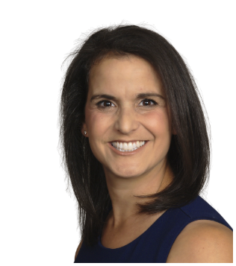
Personal Reflections: The Impact of NSrn on My Approach to Pathways, Partnership, and Leadership
Alissa Peltzman
New Skills Site Coach
Education Strategy Group

Slide 50

An A-ha, Appreciation or Accolade
Express Gratitude: Take a moment to reflect on someone in our network who has made a meaningful impact on your work. This could be a team member who offered valuable insights, a colleague who provided crucial support, or a leader whose guidance inspired you.
Using one of the note cards provided on your table, write a brief, sincere note of appreciation to this person. Consider mentioning:
A specific situation where they helped you
How their contribution affected your work or development
What you value most about their approach or perspective
This is an opportunity to strengthen professional relationships and acknowledge ways collaboration fuels our success.

Slide 51
Reflection: Looking Back to Move Forward
A Moment That Changed Me: Think back over the past five years. What is one moment, experience, or insight from this work that fundamentally shifted your thinking or approach?
Leadership Growth: How have you changed or grown as a leader? What qualities have you developed or deepened?
Collaboration and Partnership: Describe a moment when partnership made something possible that you couldn’t have done alone. How has your approach to working with others evolved?
One Lesson I’m Taking With Me: What is one key lesson from this experience that you will carry forward into your future work?
A Commitment to the Future: What is one way you will lead differently or continue the spirit of this work beyond the grant?

Slide 52

Pair Share
After completing your individual reflection, you will pair with a colleague from another community.
Take turns sharing your reflections and discussing any insights or commonalities that emerge from your experiences.

Slide 53
Leading with Purpose
1:30 - 2:15 pm

Slide 54

Leading with Purpose in a Time of Uncertainty
Kathleen Mathers
Principal
Education Strategy Group

Slide 55

Reflection Questions
Take a few minutes to reflect and write some notes to yourself on the following:
What changes have already required them to rethink how they are approaching the work?
What unknowns or uncertainties have the potential to impact the work?
What are 1-2 things I need to prioritize to ensure I am able to continue the work to the best of my ability?

Slide 56
Looking Back, Moving Forward: Reflections from JPMC
2:15 - 2:30 pm

Slide 57

Looking Back, Moving Forward: Reflections from JPMC
David Croom
Vice President, Global Philanthropy (Jobs & Skills)
J.P. Morgan Chase

Slide 58
A heartfelt thank you to all of our partners in NSrn work! It has been a wonderful 5 years of collaboration, learning, and impact.
We look forward to continued partnership in years to come.
Please stop by registration on your way out to collect your souvenir photo from your time visiting our NSrn History Museum!
Notes:
Have guests return to their seats for Part II

