Slide 1

CTE Goal-Setting Tool Quick Guide
A guide to using and interpreting the CTE Goal-Setting Tool.
Notes:
Link to the CTE Goal-Setting Tool downloadable template on the Advance CTE website:
Speaker Notes / Instructions:
Welcome! This quick guide is designed to support both independent users and facilitators as they navigate the updated CTE Goal-Setting Tool. Whether you're using this as a reference guide or leading a training session, these slides offer clear instructions, examples, and interpretation tips. Use the notes below each slide to walk users through the tool or guide yourself during implementation.

Slide 2
How to Leverage This Resource
This printable and downloadable Quick Guide is designed to serve as a companion to the CTE Goal-Setting Tool, providing guidance on entering data, filtering data, setting goals, and interpreting results from the tool. Any outstanding questions can be directed to Advance CTE for assistance.
Users of the CTE Goal-Setting Tool can leverage this guide as they work through the CTE Goal-Setting Tool template downloaded from the Advance CTE website. For maximum visibility, users are invited to use more than one screen or monitor, with one screen open to the tool and the other to this manual. Alternatively, this guide can also be printed and leveraged in that way.
All data included in this guide is dummy data and is provided solely for reference as a means to leverage the full extent of the analyses the tool provides.
Notes:
Speaker Notes / Instructions:
This resource serves two main functions:
It provides step-by-step instructions for using the tool — ideal for printing or referencing while working through the Excel file.
It is also structured to support facilitation, enabling users to train others. For group sessions, walk through each slide while demonstrating live use of the tool in Excel.
Pro tip: If facilitating a session, toggle between the Excel tool and this slide deck to model key actions in real-time.

Slide 3
CTE Goal-Setting Tool
The CTE Goal-Setting Tool supports analyses to review current representation across a comparison area (region, program, district, etc.) and set goals for greater access and success within and across CTE.
This tool supports entities in reviewing their current performance and identifying opportunities through percentage point analysis, enabling them to set intentional goals for improving access to and performance in CTE programs. The tool supports entities in looking at how many additional learners in a given category would be needed for the entity to meet their goal(s) by program, building, or institution. This tool and resource support the Comprehensive Local Needs Assessment process as well as improvement planning, strategic planning, and CTE goal setting.
Notes:
Speaker Notes / Instructions:
The tool enables analysis of current representation across student subgroups in CTE and supports goal-setting for equity. It's especially useful for Comprehensive Local Needs Assessments (CLNA), program evaluation, and improvement planning. You’ll analyze:
Percentage point differences in representation.
Numeric goals (how many more learners are needed).
Disaggregated performance by subgroup, region, or program

Slide 4
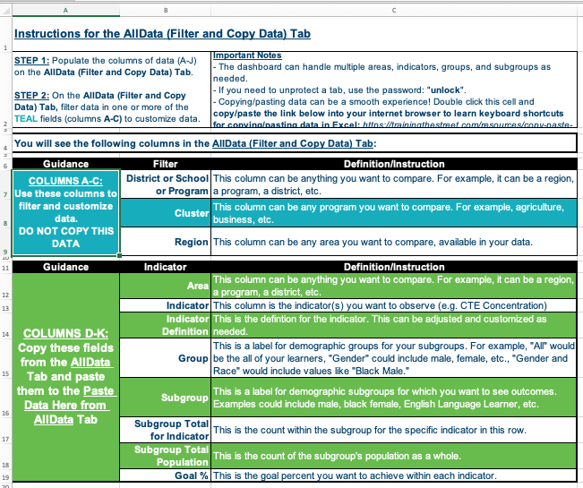
Quick Guide: Instructions for Tool Tab
Use this step to review guidance, filters, and indicator definitions for use of the goal-setting tool.
Review the instructions tab to find:
Guidance on how to use each tab in the workbook.
Definitions for key filters (e.g., district, program, region).
Clarification on indicators used in the tool.
Notes:
Speaker Notes / Instructions:
Start by reviewing the “Instructions” tab in the Excel tool. It outlines:
Definitions for filters (district, region, etc.).
Clarifies the indicators used.
During training, consider displaying the Instructions tab and walking through its contents live to ground the audience in the tool's structure.

Slide 5
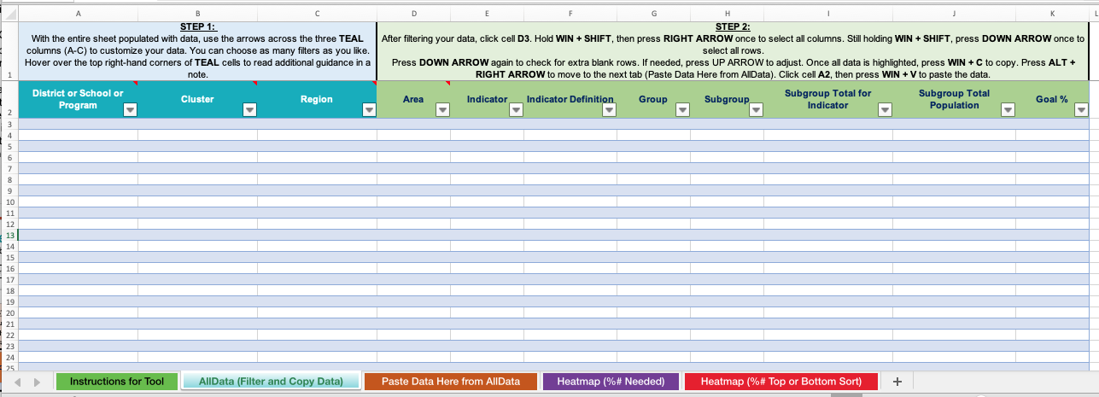
Quick Guide: AllData (Filter and Copy Data) Tab
Use this step to gain context for the data available in the AllData (Filter and Copy Data) Tab.
This tab should first be populated with data in columns A–J
Notes:
Speaker Notes / Instructions:
This is the raw data tab — columns A–J must be populated first.
Remind users:
This is where they load/export their own data.
The tool requires data in a specific format, which is outlined in the Instructions tab.
In a group setting, model the import process using a dummy data set.

Slide 6
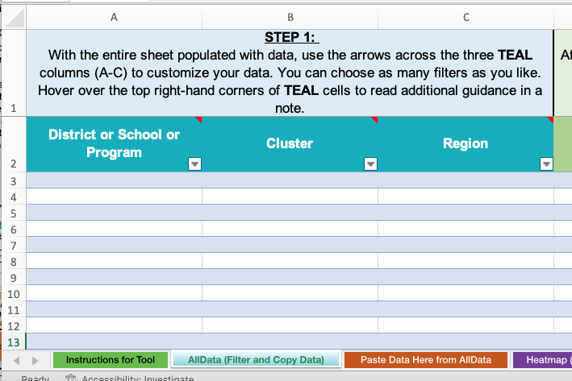
Quick Guide: AllData (Filter and Copy Data) Tab
Use this step to filter data to your desired level.
After data population, use the arrows in columns A-C to determine filters.
Press the arrows to explore filters across all teal columns
Notes:
Speaker Notes / Instructions:
Once data is loaded, users can apply filters to explore trends:
Use filters in columns A–C.
You can look at data by district, region, program, etc.
Tip: Start with one filter at a time, especially if you're new to the tool.
Facilitator tip: Pause here to demonstrate a live filtering example in Excel.

Slide 7
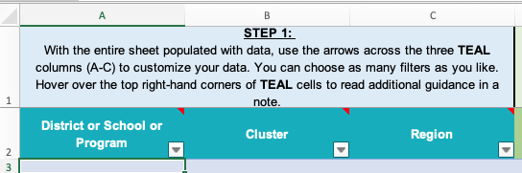
Interpreting Filters on the AllData Tab
Use this step to interpret the information shared on the Paste Data Here from AllData Tab.
You can start by using one filter at a time, such as by district/school/program, career cluster, or region, to get a clear, focused view of the data.
But feel free to experiment by combining multiple filters to explore more specific patterns or equity gaps. For example, filtering by both cluster and region can help surface localized strengths or challenges in particular program areas.
💡 Tip: If the view gets overwhelming, reset your filters and start fresh with a single lens before layering others back in.
Notes:
Speaker Notes / Instructions:
Guide users in interpreting filtered views:
Filters allow you to explore specific populations or combinations.
Look for patterns in access and performance — equity gaps may emerge.
Reset filters if the view becomes overwhelming.
Facilitator tip: Provide participants time to filter their own data and reflect on patterns they see

Slide 8
Interpreting Filters on the AllData Tab
Use this step to understand the distinctions between District, School, Program, Region, and Area.
🏫 District / School / Program: Local level (e.g., specific high schools or CTE programs). Use to address site-specific gaps and support individual programs
🌐 Region: Multi-district or labor market-aligned groupings (e.g., service centers or workforce regions). Use to identify broader trends, coordinate support, and align with regional workforce needs
📍 Area: Custom-defined groupings (e.g., all rural sites, pilot sites, or unique clusters). Use for flexible analysis across non-standard boundaries
💡 Tip: Select the level that aligns with your improvement strategy: site-specific, regional collaboration, or custom comparisons.
Notes:
Speaker Notes / Instructions:
🔹 Understanding Geographic and Organizational Levels in the CTE Goal-Setting Tool To use the tool effectively, it’s important to understand the distinctions between District/School/Program, Region, and Area. Each represents a different level of analysis and strategy setting:
1. District / School / Program Level
What it is: These are the most localized units of analysis. This level refers to individual CTE programs, high schools, or school districts where CTE is delivered.
When to use: Use this level when analyzing program-level equity gaps, setting school-specific improvement goals, or identifying supports needed by individual educators and learners.
Example: A high school welding program in Lincoln High School within Lincoln Public Schools.
2. Region Level
What it is: A grouping of districts or schools often aligned with how CTE is coordinated across a larger geographic area—like a regional service center, education service cooperative, or multi-district consortium. Sometimes, this aligns with labor market regions or workforce board boundaries.
When to use: Use this level to identify regional trends, support collaborative improvement, and align strategies with regional workforce needs or shared technical assistance efforts.
Example: Region 4 Education Service Center in Texas or a Western Colorado CTE Consortium.
3. Area Level
What it is: This is a custom or flexible designation, often used to group entities in a way that doesn’t neatly fit into a single district or region. "Area" may reflect urban vs. rural groupings, state-defined accountability zones, or pilot implementation areas.
When to use: Use this when the analysis requires custom groupings not already defined by existing regional structures. It allows users to define their own clusters for comparative or exploratory purposes.
Example: An “Area” might be all rural CTE programs across three non-contiguous districts, or all schools participating in a new pilot initiative.
✅ Tip: Choose the Level that Matches Your Improvement Strategy
If you're working on site-specific changes, start with District/School/Program.
If your strategy requires cross-district collaboration or labor market alignment, use Region.
If you're conducting experimental analysis or custom comparisons, Area provides flexibility.

Slide 9
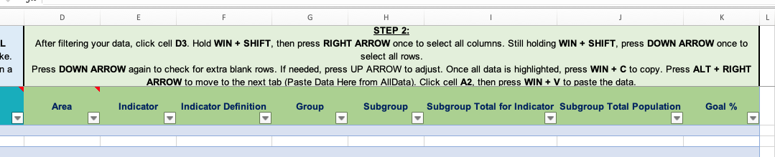
Quick Guide: AllData (Filter and Copy Data) Tab
Use this step to copy and paste filtered data.
After filtering, copy the data. Paste the data on the next tab.
DO NOT copy data from the TEAL columns/
filters.
Click cell D3 to select the starting point.
Then, press and hold Shift, and while holding it, press Ctrl + ↓ and then Ctrl + → to highlight all rows and columns of your data.
Right-click the highlighted area and select “Copy.”
Go to the next worksheet tab and paste the copied data, starting in cell A2.
Notes:
Speaker Notes / Instructions:
After filtering:
Select columns D–K (not the teal columns) and copy only filtered data rows.
Paste them into the next tab: Paste Data Here from AllData Tab.
Pro tip: Always double-check the columns you’re copying to avoid errors.

Slide 10
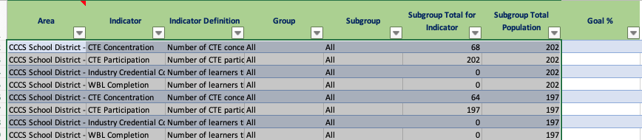
Quick Guide: Paste Data Here from AllData Tab
Use this step to paste your filtered data.
The Paste Data Here from AllData Tab will be blank until data from the previous tab is copy/pasted.
Copy selected data FROM the AllData tab (columns D-K only).
Paste selected data TO the Paste Data Here from AllData Tab (columns A-H only).
Notes:
Speaker Notes / Instructions:
This tab remains blank until data is pasted in.
Paste copied data (columns A–H) from the AllData tab.
This is your working dataset for goal-setting.
If facilitating, emphasize proper alignment of pasted columns and offer troubleshooting support if errors appear.

Slide 11
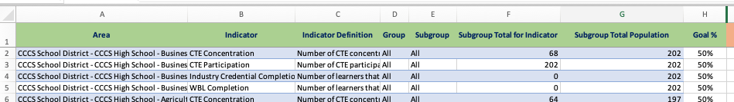
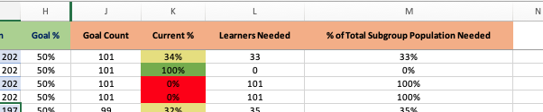
Quick Guide: Paste Data Here from AllData Tab
Use this step to review current representation and explore goal-setting.
Review the Paste Data Here from AllData Tab to begin analyzing goals.
Enter goals as your desired percentage; they will auto-populate as percentages in column H.
Goals can vary across different indicators, areas, and other factors.
As goals are entered in column H, columns J-M will auto-populate.
Review the current percentage (current representation) to assess existing representation while entering goals.
Notes:
Speaker Notes / Instructions:
Once data is pasted:
Users enter desired goals in column H (as percentages).
The tool then auto-calculates:
Current representation.
Number and percent needed to meet the goal.
Visual heatmap of performance.
Facilitator tip: Demonstrate entering one goal and interpreting the output.

Slide 12
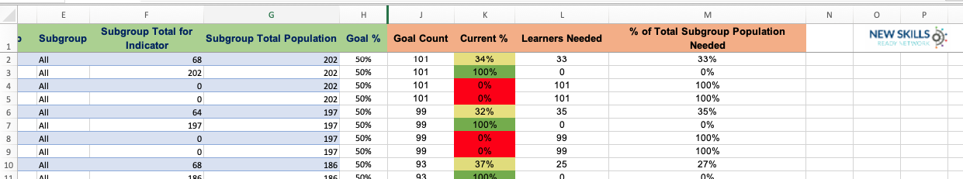
Interpreting Paste Data Here from AllData Tab
Use this step to interpret the information shared on the Paste Data Here from AllData Tab.
This column automatically populates the numerical count of goals entered as percentages.
This column automatically populates a visual heatmap of current representation informed by the low, mid, and high ranges of data entered.
This column will be blank until populated.
Enter goals as percentages in column H.
This column automatically populates the numerical value of learners needed to achieve goals.
This column automatically populates the percentage that the group needs to achieve its goals.
Notes:
Speaker Notes / Instructions:
Guide users in reading the outputs:
Column H = your target goal.
Column J = # of learners needed to reach the goal.
Column K = heatmap color for current representation.
Column L = percent difference between current and goal.
Ask participants to identify one area with a significant gap and discuss potential root causes or solutions.

Slide 13
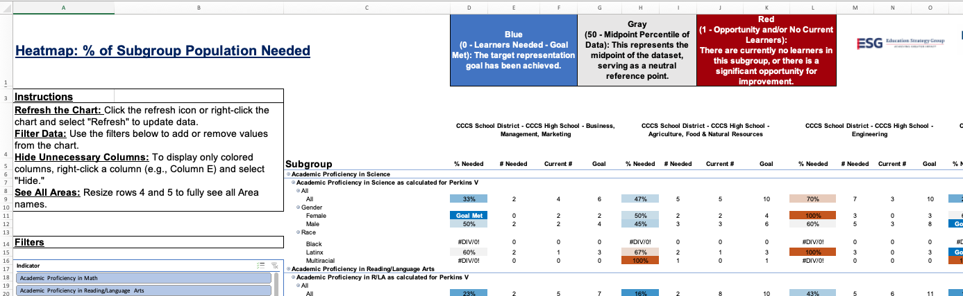
Quick Guide: Heatmap (% # Needed) Tab
Use this step to review data visually across desired filters.
This tab must be REFRESHED to update and include any data from the previous tab.
Refresh the table by right-clicking on the subgroup and choosing ‘Refresh’
This row displays the various AREAS represented in the data. Drag the size of Row 4 on the left-hand side of the Excel window to see Areas clearly
These columns show the percentage, number, current and goal of learners across the data
Notes:
Speaker Notes / Instructions:
This is a visual summary tab.
Refresh the pivot table after entering new data.
Right-click any cell in the table and select "Refresh".
Adjust row height (especially Row 4) to clearly view area names.
Facilitator tip: Walk through a full refresh demonstration and point out common pitfalls.
This tab must be REFRESHED to update (see slide 13).

Slide 14
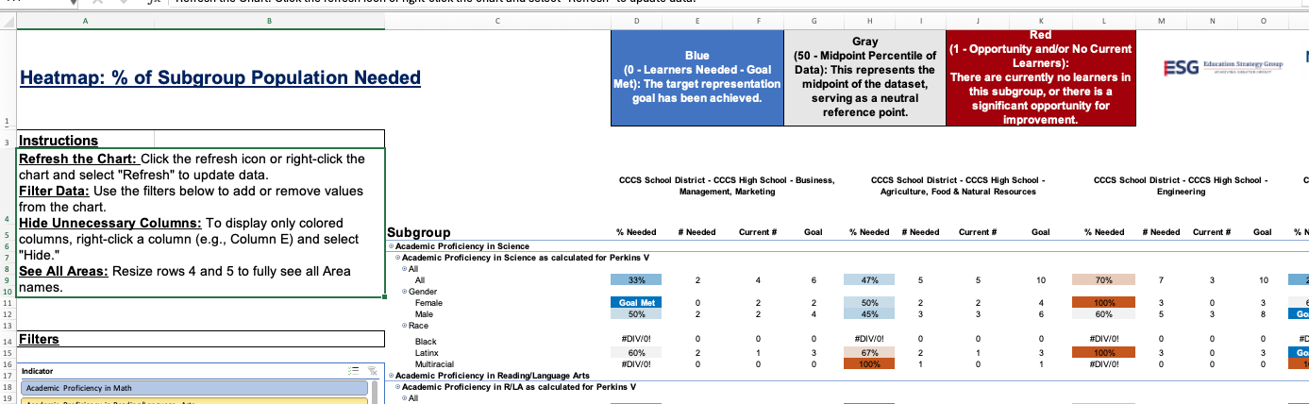
Quick Guide: Heatmap (% # Needed) Tab
Use this step to review data visually across desired filters.
This tab must be REFRESHED to update and include any data from the previous tab.
This portion of the heatmap provides a visualization of the data across chosen indicators and areas, including the percentage, number, current, and goal of learners.
Notes:
Speaker Notes / Instructions:
This portion shows:
% goal gap.
# of learners needed.
Current and goal percentages.
Color coding helps you quickly assess gaps.
Prompt users to find areas with the darkest shade — what might that indicate?
This tab must be REFRESHED to update (see slide 13).

Slide 15
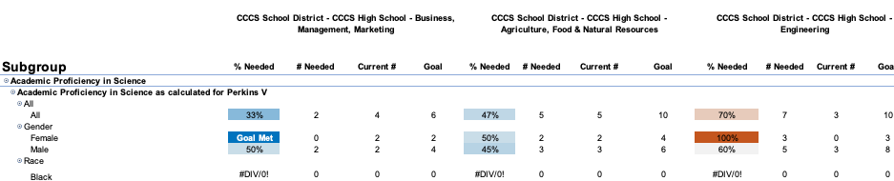
Interpreting the Heatmap (% # Needed) Tab
Use this step to interpret the Heatmap (% # Needed) Tab and identify where targeted improvement efforts may be most needed or have the greatest impact.
Interpretation Guidance:
Darker colors = larger gaps between current outcomes and your set goals.
Pay attention to both the % gap and the raw number — a small percentage gap might still represent a large number of learners.
The number shown represents the actual count of learners who need to meet the performance benchmark for the selected group (district, school, program, region, or cluster) to reach its goal.
The percentage reflects how far current performance is from the goal (e.g., "We’re 12% away from our target").
Darker shading = larger gaps between current performance and goals — either by percent, number, or both.
Use both metrics together: A small % gap may still mean many learners need support, and a large % gap might reflect a small group.
Notes:
Speaker Notes / Instructions:
Use this slide to explain how to analyze the heatmap:
Darker colors = greater gaps.
Both % and raw # matter: A small % gap can still mean many learners.
Use this insight to guide equity-focused improvement strategies.
Facilitator tip: Encourage users to name 1–2 high-priority areas for intervention based on their data.

Slide 16
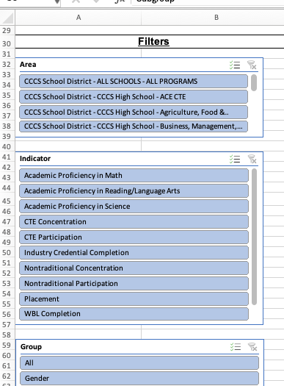
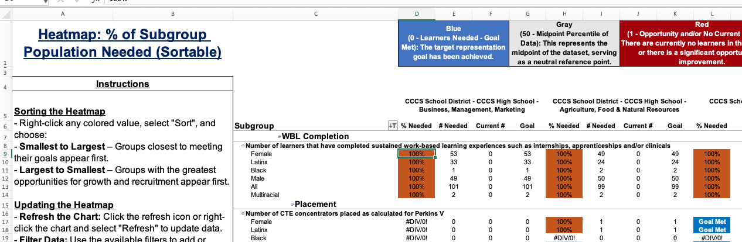
Quick Guide: Heatmap % # Top or Bottom Sort) Tab
Use this step to filter and sort data visually.
This tab must be REFRESHED to update (see slide 13).
Use the data in this sortable table to explore goal-setting scenarios and prioritization for strategies, interventions, and more.
Choose the desired filters to review. Select/deselect multiple filters by choosing the check marks in the top right-hand box of each filter.
Right-click on ANY SHADED cell to sort from smallest to largest, or largest to smallest.
Notes:
Speaker Notes / Instructions:
This tab allows sorting by gap size or number of learners needed.
Refresh the pivot table before using.
Filters can be adjusted to isolate specific regions or clusters.
Right-click shaded cells to sort data in ascending/descending order.
This is excellent for identifying top priorities or bright spots.

Slide 17
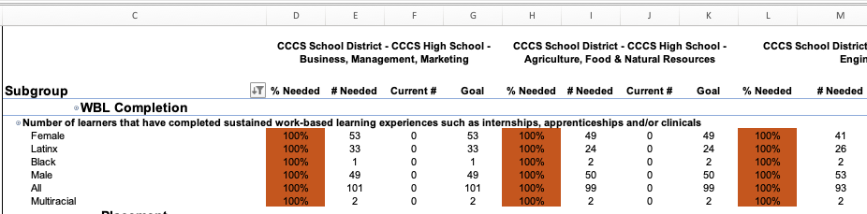
Interpreting the Heatmap (% # Top or Bottom Sort) Tab
Use this step to interpret the Heatmap (% # Top or Bottom Sort) Tab and quickly identify where the most significant gaps exist by sorting the data — either by percent gap or number of learners needed to meet the goal.
Interpretation Guidance:
This tab ranks the rows (e.g., programs, schools, clusters, regions) based on:
    % Gap from the set goal (how far below the target you are), or
  # of Learners still needed to meet the goal.
You can use this to identify quickly:
Highest-need areas or bright spots.
Sort ascending or descending depending on whether you want to focus on the most significant gaps or the strongest performance.
Helpful for setting priorities and communicating targeted interventions.
Key Notes on the Numbers:
The “# of learners” column = how many additional learners must meet the benchmark to hit the goal.
The “% gap” column = the percentage of learners currently not meeting the goal.
Notes:
Speaker Notes / Instructions:
Use this tab for strategic planning:
Sort by % gap or learner count to identify the most critical gaps.
Use this to rank areas by urgency.
Facilitator tip: Lead a discussion on what intervention strategies might look like for top-priority areas based on this data.

