Slide 1
The Connected Path:
A Shared Vision for Opportunity and Empowerment Through Career Technical Education
Update with the date/location/ and presenter information if not using the speaker slide

Slide 2
SPEAKERS
Notes:
Update or hide as needed

Slide 3

CTE Without Limits
Published in March 2021 with over 30 national supporters
Pushed the field to remove barriers like geographical location and siloed systems
30 state teams reduced limitations to access and success through 100 technical assistance projects

Slide 4



Slide 5
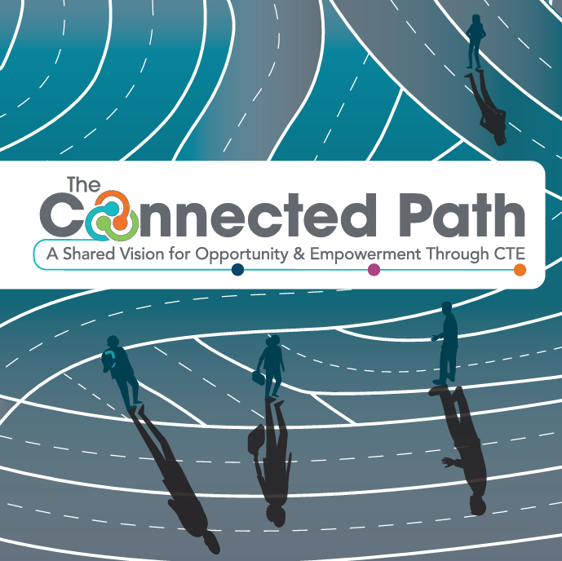
The Connected Path: A Shared Vision for Opportunity and Empowerment Through CTE
Engaged partner organizations and members to synthesize and prioritize the ideas, strategies, and goals of the Summit.
Released publicly May 1, 2026

Slide 6
A SHARED VISION

Slide 7
Principle 1: Each learner engages in a coherent CTE system codesigned by education and industry.
Principle 2: Each learner participates in a CTE system that is transparent and accountable to all partners.
Principle 3: Each learner experiences
a learning journey that seamlessly
integrates CTE and core academics.
Principle 4: Each learner has access to personalized and flexible pathways.
Principle 5: Each learner develops a sense of empowerment and belonging through CTE.
Principle 6: Each learner navigates ethical and innovative approaches to using emerging technologies.

Slide 9
To achieve this future, we must:
Develop an aligned statewide talent strategy;
Standardize a common language across partners; and
Organize employer partners to provide a collective voice.

Slide 11
To achieve this future, we must:
Design and employ a data strategy that centers outcomes;
Improve the ability of data to drive decisions and support shared priorities; and
Make data publicly available and understandable.

Slide 13
To achieve this future, we must:
Dismantle the silos between technical education and core academic subjects;
Equip every learner with transferable career readiness skills; and
Expand and strengthen work-based learning, career exploration, and career advising for all learners.

Slide 15
To achieve this future, we must:
Modernize program design to allow for more learner choice;
Strengthen the CTE workforce by investing in professional development and instructor credentialing; and
Recognize and signal skills and competencies in an industry-aligned way.

Slide 17
To achieve this future, we must:
Expose learners to experiences that build social capital and self-efficacy;
Fully fund wraparound supports and incorporate them into CTE experiences; and
Partner with families and learners to shape the educational experience.

Slide 19
To achieve this future, we must:
Define a learner’s rights and responsibilities for the use of emerging technology;
Expand opportunities to build mastery of emerging technologies as identified by industry; and
Leverage technology as a tool to support personalization, targeted interventions, and curricular enhancements.

Slide 20
CALL TO ACTION
We must all work together to design and champion a career readiness ecosystem that:
  centers learner experience;
  reimagines partnership with industry;
  leverages technology; and
  strengthens outcomes for all partners.
CTE bridges education and industry and operates as the connected path to economic mobility for learners of all ages.

Slide 21
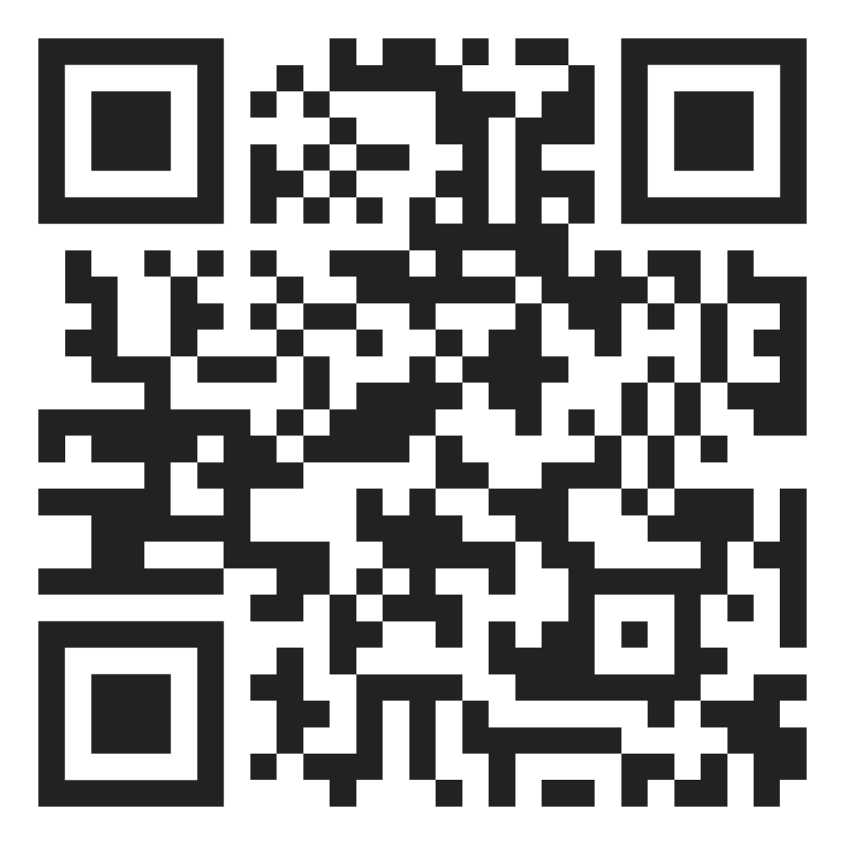
LET’S CONNECT
Read the full vision
Access additional resources
Sign up to stay connected
www.careertech.org/cte-connects
SCAN THE CODE

Slide 22
THANK YOU!
CTE Connects is stewarded by
Advance CTE
8484 Georgia Ave, Suite 620
Silver Spring, Maryland, 20910
Enter personal contact info as desired
Notes:
Enter personal contact info or delete that text box

